Slide 1

From The Top Down!
Create An
Embedded Reading!

Slide 2
This slide show has been made available for educational purposes
only.
If you have any questions, or would like to know more about Embedded Reading, check out the website at www.EmbeddedReading.com
or feel free contact us at lclarcq@yahoo.com
© Clarcq, Whaley 2012

Slide 3
The purpose of language,
used in communication,
is to create a picture
in the mind
and/or the heart
of another person.
L. Clarcq
Notes:
Purpose of Language is slide/communication is slide

Slide 4
How do I create
Embedded Readings
for my own classes?!
© Clarcq, Whaley 2012

Slide 5
One way to create an embedded reading….
is from the Top Down

Slide 6
Top Down
Step 1: Choose the “advanced” text.
Step 2: Identify the main points.
Step 3: Identify the crucial structures
and vocabulary.
Step 4: TAKE OUT unnecessary language.
REPEAT!!!
© Clarcq, Whaley 2012

Slide 7
Top Down
Step 1: Choose the “advanced” text.
Songs
Articles
Poetry
Short stories
Interviews
Letters
Novels
© Clarcq, Whaley 2012

Slide 8
Example #1 Top Down
Step 1: Choose the “advanced” text.
Oh, give me a home, where the buffalo roam,
Oh give me a home, where the buffalo roam!
Where the deer and the antelope play;
Where seldom is heard a discouraging word,
And the skies are not cloudy all day.
Home, home, on the range,
Where the deer and the antelope play;
Where seldom is heard a discouraging word,
And the skies are not cloudy all day.
How, often at night where the heavens are bright,
With the light from the glittering stars,
Have I stood there amazed and asked as I gazed
If their glory exceeds that of ours.

Slide 9
Example #1 Top Down
Step 2: Identify the main points.
Oh, give me a home, where the buffalo roam,
Oh give me a home, where the buffalo roam!
Where the deer and the antelope play;
Where seldom is heard a discouraging word,
And the skies are not cloudy all day.
Home, home, on the range,
Where the deer and the antelope play;
Where seldom is heard a discouraging word,
And the skies are not cloudy all day.
How, often at night where the heavens are bright,
With the light from the glittering stars,
Have I stood there amazed and asked as I gazed
If their glory exceeds that of ours.

Slide 10
Example #1 Top Down
Step 3: Identify crucial vocabulary and structures
Oh, give me a home, where the buffalo roam,
Oh give me a home, where the buffalo roam!
Where the deer and the antelope play;
Where seldom is heard a discouraging word,
And the skies are not cloudy all day.
Home, home, on the range,
Where the deer and the antelope play;
Where seldom is heard a discouraging word,
And the skies are not cloudy all day.
How, often at night where the heavens are bright,
With the light from the glittering stars,
Have I stood there amazed and asked as I gazed
If their glory exceeds that of ours.

Slide 11
Each teacher will make these distinctions based
the knowledge and needs of his or her own students.
What information is critical for understanding?
Which vocabulary and structures are crucial
to comprehension?
© Clarcq, Whaley 2012

Slide 12
Example #1 Top Down
Step 4 : Take out unnecessary language and information
( one fourth to one fifth of the material) the buffalo roam,
Oh give me a home, where the buffalo roam!
Where the deer play;
Seldom is heard a discouraging word,
And the skies are not cloudy .
Home on the range,
Where the deer play;
Seldom is heard a discouraging word,
And the skies are not cloudy.
Often the heavens are bright,
With the light from the stars,
Have I stood amazed and asked as I gazed
If their glory exceeds ours.

Slide 13
Example #1 Top Down
Repeat
( one fourth to one fifth of the material) the buffalo roam,
Give me a home, where the buffalo roam!
Where the deer play;
Seldom is heard a word,
And the skies are not cloudy .
Home on the range,
Where the deer play;
Seldom is heard a word,
And the skies are not cloudy.
Often the heavens are bright,
With stars,
I stood amazed and asked
If their glory is greater.

Slide 14
Example #1 Top Down
Repeat
( one fourth to one fifth of the material) the buffalo roam,
Give me a home!
Where the deer play;
and the skies are not cloudy .
A home on the range,
Where the deer play;
and the skies are not cloudy.
Often the heavens are bright,
I stood amazed.

Slide 15
Th
Move words or utilize synonyms as necessary
in order to make the piece more and more
comprehensible with each change.
© Clarcq, Whaley 2012

Slide 16
the Until a base reading emerges!! buffalo roam,
I stood amazed at a
home on the range!
Where the deer often play;
and the skies are not cloudy .

Slide 17
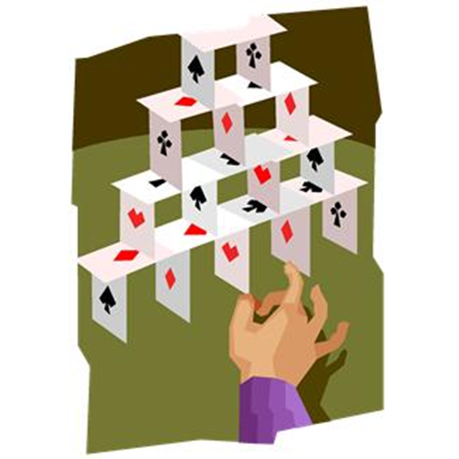
The success of an Embedded Reading
is dependent upon the quality of the
base reading.

Slide 18
The first, or base, reading
is at a basic level, easy for any student
to understand.
It is a summary or an outline.
© Clarcq, Whaley 2012

Slide 19
It contains key information and/or key structures.
It is completely comprehensible.
© Clarcq, Whaley 2012

Slide 20
The most successful readings are of interest to students.
They also guarantee that the student will experience success.
© Clarcq, Whaley 2012

Slide 21


Interest
and
Success

Slide 22
Begin by using the base reading with students:uffalo roam,
I stood amazed at a
home on the range…
where the deer often play
and the skies are not cloudy .

Slide 23
Use the base reading in any number of ways in order to connect the student with the text.
Illustrate.
Compare to a similar situation, event or emotion.
Act out.
Debate.
© Clarcq, Whaley 2012

Slide 24
When the students have successfully understood, and have made connections to or about the base reading, show them the next most complex version of the text. Use a different set of questions or activities with this version of the piece.
© Clarcq, Whaley 2012

Slide 25
the buffalo roam,
Version #2:
Often the heavens were bright
and I stood amazed……..
Give me a home!
Where the deer play
and the skies are not cloudy .
A home on the range,
Where the deer play
and the skies are not cloudy.

Slide 26
Continue to alternate new activities with a more complex version of the text..
© Clarcq, Whaley 2012

Slide 27
the buffalo roam,
Version # 3:
Give me a home, where the buffalo roam!
Where the deer play;
Seldom is heard a word,
And the skies are not cloudy .
Home on the range,
Where the deer play;
Seldom is heard a word,
And the skies are not cloudy.
Often the heavens are bright,
With stars,
I stood amazed and asked
If their glory is greater.

Slide 28
Version #4:
Oh give me a home, where the buffalo roam!
Where the deer play;
Seldom is heard a discouraging word,
And the skies are not cloudy .
Home on the range,
Where the deer play;
Seldom is heard a discouraging word,
And the skies are not cloudy.
Often the heavens are bright,
With the light from the stars,
Have I stood amazed and asked as I gazed
If their glory exceeds ours.

Slide 29
Final (original) version:
Oh give me a home, where the buffalo roam!
Where the deer and the antelope play;
Where seldom is heard a discouraging word,
And the skies are not cloudy all day.
Home, home, on the range,
Where the deer and the antelope play;
Where seldom is heard a discouraging word,
And the skies are not cloudy all day.
How, often at night where the heavens are bright,
With the light from the glittering stars,
Have I stood there amazed and asked as I gazed
If their glory exceeds that of ours.

Slide 30
The final version that is used with students
does NOT have to be the original version
of the reading.
It SHOULD be the version of the reading
that the majority of students can read and
comprehend without frustration .
© Clarcq, Whaley 2012

Slide 31
It is important, when using Embedded Reading, to
involve the students in a variety of activities. In this
way, the students will approach each new version
with a different purpose and perspective.
In addition, not every student needs to advance
through each level. Because the information is
included from the beginning, each student will
comprehend and acquire the most crucial information.
This allows the teacher to differentiate with every
reading.
© Clarcq, Whaley 2012

Slide 32
Creating and using embedded readings may take
some practice, but don’t wait until you have
“perfected” the skill!
Students will benefit from your knowledge,
expertise AND your practice.
If you have questions, please feel free
to contact us:
lclarcq@yahoo.com

