Slide 1
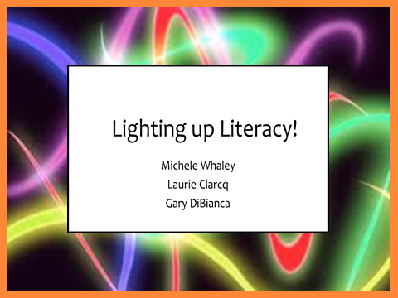

Slide 2
Originally presented at NTPRS 13
in Dallas, Texas
July 2013

Slide 3
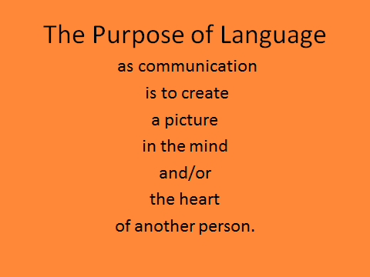

Slide 4
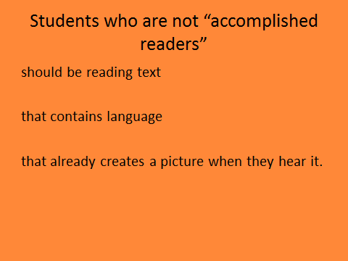

Slide 5
The Three “Stages”
of
Reading Comprehension
in a
Second Language Classroom

Slide 6
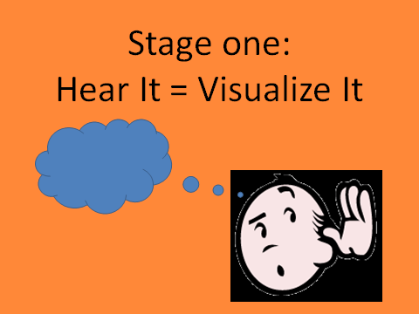

Slide 7
Listening Recognition and Comprehension
is actually the first stage
Reading Comprehension !!

Slide 8
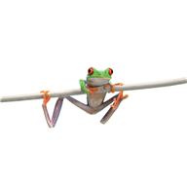
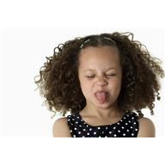


Stage Two:
A. Text is a code for language that you know.
frog

Slide 9

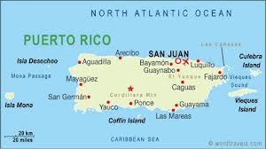



“San Juan es la capital
de Puerto Rico.”
Students can decode the
text because they know
how it sounds.
Reading the text puts a
clear picture in the mind.

Slide 10
Once a student is relatively accomplished with
reading recognizable and familiar words and phrases…
There are actually THREE new levels of word attack skills:

Slide 11
Words and phrases that are:

Slide 12
A. Familiar in sound and meaning…
…but NEW in text.
That’s how
you spell it?!

Slide 13
2. Familiar in sound…
..but NEW in meaning
and in text.
I’ve heard
that before.

Slide 14
3. NEW in sound
AND in meaning
AND in text.
HUH????

Slide 15
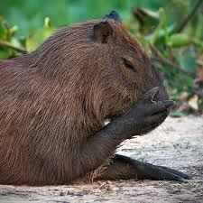
Stage Two:
B. Text is a code for all language.
capybara

Slide 16
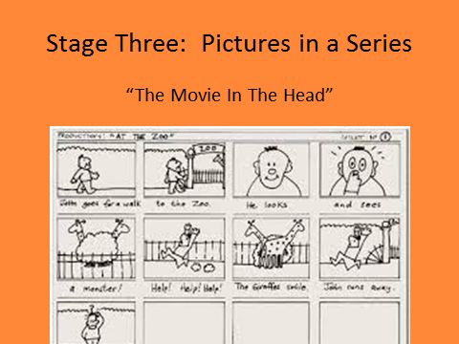

Slide 17
Visualization is the key to comprehension!!
How well do you comprehend
the following paragraph?

Slide 18
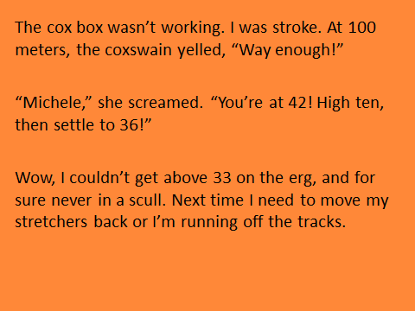

Slide 19
This paragraph was written by someone who
is on a crew, or rowing, team. Even if you are “fluent” in English, unless you are familiar with the specific terms used by rowers, it is very difficult to understand. Why? It is impossible
to “see” what is happening in your mind.

Slide 20
The Power of Background Knowledge
Background knowledge is a familiarity with the practices, products, people etc. related to
a specific topic. The more background knowledge a reader possesses, the easier it is to comprehend text about that topic.

Slide 21
Background Knowledge
The specific terms related to the culture of
a group are connected to the practices of
the group. Unless the reader is familiar
with the practices, the terms will have
little or no meaning.

Slide 22
For example, the following terms are specific to the sport of rowing:
Coxswain
Cox box
Way Enough
High Ten
Erg
Scull
Without some background knowledge, even a description or “translation” of these terms may not put the “right” picture in the mind of the reader.

Slide 23
Much of what we have students read in a target language is culturally-rich information. Students may need exposure to this information in their first language, or in a visual/kinesthetic form before they can actually comprehend a reading.

Slide 24
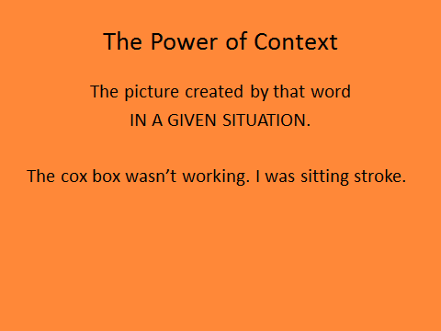

Slide 25
Some structures may be completely comprehensible in one situation, yet make no sense in another.
Words and structures with several meanings can be very challenging.
Idiomatic expressions are often very troublesome for language learners.

Slide 26
Skill-based Strategy:
Many teachers try to give their students opportunities to practice identifying the meaning of familiar words in a new context.
The following slide is an example:

Slide 27
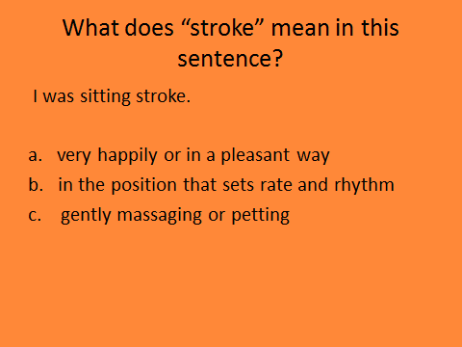

Slide 28
Did you know….?
Many students do NOT realize that in order to find the answer to that question, they should substitute an answer (a, b, c) for the word
“stroke” in the sentence to see what makes sense.

Slide 29
Acquisition-based Strategy:
Consider “front-loading” the structures by creating sentences that personally connect with students:
Instead of first going directly to the target reading:
The cox box wasn’t working. I was stroke. At 100 meters, the coxswain yelled, “Weigh enough!”

Slide 30
Consider first using a situation,
like the following suggested by participants,
in a CONTEXT
that is of high interest to students:

Slide 31
The Internet connection wasn’t working . I was just about to go buy tickets for the concert when my sister yelled, “Internet is down!”

Slide 32
or…
I was at one end of the cafeteria and Marla was at the other. My phone wasn’t working well. I was just about to send Marla a text and ask her to the dance, when Jackson yelled, “Hey Marla, want to go to the dance with me?”

Slide 33
It is possible to create a number of scenarios using the same three target structures and use these scenarios with students PRIOR to the cultural reading.
wasn’t working
I was
yelled
Then, when we add more culturally-specific terms the above structures will already be familiar and recognizable.

Slide 34
We know why our students
SHOULD read in the target language
(if not, read Krashen!!)
..but…

Slide 35


Slide 36


Slide 37
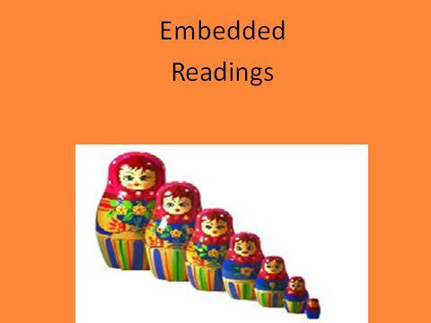

Slide 38
There are two types
of Embedded Readings.
They are used
the same way with students, but they are created differently.

Slide 39
The following is an example of a “Top-Down” reading. It is created from a pre-existing text. The text is pared down in stages until a base reading is created.

Slide 40
Mending Wall by Robert Frost
Something there is that doesn’t love a wall, "Why do they make good neighbours? Isn’t it
That sends the frozen-ground-swell under it, Where there are cows? But here there are no cows.
And spills the upper boulders in the sun; Before I built a wall I’d ask to know
And makes gaps even two can pass abreast. What I was walling in or walling out,
The work of hunters is another thing: And to whom I was like to give offence.
I have come after them and made repair Something there is that doesn’t love a wall,
Where they have left not one stone on a stone, That wants it down." I could say "Elves" to him,
But they would have the rabbit out of hiding, But it’s not elves exactly, and I’d rather
To please the yelping dogs. The gaps I mean, He said it for himself. I see him there
No one has seen them made or heard them made, Bringing a stone grasped firmly by the top
But at spring mending-time we find them there. In each hand, like an old-stone savage armed
I let my neighbor know beyond the hill; He moves in darkness as it seems to me,
And on a day we meet to walk the line Not of woods only and the shade of trees
And set the wall between us once again. He will not go behind his father’s saying,
We keep the wall between us as we go. And he likes having thought of it so well
To each the boulders that have fallen to each. He says again, "Good fences make good neighbours.”
And some are loaves and some so nearly balls
We have to use a spell to make them balance:
"Stay where you are until our backs are turned!"
We wear our fingers rough with handling them.
Oh, just another kind of out-door game,
One on a side. It comes to little more:
There where it is we do not need the wall:
He is all pine and I am apple orchard.
My apple trees will never get across
And eat the cones under his pines, I tell him.
He only says, "Good fences make good neighbours."
Spring is the mischief in me, and I wonder
If I could put a notion in his head:

Slide 41
Mending Wall by Robert Frost
Something doesn’t love walls,
And makes gaps.
I have repaired the gaps that hunters left.
But no one has seen the other gaps made
But they are there.
My neighbor and I meet
And set the wall between us once again.
Fixing the boulders on each side.
Some square, some round
We say a spell, “ Stay where you !"
Here we do not need the wall:
My apple trees will never get across, I tell him.
He only says, "Good fences make good neighbors."
“Why ? I ask.
Something doesn’t love walls and knocks them down.“
In the darkness
He says again, "Good fences make good neighbors.”

Slide 42
Mending Wall by Robert Frost
Something doesn’t love walls,
I have repaired the gaps.
But no one has seen them made
But they are there.
My neighbor and I fix the wall between us.
He says, "Good fences make good neighbors."
“Why ? I ask.
He says again, "Good fences make good neighbors.”

Slide 43
Mending Wall
by Robert Frost
I don’t love a wall,
but my neighbor says that good fences make good neighbors.

Slide 44
The base reading should be simple and clear, comprehensible to even the least-confident reader.

Slide 45
Mending Wall
by Robert Frost
I don’t love a wall,
but my neighbor says that good fences make good neighbors.

Slide 46
When using an Embedded Reading with students, the teacher begins with the base reading and makes sure that it is comprehensible via a variety of activities. The teacher then proceeds to the next, more complex, version.

Slide 47
Mending Wall by Robert Frost
Something doesn’t love walls,
I have repaired the gaps.
But no one has seen them made
But they are there.
My neighbor and I fix the wall between us.
He says, "Good fences make good neighbors."
“Why ? I ask.
He says again, "Good fences make good neighbors.”

Slide 48
The teacher then creates and implements appropriate activities for this level of the text.
When this level is clearly comprehensible, the process is repeated with the remaining versions of the text.

Slide 49
Mending Wall by Robert Frost
Something doesn’t love walls,
And makes gaps.
I have repaired the gaps that hunters left.
But no one has seen the other gaps made
But they are there.
My neighbor and I meet
And set the wall between us once again.
Fixing the boulders on each side.
Some square, some round
We say a spell, “ Stay where you !"
Here we do not need the wall:
My apple trees will never get across, I tell him.
He only says, "Good fences make good neighbors."
“Why ? I ask.
Something doesn’t love walls and knocks them down.“
In the darkness
He says again, "Good fences make good neighbors.”

Slide 50
Longer, more complex texts may take a long period of time to address, or the reading and subsequent activities may be spread out over a longer period of time.

Slide 51
Mending Wall by Robert Frost
Something doesn’t love a wall,
And makes gaps even two can pass abreast.
The work of hunters is one thing:
I have made repair where they have let
the rabbit out of hiding to please the dogs.
But no one has seen the other gaps made
But in springtime we find them there.
I let my neighbor and we meet
And set the wall between us once again.
We keep the wall between us as we go.
Fixing the boulders fallen on each side.
Some shaped like loaves and some so round
We have to use a spell to make them balance:
"Stay where you are until our backs are turned!"
A kind of out-door game, one on a side.
There where it is we do not need the wall:
My apple trees will never get across
And eat the cones under his pines, I tell him.
He only says, "Good fences make good neighbors."
“Why do they make good neighbors?
Before I built a wall I’d ask what I was
walling in or walling out.
Something doesn’t love a wall,
That wants it down.“
Maybe it’s elves, but it’s not elves.
I see him there, a stone in each hand.
In the darkness not only of the woods and shade
He says again, "Good fences make good neighbors.”

Slide 52
Bear in mind that even with scaffolding some texts may be too complex to use so remember that the

Slide 53
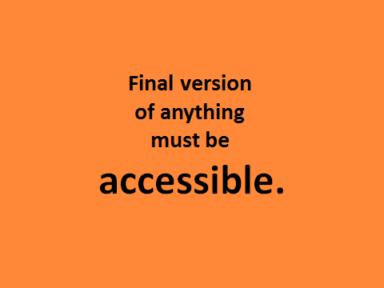

Slide 54
Teachers may want to create a template/rubric to evaluate the adaptability of a text for Embedded Reading.

Slide 55
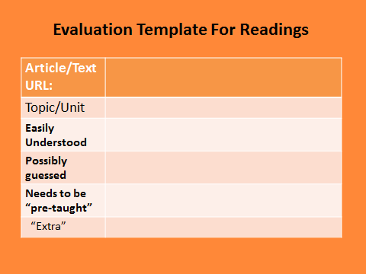

Slide 56
Not all texts need to be complicated,
nor lengthy, in order to be used in an
Embedded Reading format. Consider
the following piece:

Slide 57
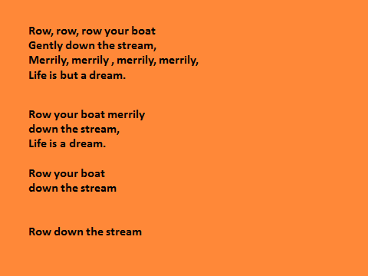

Slide 58
Remember,
when working with an already existing text,

Slide 59
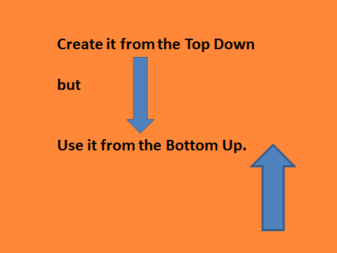

Slide 60
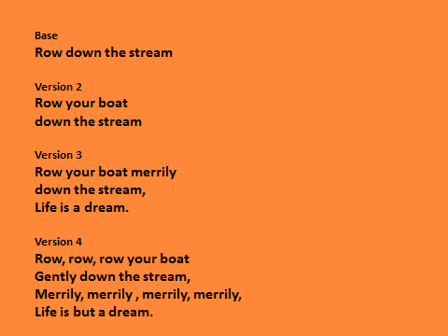

Slide 61
Even with a “simple” text,
it is important to alternate
the reading of the text
with activities that
relate to the text.

Slide 62
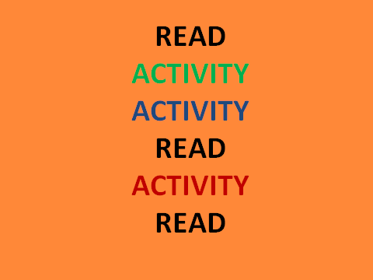

Slide 63
The other way to create an Embedded Reading is from the “Bottom Up.”
A “Bottom Up” reading also begins with a base reading that is clearly comprehensible.
The teacher chooses the important structures and the readings can be created by the teacher alone, or by the teacher and students.

Slide 64
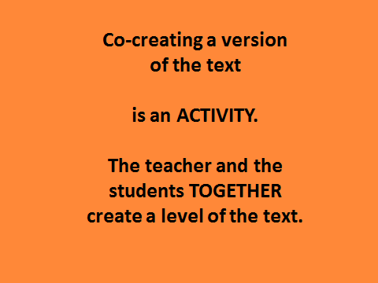

Slide 65
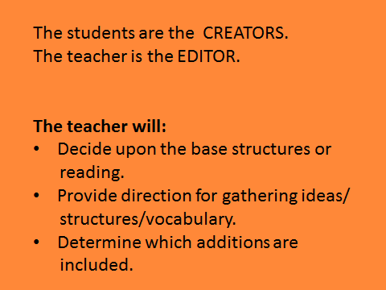

Slide 66
The following is a series of readings co-created by the presenter and participants in a workshop. The same process is used with a teacher and students.

Slide 67
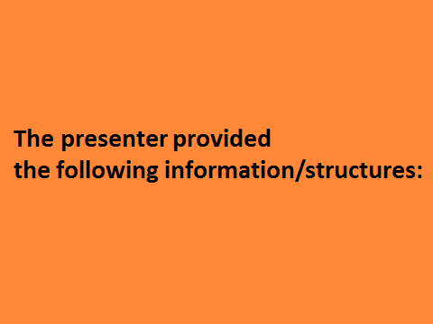

Slide 68
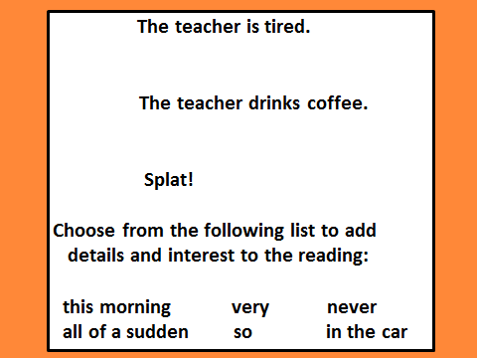

Slide 69
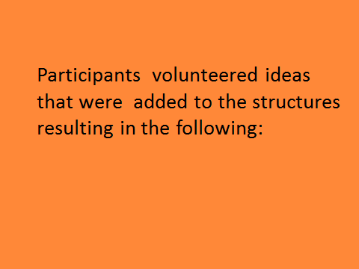

Slide 70
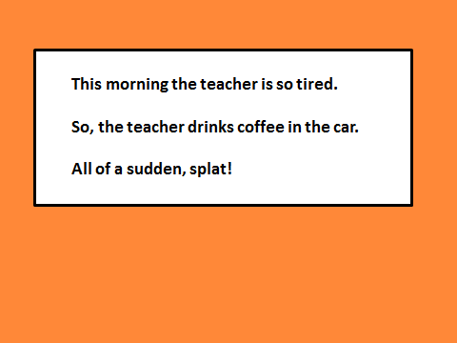

Slide 71
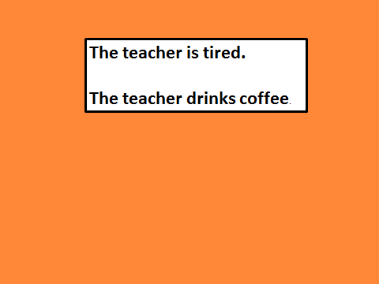
Given just these two sentences, participants volunteered typical words/phrases that students might know.

Slide 72
Participants offered the following:
class zoo walks with the class
In small groups, teachers brainstormed
possibilities, the following is the result of
one group’s work:

Slide 73
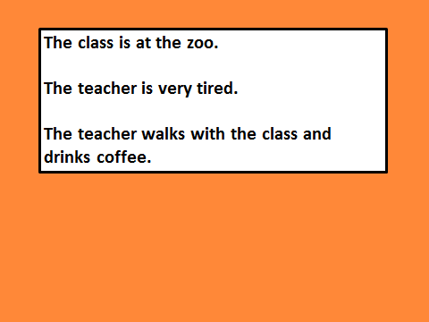

Slide 74
As a large group, the presenter and
participants brainstormed other structures
that could be included and created the
following, more complex, version:

Slide 75
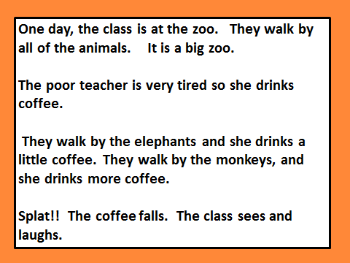

Slide 77
Each teacher then submitted another idea
on a small scrap of paper and those ideas
were collected. The presenter then added
those ideas and the following version was
created:

Slide 78
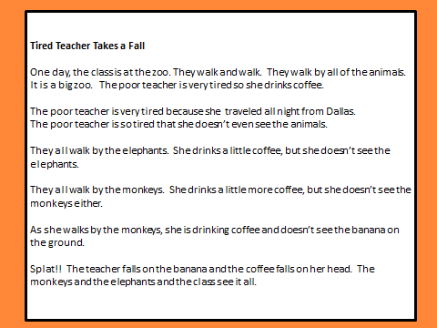

Slide 79
Totally Teacher-Created Texts

Slide 80
Create a base reading that will be totally comprehensible to all students.

Slide 81
(It may contain “new” structures, but when you use it,
the class will not move on to the next version until everyone in the class is highly competent with the structures in the base reading.)

Slide 82
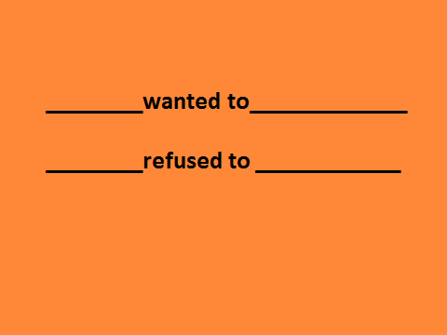

Slide 83
Then add a variety of words and structures that will add information and interest to the base reading!!

Slide 84
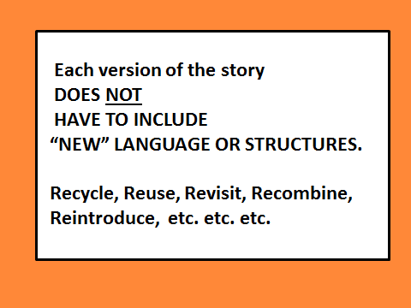

Slide 85
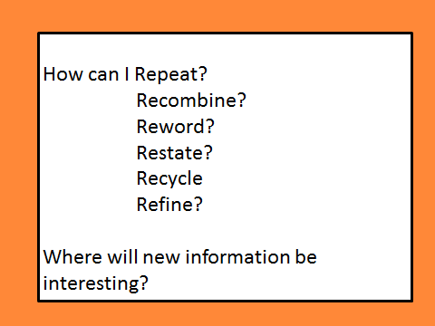

Slide 86
Copy, paste, and repeat.
Remember to ALWAYS keep a copy of each
level so that you have several, differentiated
versions of the reading.

Slide 87
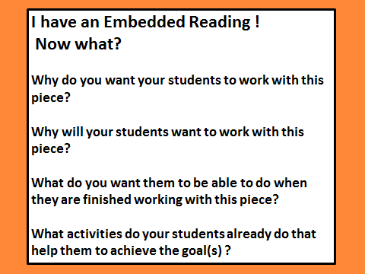

Slide 88
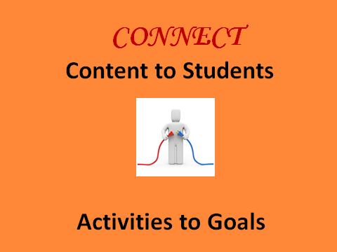

Slide 90
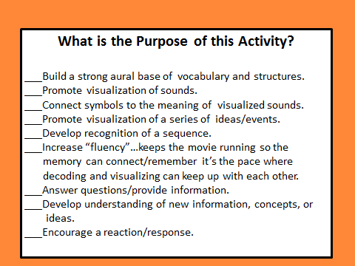

Slide 91
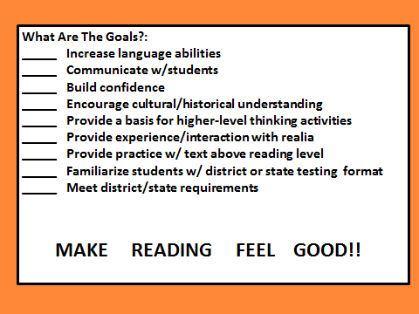

Slide 92
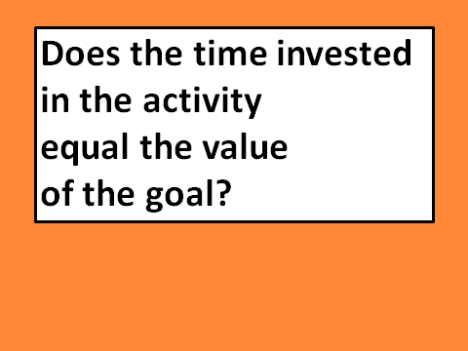

Slide 93
Check www.EmbeddedReading.com for posts on the types of activities that can be used with Embedded Readings.
Hint: If you already do an activity
that works…keep using it with
your students with Embedded
ReadingJ!!

Slide 94
It is important, when using Embedded Reading, to
involve the students in a variety of activities. In this
way, the students will approach each new version
with a different purpose and perspective.
In addition, not every student needs to advance
through each level. Because the information is
included from the beginning, each student will
comprehend and acquire the most crucial information.
This allows the teacher to differentiate with every
reading.
© Clarcq, Whaley 2012

Slide 95
Creating and using embedded readings may take
some practice, but don’t wait until you have
“perfected” the skill!
Students will benefit from your knowledge,
expertise AND your practice.
If you have questions, please feel free
to contact us:
lclarcq@yahoo.com
© Clarcq, Whaley 2012

