Slide 1

Lighting Up Languages
with Literacy !!
NYSAFLT Summer Institute
2013
Laurie Clarcq
lclarcq@rochester.rr.com
©Clarcq, Whaley 2013

Slide 2
The Purpose of Language
as COMMUNICATION
is to create
a picture
in the mind
and/or
the heart
of another person.
©Clarcq, Whaley 2013

Slide 3
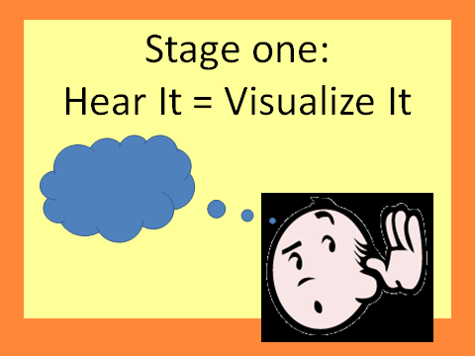
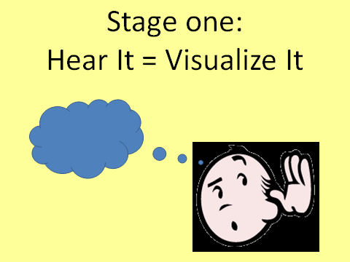
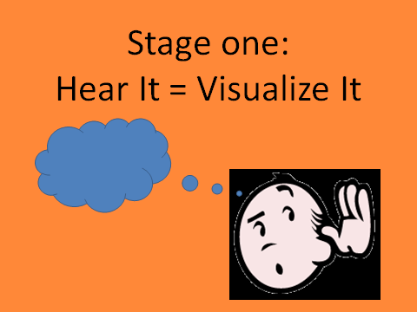

Slide 4
Stage One:
Listening Recognition and Comprehension

Slide 5
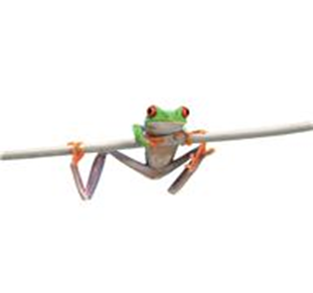



Stage Two:
A. Text is a code for language that you know.
frog

Slide 6
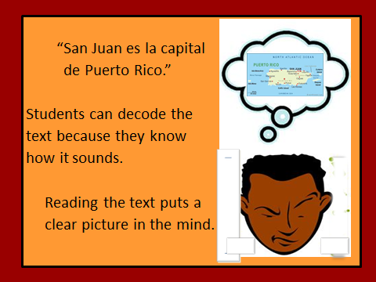

Slide 7
Visualization
is the key to
Comprehension!!

Slide 8
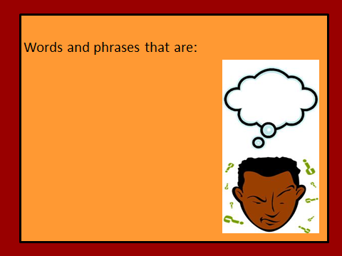

Slide 9
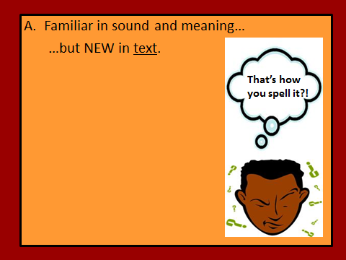

Slide 10
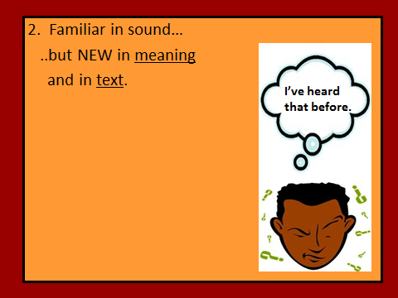

Slide 11
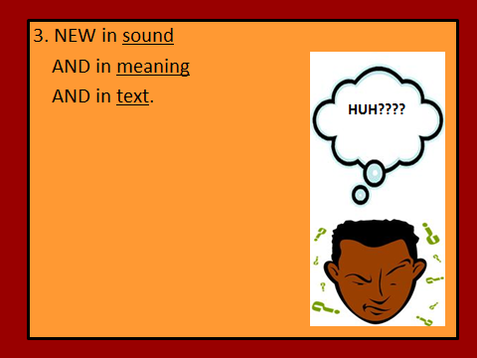

Slide 12
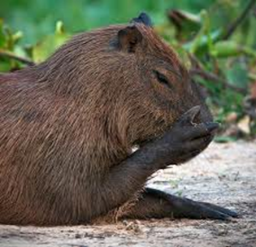
Stage Two:
B. Text is a code for all language.
capybara

Slide 13
Visualization
is the key to
Comprehension!!

Slide 14
Visualization of
Objects/Actions
is the key to
Comprehension!!

Slide 15
The cox box wasn’t working. I was sitting stroke. At 100 meters, the coxswain yelled, “Way enough!” “Michele,” she screamed. “You’re at 42! High ten, then settle to 32!”
Wow, I couldn’t get above 33 on the erg, and for sure never in a scull. Next time I need to move my stretchers back or I’m running off the tracks.

Slide 16
For example, the following terms are specific to the sport of rowing:
Coxswain
Cox box
Way Enough
High Ten
Erg
Scull
Without some background knowledge, even a description or “translation” of these terms may not put the “right” picture in the mind of the reader.

Slide 17
Students who are not “accomplished readers”
should be reading text
that contains language
that already creates a picture when they hear it.

Slide 18
Emerging readers need to
READ WHAT HAS MEANING
not just vocabulary.

Slide 19
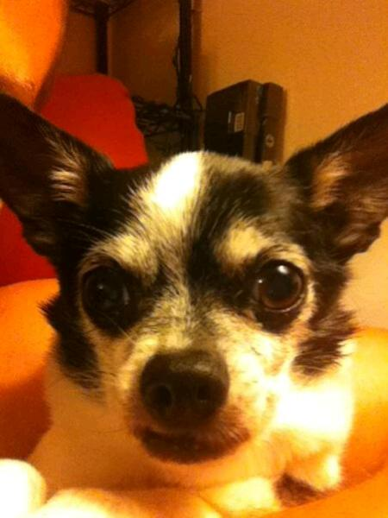

un Perro

Slide 20
dog

Slide 21
un Perro

Slide 22
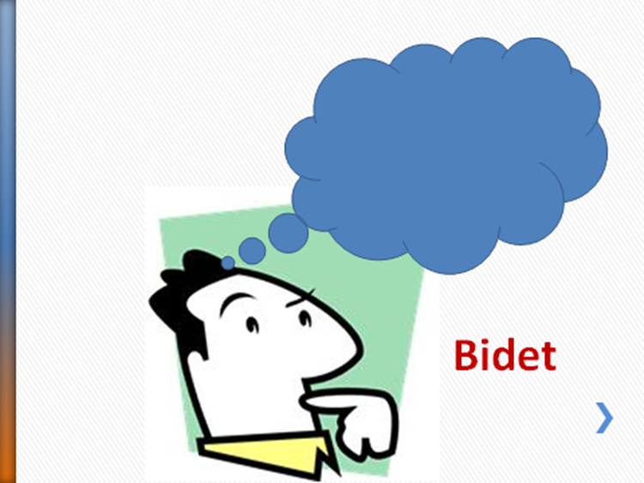
un Perro

Slide 23
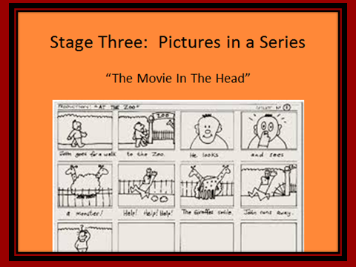

Slide 24
Stage One:
Hear It = Visualize It
Stage Two:
Text is a code for language that you know.
Text can be a code for all language.
Stage Three:
Pictures in a Series
“The Movie In The Head”

Slide 25
The Power of Context
The cox box wasn’t working.
I was sitting stroke.

Slide 26
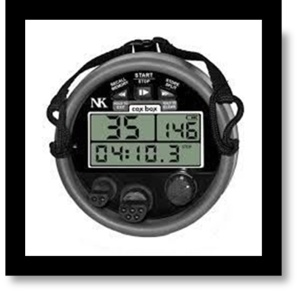
The Power of Context
The picture created by that word
IN A GIVEN SITUATION.
The wasn’t working.
I was sitting stroke.

Slide 27
Skill-based Strategy:
Many teachers try to give their students opportunities to practice identifying the meaning of familiar words in a new context.

Slide 28
What does “stroke” mean in this sentence?
I was sitting stroke.
very happily or in a pleasant way
in the position that sets rate and
rhythm
c. gently massaging or petting

Slide 29
Fill in the ______________.
Check the _____________.
Does the picture make ___________?

Slide 30
The cox box wasn’t working. I was sitting stroke. At 100 meters, the coxswain yelled, “Way enough!”

Slide 31
Some structures may be completely comprehensible in one situation, yet make no sense in another.
Words and structures with several meanings can be very challenging.
Idiomatic expressions are often very troublesome for language learners.

Slide 32
“Front-load Structures”

Slide 33
The cox box wasn’t working. I was sitting stroke. At 100 meters, the coxswain yelled, “Way enough!”

Slide 34
The cox box wasn’t working. I was stroke. At 100 meters, the coxswain yelled, “Way enough!”

Slide 35
wasn’t working
I was
yelled

Slide 36

When Reading Feels Good, Students Read
©Clarcq, Whaley 2013

Slide 37
When we only have students reading in class
in order to become better test-takers,
it doesn’t feel good!!
However, if they can, and do, read for fun, their
reading skills AND test scores will improve.
Take a look at the following examples:

Slide 38
Now, a better understanding of the brain basis of reading has been reported in research published in the open-access, peer-reviewed journal PLoS ONE. The research was led by Piers Cornelissen, Morten Kringelbach, Ian Holliday and Peter Hansen from the Universities of York, Oxford, Aston, and Birmingham UK, and was funded by the Wellcome Trust. The authors showed very early interactions between the vision and language domains during reading, with the speech motor areas of the brain (inferior frontal gyrus) being active at the same time (after a seventh of a second) as the orthographic word-form is being resolved within a brain region called the fusiform gyrus. This finding challenges the conventional view of a temporally serial processing sequence for reading in which letter forms are initially decoded, interact with their phonological and semantic representations, and only then gain access to a speech code.
http://www.eurograduate.com/arch_article.asp?id=2578

Slide 39
Se invita a los niños a colorear, a leer cuentos y a mandar sus dibujos y pinturas para ser expuestos en una galería de arte infantil del Internet.
June 2009 Proficiency Exam

Slide 40
Ölim in urbe Spartä in Graeciä antïquä erat puer pulcher nömine Hyacinthus, fïlius rëgis. Hyacinthus et deus Apollö erant amïcï. Saepe Apollö veniëbat ad urbem Spartam ubi puer habitäbat. Ibi deus et puer per silväs ambuläre et discum iacere amäbant.

Slide 41
Chiara,
sono andata da Teresa per aiutarla con i compiti. Non dimenticaredi dare da mangiare al cane a
mezzogiorno. Ci vediamo verso le tre.

Slide 42
Nehmen Sie als Reiseproviant Brot mit magerem Belag, frisches Obst und rohes Gemüse mit. Diese Lebensmittel können Sie auch leicht transportieren. Als Durstlöscher kommen Mineralwasser (evtl. mit Obstsaft vermischt),
Früchte– und Kräutertee, sowie Buttermilch in Frage.

Slide 43
Lors de votre séjour à l’étranger, vous avez peut-être été exposé à des maladies infectieuses rares au Canada.
Même si le risque de contracter ces maladies est faible, la possibilité existe. Si vous avez de la fièvre ou des symptômes de la grippe après votre voyage dans un pays tropical, Santé Canada vous recommande de consulter un médecin ou une clinique médicale immédiatement. On vous fera les analyses nécessaires.

Slide 44
We know why our students
SHOULD read in the target language
(if not, read Stephen Krashen!!)

Slide 45
Read more, acquire more language.
Read more, know more.
Read more, understand more.
Read more, think more.
Read more, imagine more.
Read more, grow more.
Read more, be more.
©Clarcq, Whaley 2013

Slide 46
Connections

Slide 47
Success

Slide 48
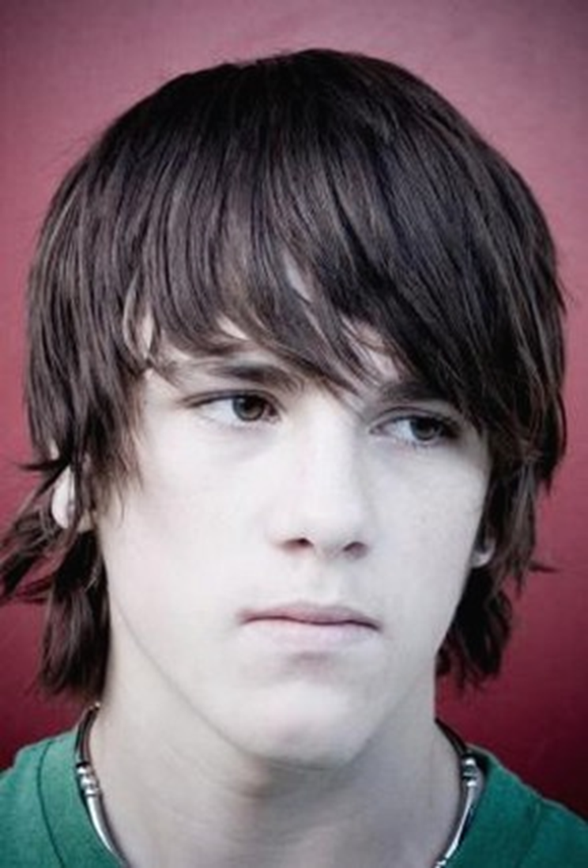

Slide 49
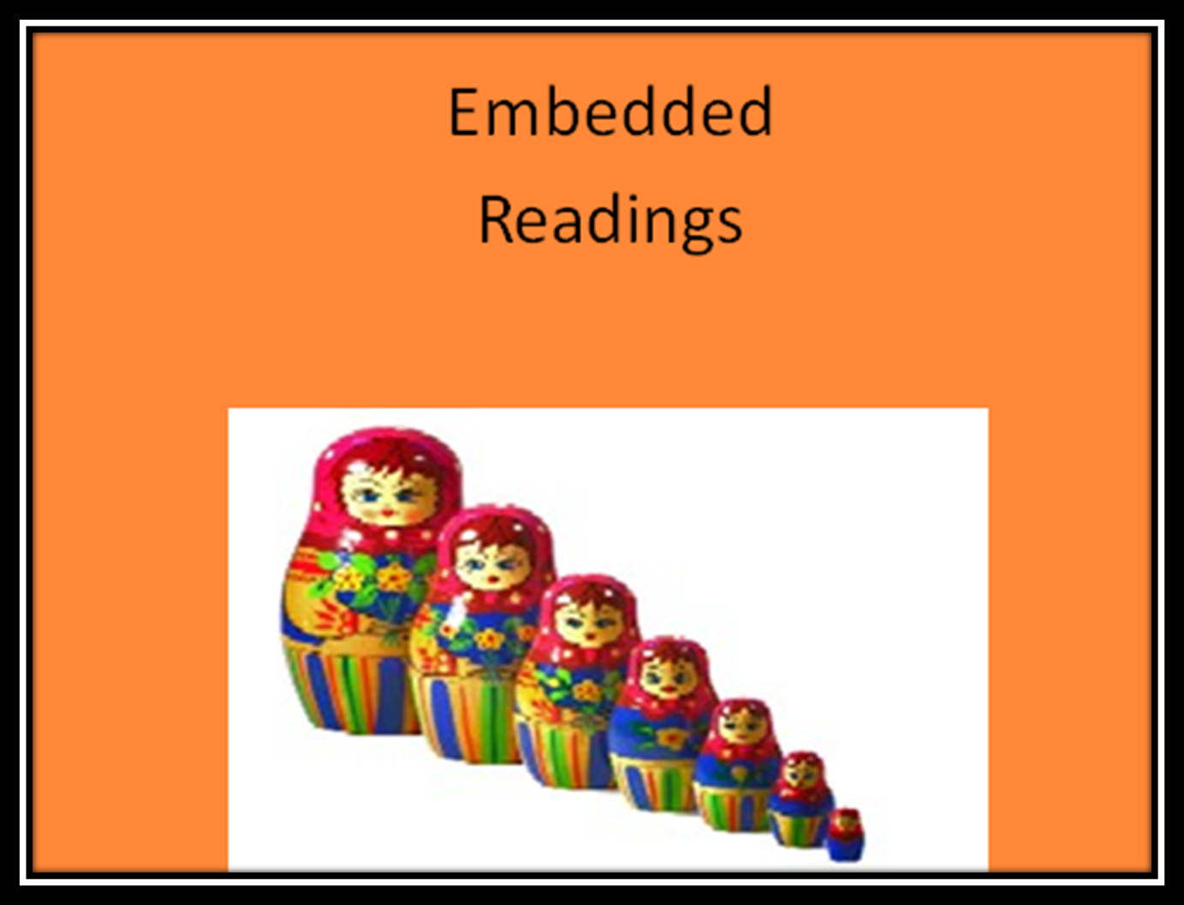

Slide 50
What does a
“successful reader”
do?

Slide 51
What does
“successful reading”
look like in the classroom?

Slide 52
What skills does
the brain need to
develop in order
to grow
as a “reading brain”??

Slide 53
Decoding
Comprehension
Visualization
“Fluency”
Immersion

Slide 54
What do the students need in order to develop those skills?
Successful Practice !!

Slide 55
Compelling
Comprehensible
%

Slide 56
_________ ______ SQUARE ________
1 ________ ______ flour
1/2 c. ______ cooking _________
1/2 c. brown _____
______ c. ___________
________ until ________ and ______ in 9 x 13 inch ______._______ _____ __________ (follow ________ on _______). Pour on _______ and bake 20 ______ at ___________.
___________
1/2 ______ nuts
1/2 c. _______ ______
2 ____. butter
________ over hot _________ _________. ________ to oven and bake 15-20 ________ until ________ is set.__________ in _______. Cut in 2 inch_____. __________ with _______ _______. Makes 2 ______.

Slide 57
PUMPKIN ______ SQUARE ________
1 ________ ______ flour
1/2 c. ______ cooking _________
1/2 c. brown _____
______ c. butter
________ until ________ and ______ in 9 x 13 inch ______. Bake for 15 minutes at _______ ________. _______ 1 (28 ounce) can _____ pumpkin (follow ________ on can). Pour on _______ and bake 20 ______ at ___________.
___________
1/2 ______ nuts
1/2 c. _______ ______
2 ____. butter
________ over hot pumpkin _________. ________ to oven and bake 15-20 minutes until ________ is set. Cool in pan. Cut in 2 inch_____. Serve with _______ _______. Makes 2 ______.

Slide 58
PUMPKIN ______ SQUARE ________
1 ________ ______ flour
1/2 c. ______ cooking _________
1/2 c. brown _____
______ c. butter
Mix until ________ and ______ in 9 x 13 inch ______. Bake for 15 minutes at 350 ________. Mix 1 (28 ounce) can _____ pumpkin (follow ________ on can). Pour on _______ and bake 20 ______ at 350 degrees.
___________
1/2 ______ nuts
1/2 c. _______ ______
2 ____. butter
Sprinkle over hot pumpkin _________. ________ to oven and bake 15-20 minutes until ________ is set. Cool in pan. Cut in 2 inch_____. Serve with whip _______. Makes 2 ______.

Slide 59
PUMPKIN ______ SQUARE COOKIES
1 c. ______ flour
1/2 c. ______ cooking oatmeal
1/2 c. brown _____
______ c. butter
Mix until ________ and ______ in 9 x 13 inch pan. Bake for 15 minutes at 350 degrees. Mix 1 (28 ounce) can _____ pumpkin (follow ________ on can). Pour on crust and bake 20 ______ at 350 degrees.
___________
1/2 ______ nuts
1/2 c. _______ ______
2 ____. butter
Sprinkle over hot pumpkin _________. ________ to oven and bake 15-20 minutes until ________ is set. Cool in pan. Cut in 2 inch_____. Serve with whip _______. Makes 2 ______.

Slide 60
PUMPKIN ______ SQUARE COOKIES
1 c. ______ flour
1/2 c. ______ cooking oatmeal
1/2 c. brown _____
______ c. butter
Mix until crumbly and ______ in 9 x 13 inch pan. Bake for 15 minutes at 350 degrees. Mix 1 (28 ounce) can _____ pumpkin (follow directions on can). Pour on crust and bake 20 ______ at 350 degrees.
TOPPING:
1/2 ______ nuts
1/2 c. brown ______
2 ____. butter
Sprinkle over hot pumpkin _________. Return to oven and bake 15-20 minutes until filling is set. Cool in pan. Cut in 2 inch_____. Serve with whip cream. Makes 2 ______.

Slide 61
PUMPKIN PIE SQUARE COOKIES
1 c. sifted flour
1/2 c. quick cooking oatmeal
1/2 c. brown sugar
1/2 c. butter
Mix until crumbly and press in 9 x 13 inch pan. Bake for 15 minutes at 350 degrees. Mix 1 (28 ounce) can Libby's pumpkin (follow directions on can). Pour on crust and bake 20 minutes at 350 degrees.
TOPPING:
1/2 c. nuts
1/2 c. brown sugar
2 tbsp. butter
Sprinkle over hot pumpkin filling. Return to oven and bake 15-20 minutes until filling is set. Cool in pan. Cut in 2 inch squares. Serve with whip cream. Makes 2 dozen.

Slide 62
The ______ family _______a new dog for _______ ________. The dog’s ______ was ________. _______ ________ was ______, so they _____ to the store to ______him _______. “I _____ he is ______ alone”, said Michelle, the _______ _________. The family ______for the dog as _____as they came home. Oh ____! They ______find ________!!
Where ______ he be? They _______ ______ the house and _______ in the yard. ________ was a ______ dog and ______ to find. He was a ________ ___________! They _____ and _______.
“________! ______ are you?”, they ________. ________ didn’t _____.
They _________under the ______. They _______ in the ________.
They ______ ________ in the _____ can! Finally, Michelle _____, “I ________him!” ______ was _________ the ______ basket, ________ up in the _________ ________. Thank ________!

Slide 63
The ______ family bought a new dog for _______ ________. The dog’s ______ was Pickles. _______ Pickles was ______, so they went to the store to buy him _______. “I hope he is ______ alone”, said Michelle, the _______ _________. The family ______for the dog as _____as they came home. Oh ____! They ______find Pickles!!
Where ______ he be? They _______ ______ the house and _______ in the yard. Pickles was a ______ dog and ______ to find. He was a ________ ___________! They _____ and _______.
“Pickles! Where are you?”, they ________. Pickles didn’t _____.
They _________under the ______. They _______ in the ________.
They ______ ________ in the _____ can! Finally, Michelle yelled, “I ________him!” Pickles was _________ the ______ basket, ________ up in the _________socks. Thank ________!

Slide 64
The ______ family bought a new dog for _______ ________. The dog’s ______ was Pickles. Poor Pickles was ______, so they went to the store to buy him _______. “I hope he is okay alone”, said Michelle, the _______ _________. The family looked for the dog as soon as they came home. Oh ____! They ______find Pickles!!
Where ______ he be? They looked ______ the house and _______ in the yard. Pickles was a tiny dog and ______ to find. He was a ________ ___________! They _____ and _______.
“Pickles! Where are you?”, they ________. Pickles didn’t answer.
They looked under the ______. They looked in the ________.
They even looked in the _____ can! Finally, Michelle yelled, “I found him!” Pickles was _________ the ______ basket, ________ up in the clean socks. Thank goodness!

Slide 65
The Miller family bought a new dog for _______Miller. The dog’s name was Pickles. Poor Pickles was ______, so they went to the store to buy him food. “I hope he is okay alone”, said Michelle, the _______ daughter. The family looked for the dog as soon as they came home. Oh no! They couldn’t find Pickles!!
Where ______ he be? They looked ______ the house and outside in the yard. Pickles was a tiny dog and ______ to find. He was a miniature___________! They called and called.
“Pickles! Where are you?”, they called. Pickles didn’t answer.
They looked under the ______. They looked in the ________.
They even looked in the _____ can! Finally, Michelle yelled, “I found him!” Pickles was _________ the ______ basket, ________ up in the clean socks. Thank goodness!

Slide 66
The Miller family bought a new dog for Grandpa Miller. The dog’s name was Pickles. Poor Pickles was hungry, so they went to the store to buy him food. “I hope he is okay alone”, said Michelle, the youngest daughter. The family looked for the dog as soon as they came home. Oh no! They couldn’t find Pickles!!
Where could he be? They looked inside the house and outside in the yard. Pickles was a tiny dog and hard to find. He was a miniature Chihuahua! They called and called.
“Pickles! Where are you?”, they called. Pickles didn’t answer.
They looked under the couch. They looked in the bathtub.
They even looked in the garbage can! Finally, Michelle yelled, “I found him!” Pickles was asleep the laundry basket, curled up in the clean socks. Thank goodness!

Slide 67
Are we asking our students to read?
Or…
Are we asking our students
to “hunt” for recognizable text?
©Clarcq, Whaley 2013

Slide 68
Word
Phrase
Sentence
Paragraph
Page
Several pages
Chapter
Book

Slide 69
Word
Phrase
Sentence
Paragraph
Page
Several pages
Chapter
Book

Slide 70
Use existing materials.
Purchase new materials.
Adapt existing materials.
Search for new materials.

Slide 71
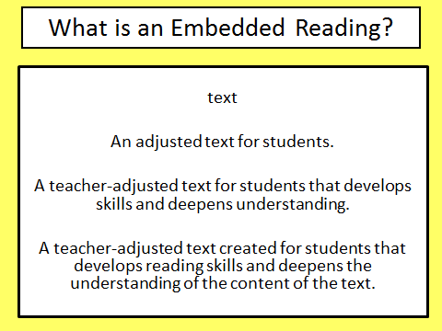
©Clarcq, Whaley 2013

Slide 72


Slide 73
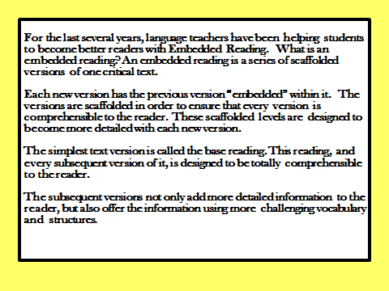
©Clarcq, Whaley 2013

Slide 74
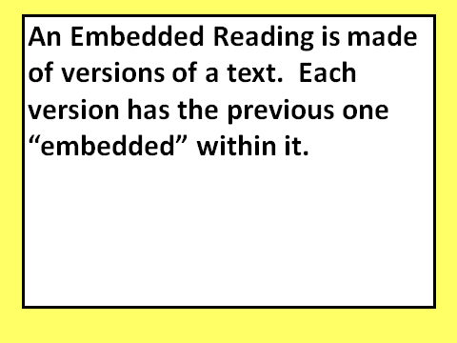
©Clarcq, Whaley 2013

Slide 75
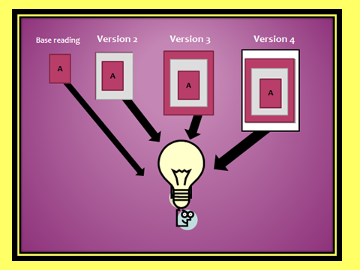
©Clarcq, Whaley 2013

Slide 76
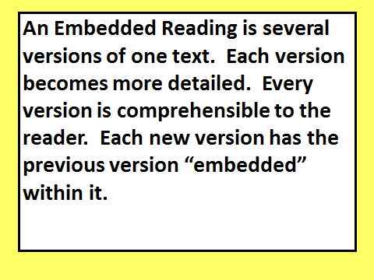
©Clarcq, Whaley 2013

Slide 77
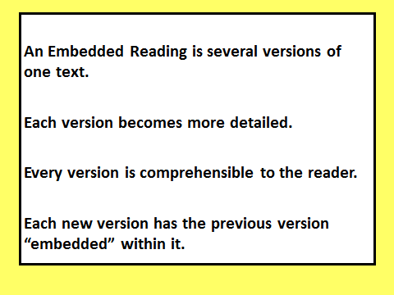
©Clarcq, Whaley 2013

Slide 78
©Clarcq, Whaley 2013

Slide 79

©Clarcq, Whaley 2013

Slide 80
©Clarcq, Whaley 2013

Slide 81
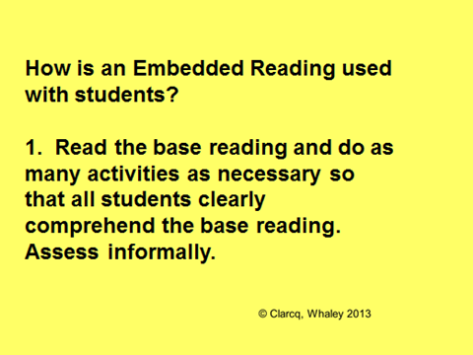

Slide 82
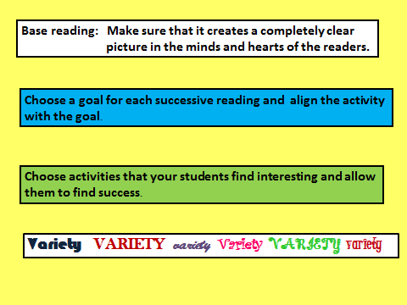
©Clarcq, Whaley 2013

Slide 83
There are two types
of Embedded Readings.
They are used
the same way with students, but they are created differently.

Slide 84
Mending Wall by Robert Frost
Something there is that doesn’t love a wall, "Why do they make good neighbours? Isn’t it
That sends the frozen-ground-swell under it, Where there are cows? But here there are no cows.
And spills the upper boulders in the sun; Before I built a wall I’d ask to know
And makes gaps even two can pass abreast. What I was walling in or walling out,
The work of hunters is another thing: And to whom I was like to give offence.
I have come after them and made repair Something there is that doesn’t love a wall,
Where they have left not one stone on a stone, That wants it down." I could say "Elves" to him,
But they would have the rabbit out of hiding, But it’s not elves exactly, and I’d rather
To please the yelping dogs. The gaps I mean, He said it for himself. I see him there
No one has seen them made or heard them made, Bringing a stone grasped firmly by the top
But at spring mending-time we find them there. In each hand, like an old-stone savage armed
I let my neighbor know beyond the hill; He moves in darkness as it seems to me,
And on a day we meet to walk the line Not of woods only and the shade of trees
And set the wall between us once again. He will not go behind his father’s saying,
We keep the wall between us as we go. And he likes having thought of it so well
To each the boulders that have fallen to each. He says again, "Good fences make good neighbours.”
And some are loaves and some so nearly balls
We have to use a spell to make them balance:
"Stay where you are until our backs are turned!"
We wear our fingers rough with handling them.
Oh, just another kind of out-door game,
One on a side. It comes to little more:
There where it is we do not need the wall:
He is all pine and I am apple orchard.
My apple trees will never get across
And eat the cones under his pines, I tell him.
He only says, "Good fences make good neighbours."
Spring is the mischief in me, and I wonder
If I could put a notion in his head:

Slide 85
Mending Wall by Robert Frost
Something doesn’t love walls,
And makes gaps.
I have repaired the gaps that hunters left.
But no one has seen the other gaps made
But they are there.
My neighbor and I meet
And set the wall between us once again.
Fixing the boulders on each side.
Some square, some round
We say a spell, “ Stay where you !"
Here we do not need the wall:
My apple trees will never get across, I tell him.
He only says, "Good fences make good neighbors."
“Why ? I ask.
Something doesn’t love walls and knocks them down.“
In the darkness
He says again, "Good fences make good neighbors.”

Slide 86
Mending Wall by Robert Frost
Something doesn’t love walls,
I have repaired the gaps.
But no one has seen them made
But they are there.
My neighbor and I fix the wall between us.
He says, "Good fences make good neighbors."
“Why ? I ask.
He says again, "Good fences make good neighbors.”

Slide 87
Mending Wall
by Robert Frost
I don’t love a wall,
but my neighbor says that good fences make good neighbors.

Slide 88
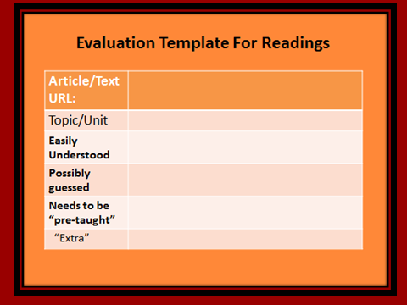
©Clarcq, Whaley 2013

Slide 89
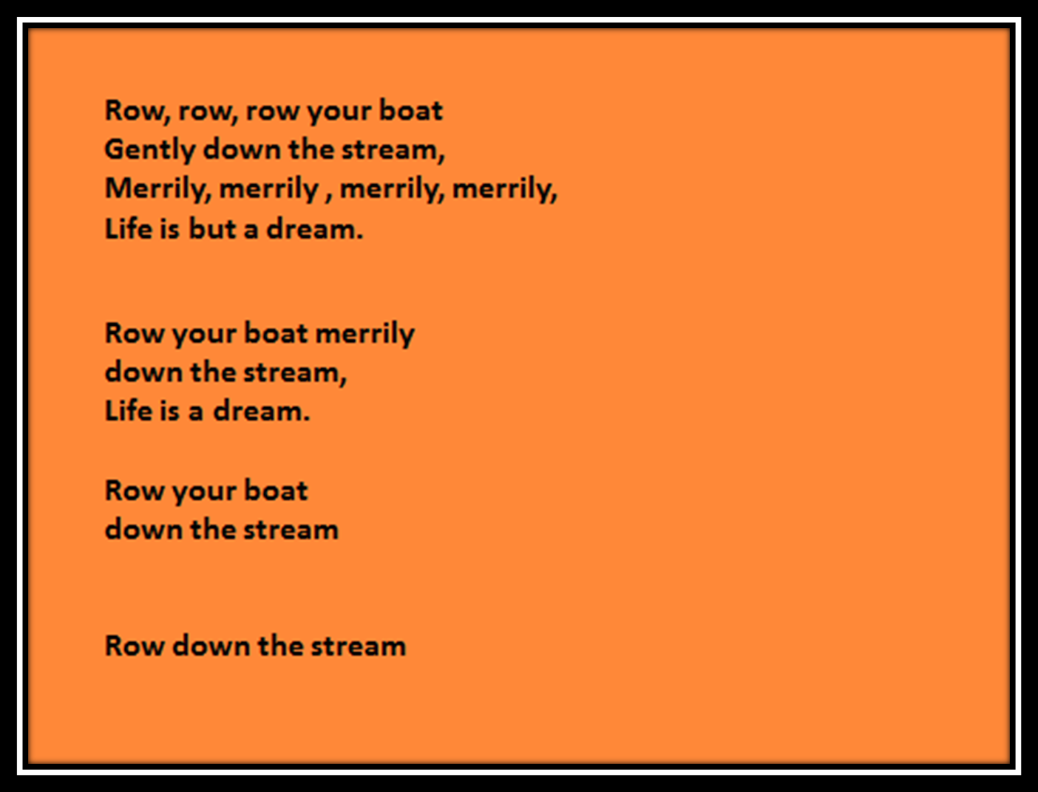

Slide 90
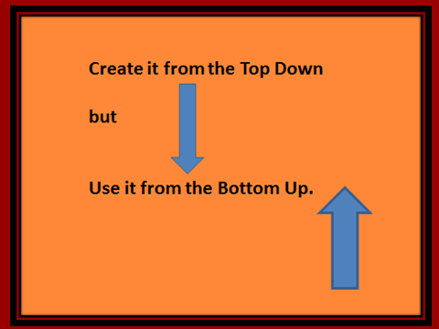
©Clarcq, Whaley 2013

Slide 91
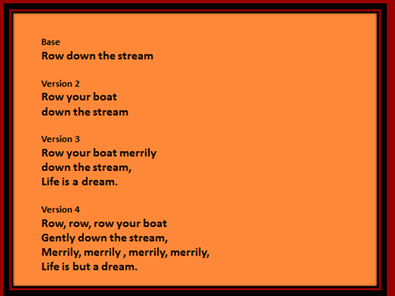

Slide 92
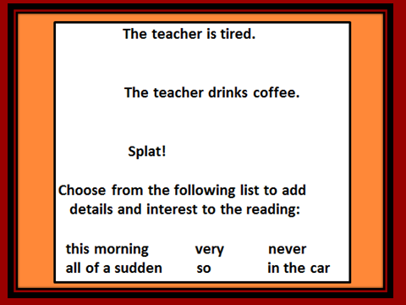

Slide 93
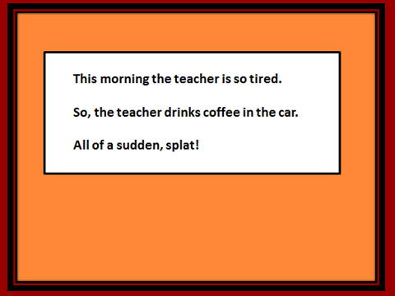
©Clarcq, Whaley 2013

Slide 94
Wanted to_______
Refused to_______

Slide 95

©Clarcq, Whaley 2013

Slide 96
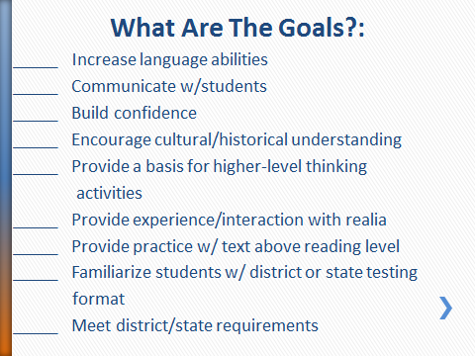
©Clarcq, Whaley 2013

Slide 97
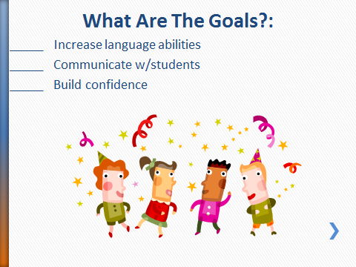
©Clarcq, Whaley 2013

Slide 98
There is no uniform set of goals.
Each class should, and will, have its own needs.
Feed the needs.
©Clarcq, Whaley 2013

Slide 99
What is the Purpose of this Activity?
___Build a strong aural base of vocabulary and structures.
___Promote visualization of sounds.
___Connect symbols to the meaning of visualized sounds.
___Promote visualization of a series of ideas/events.
___Develop recognition of a sequence.
___Answer questions/provide information.
___Develop understanding of new information, concepts, or ideas.
___Encourage a reaction/response.
Etc. ©Clarcq, Whaley 2013

Slide 100
And…
Always remember…..
It’s about our STUDENTS.
ALWAYS.
If it isn’t working,
It’s because we made it about
Something other than our students.
©Clarcq, Whaley 2013

