Slide 1
Embedded Reading
Part deux
Michele Whaley and Laurie Clarcq
Whaley_michele@acsd.org lclarcq@yahoo.org
© Clarcq, Whaley 2014

Slide 2
The purpose of language
used in communication
is to put a picture
in the heart, and/or mind
of another person.
© Clarcq, Whaley 2014

Slide 3
Ideas for how to …
Choose structures.
Write a base story.
Write interesting story versions.
“Whittle” a story.
Use a story.
with
Sharing and
Q and A along the way.
© Clarcq, Whaley 2014

Slide 4
Choosing Structures

Slide 5
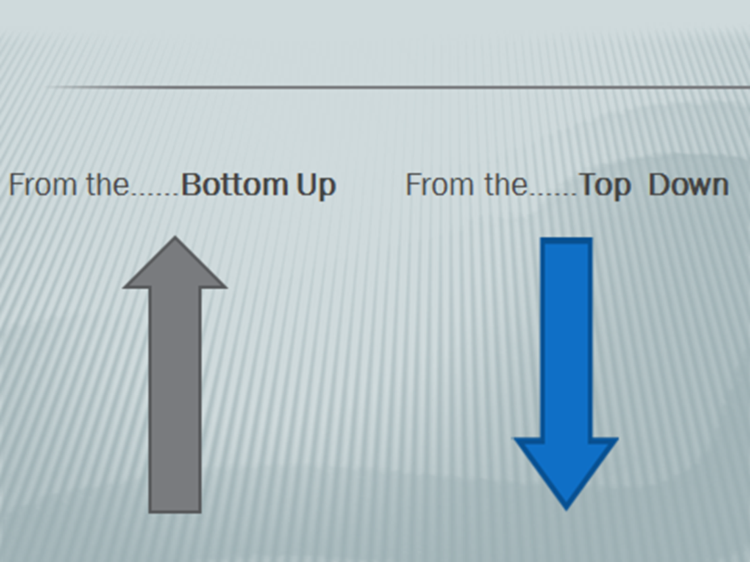

Slide 6
The teacher chooses
the target structures.
© Clarcq, Whaley 2014

Slide 7
How to choose structures
target structures from curriculum
target structures from upcoming novel/story/song/etc.
late-acquired structures
verbs/verb phrases
adverbial phrases
prepositional phrases
© Clarcq, Whaley 2014

Slide 8
How to choose structures
Cause and Effect
is hungry/eats wants/looks for
has to/doesn’t want to sees/takes
© Clarcq, Whaley 2014

Slide 9
Structures to base story

Slide 10
Students create a base story with the structures
wanted to
shouldn’t
decided to

Slide 11
Students create a base story with the structures
Marquis wanted to dance.
He was too shy. He was sad.
© Clarcq, Whaley 2014

Slide 12
Marquis wanted to dance.
He was too shy. He was sad.
At Homecoming, Marquis wanted to
dance. He was too shy. He wanted to run.
The teacher said that he shouldn’t run. He
decided to dance, but he was too shy. He was
sad.
© Clarcq, Whaley 2014

Slide 13
Students create a base story with the structures
Get to know the “hot” topics from students.
Be prepared to change course.
Don’t use everything.
File good ideas away for later.
© Clarcq, Whaley 2014

Slide 14
Students create a base story with the structures
Students write a base story (3-5 sentences)
* for homework
* at the end of class
* on Edmodo
© Clarcq, Whaley 2014

Slide 15
Teacher creates a base story with the structures
1. beginning, middle, end
2. character, setting, problem/situation
3. uses target structures
© Clarcq, Whaley 2014

Slide 16
Teacher creates a base story with the structures
wanted to
decided to

Slide 17
creating new versions
Dave is a teacher. He decided to try to find
a job. Dave wanted to teach in an important
university. He found a job.
© Clarcq, Whaley 2014

Slide 18
Teacher creates a base story with the structures
wanted to
decided to

Slide 19
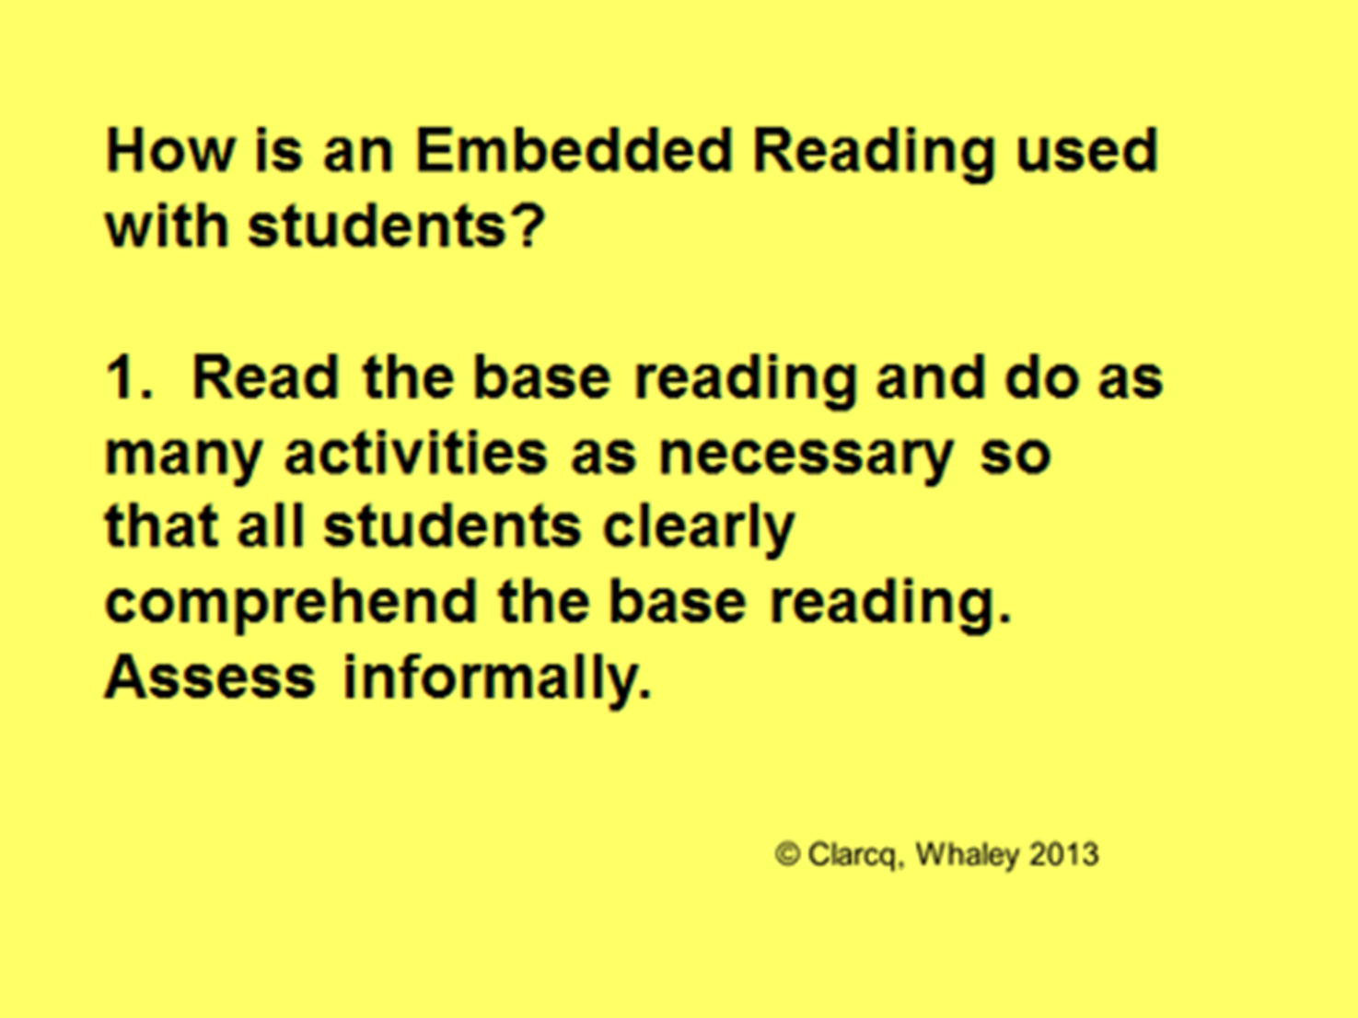

Slide 20
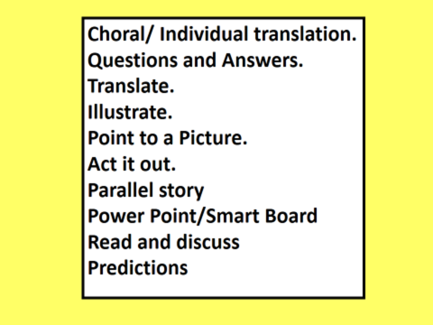

Slide 21
presentation

Slide 22
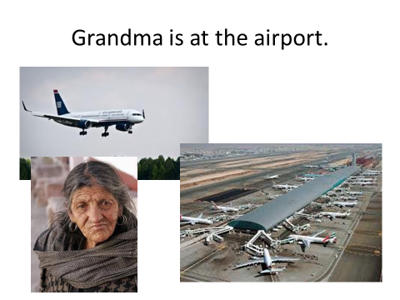
Powerpoint example
© Clarcq, Whaley 2014

Slide 23
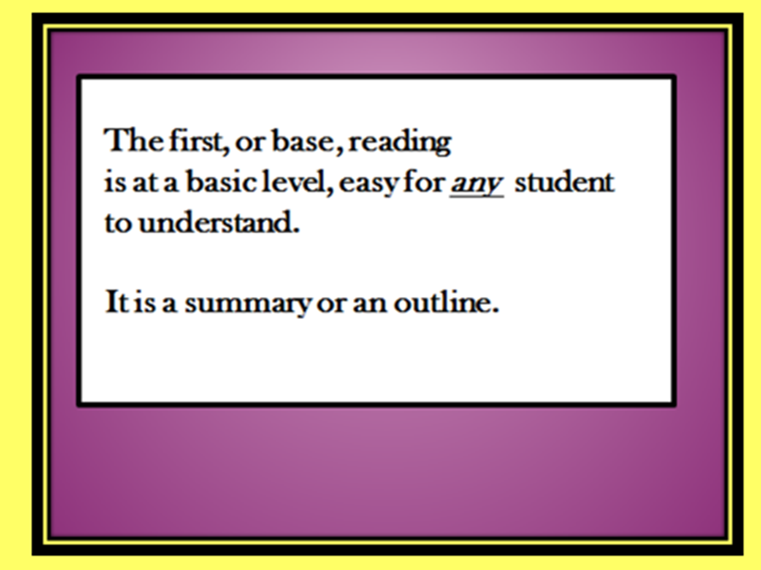
a base story
© Clarcq, Whaley 2014

Slide 24
from
Luis et Steve ad Sea World iter fecerunt. Luis et Steve cum feminis convivari volebant! cum ad Sea World pervenissent, dixerunt, “Woo-woo!” hoc dixerunt quod multas feminas viderunt! tum, Luis et Steve Tactical-Monopoly-Supreme cum feminis ludere coeperunt.
From www.embeddedreading.com

Slide 25
Luis et Steve ad Sea World iter fecerunt. Luis et Steve cum
feminis convivari volebant! cum ad Sea World pervenissent,
dixerunt, “Woo-woo!” hoc dixerunt quod multas feminas
viderunt! tum, Luis et Steve Tactical-Monopoly-Supreme
cum feminis ludere coeperunt.
From www.embeddedreading.com

Slide 26
A variety of presentation modes with
one reading!!
Pre-teach with a song: projected
Ask and act a story: read from paper
Create a second version with class: screen
© Clarcq, Whaley 2014

Slide 27
Michele’s picture side

Slide 28
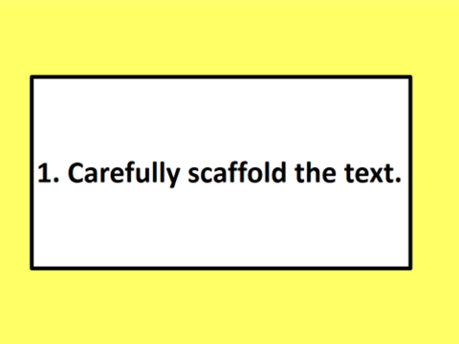
© Clarcq, Whaley 2014

Slide 29
Dave wanted to teach and went to TeachersRUs
University to study. It’s a unique university. Now Dave
is a teacher. He decided to try to find a unique job. Dave
thought that he wanted to teach in an important university
in London, England. But, he found a job someplace else.
© Clarcq, Whaley 2014

Slide 30
When? today, on Friday, last year, next summer
How? very, quickly, easily, on a train, nervously
Which (one)? blue, favorite, this/that, the best
How often? always, never, six times, every day
Common phrases: all of a sudden, next, well…
Dialogue: said “…” thought “….”
Questions: What happened next?
Additional verb: discovered/saw/realized that
© Clarcq, Whaley 2014

Slide 31
Hints:
Change the first line of the reading.
Create a hook at the end.
But (the character) did/found/saw something else.
went somewhere else.
saw/danced with someone else.
But (the character) was determined/convinced/sure that _______.
But nothing in life is easy so….
Believe it or not…..
The door opened and……
© Clarcq, Whaley 2014

Slide 32
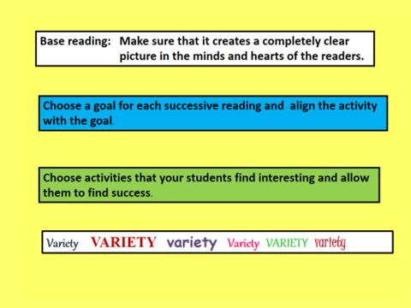
© Clarcq, Whaley 2014

Slide 33

© Clarcq, Whaley 2014

Slide 34
Activities:
Translate
Read and discuss
Read and draw
Read and act
Read and discuss
Read and predict
Read and….you choose what works with your students!!
© Clarcq, Whaley 2014

Slide 35
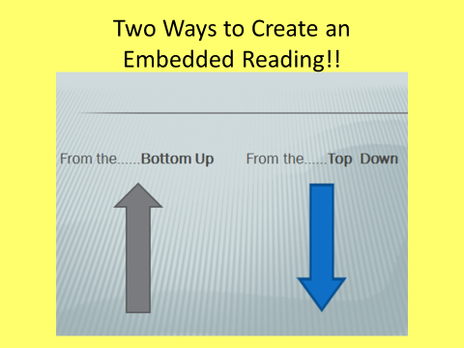

Slide 36
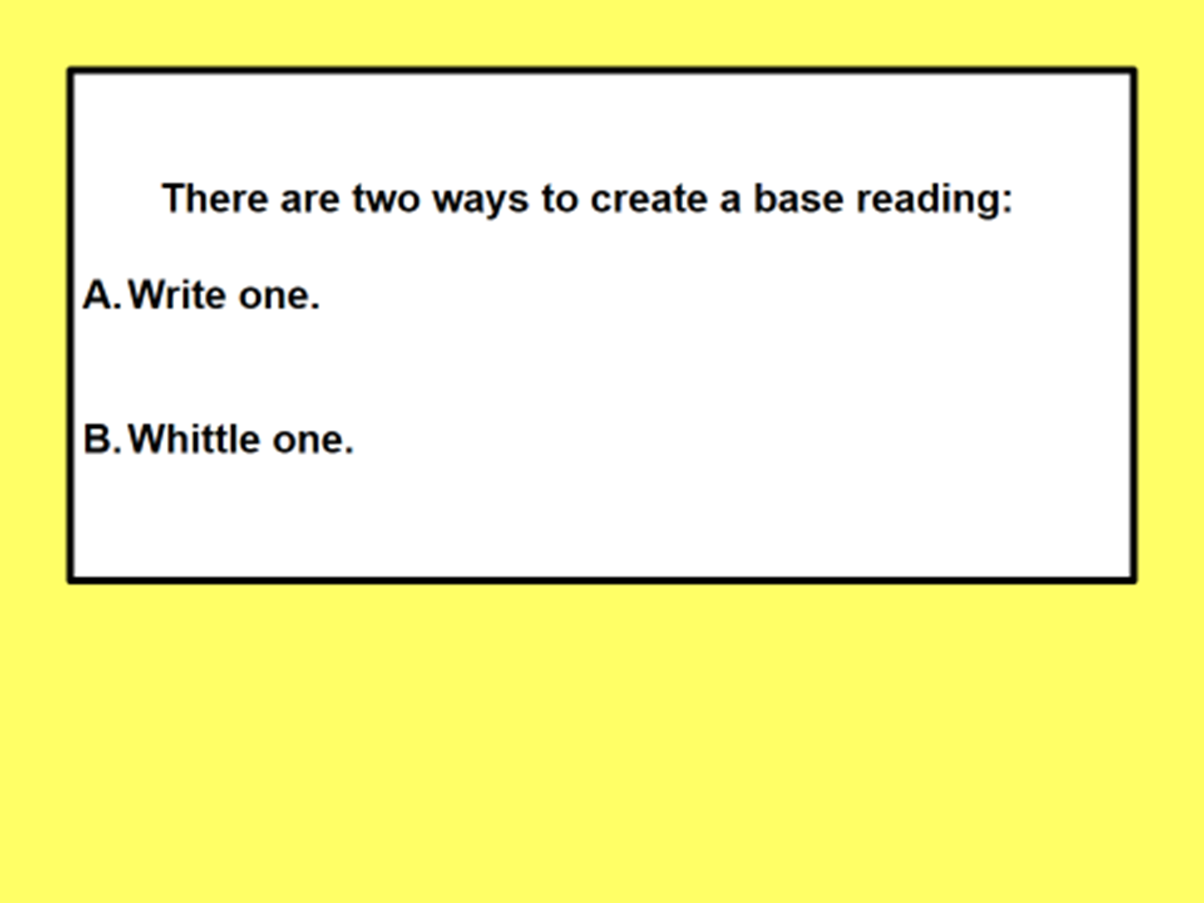
© Clarcq, Whaley 2014

Slide 37
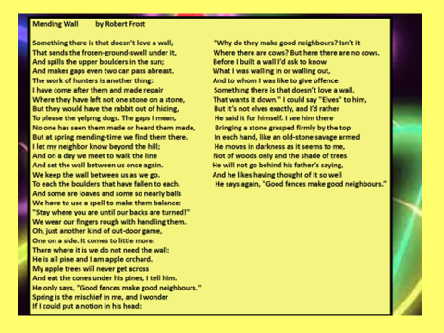

Slide 38


Slide 40
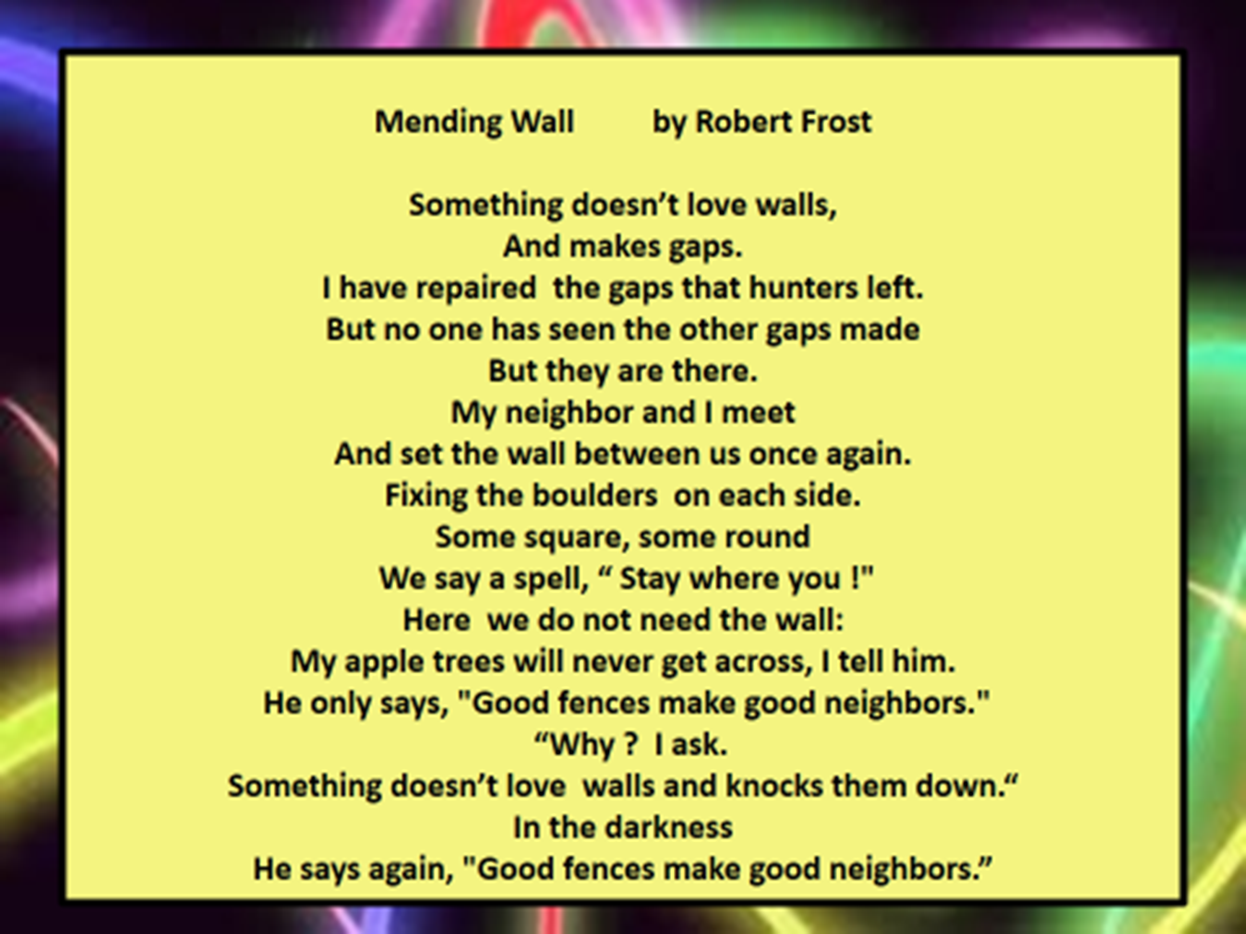

Slide 41


Slide 43
Practice

Slide 44
Do you….?
Can you…?
Could you…?
Should you…?

Slide 45
Yes!! If it benefits your students!!

