Slide 1
Embedded Reading
Part deux
Laurie Clarcq
lclarcq@yahoo.org
© Clarcq, Whaley 2014

Slide 2
The purpose of language
used in communication
is to put a picture
in the heart, and/or mind
of another person.
© Clarcq, Whaley 2014

Slide 3
Questions:
1. How do I Choose Structures?

Slide 4
The teacher chooses
the target structures.
© Clarcq, Whaley 2014

Slide 5
How to choose structures
Where do I find structures?
target structures from curriculum
target structures from upcoming novel/story/song/etc.
late-acquired structures
What kind of structures are useful?
verbs/verb phrases
adverbial phrases
prepositional phrases
© Clarcq, Whaley 2014

Slide 6


Chosen
vocabulary
Chosen
grammar
Historical background
Cultural
connections
“Traditional” Planning

Slide 7
Interactive Activity
(i.e.written story)
Structures
Responses
Facts
Understandings
Goal
Backwards
Planning

Slide 8
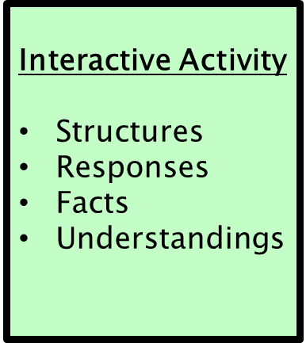




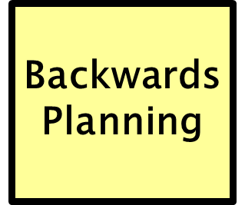
Goal
Goal
Interactive Activity
Structures
Responses
Facts
Understandings

Slide 9
Interaction-based Activities
Oral Stories
Co-created stories
Legends/Myths
Conversations
Calendar
Current events
Topic-centered
Pictures
Debates
Read/Listen and Respond
Authentic materials
Purchased materials
Teacher-created materials
Co-created materials
Student-created materials

Slide 10
Interaction-based Activities
Problem
Issue
Image

Slide 11
The purpose of language
used in communication
is to put a picture
in the heart, and/or mind
of another person.
© Clarcq, Whaley 2014

Slide 12


CATALYST
Problem
Issue
Image
Interaction-based Activities

Slide 13


Structures
Responses
Facts
Understandings
Active Listening
Active Reading
Speaking
Writing

Slide 14
Interaction-based Activities
Oral Stories
Co-created stories
Legends/Myths
Conversations
Calendar
Current events
Topic-centered
Pictures
Debates
Read/Listen and Respond
Authentic materials
Purchased materials
Teacher-created materials
Co-created materials
Student-created materials

Slide 15
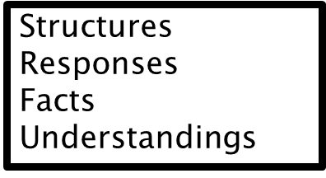
Which of these
do the students need
in order to be successful
at this activity?

Slide 16
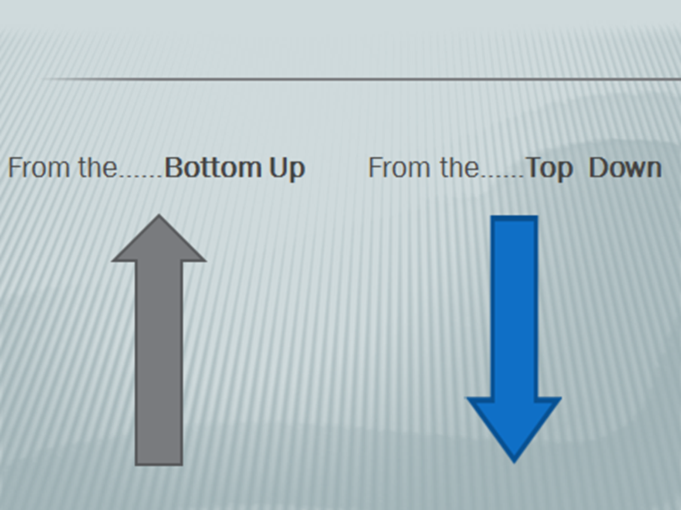

Slide 17
BOTTOM UP
2. Create a reading.
1. Choose structures.

Slide 18

BOTTOM UP
2. Choose structures.
Needs food/drink
Needs article of clothing
Needs a gift
1. Identify PROBLEM
(or ISSUE or IMAGE)

Slide 19
How to choose structures
Cause and Effect
is hungry/eats wants/looks for
has to/doesn’t want to sees/takes
© Clarcq, Whaley 2014

Slide 20
Structures to base story

Slide 21
Students create a base story with the structures
wanted to
shouldn’t
decided to

Slide 22
Students create a base story with the structures
Marquis wanted to dance.
He was too shy. He was sad.
© Clarcq, Whaley 2014

Slide 23
Marquis wanted to dance.
He was too shy. He was sad.
At Homecoming, Marquis wanted to
dance. He was too shy. He wanted to run.
The teacher said that he shouldn’t run. He
decided to dance, but he was too shy. He was
sad.
© Clarcq, Whaley 2014

Slide 24
Students create a base story with the structures
Get to know the “hot” topics from students.
Be prepared to change course.
Don’t use everything.
File good ideas away for later.
© Clarcq, Whaley 2014

Slide 25
Students create a base story with the structures
Students write a base story (3-5 sentences)
* for homework
* at the end of class
* on Edmodo
© Clarcq, Whaley 2014

Slide 26
Teacher creates a base story with the structures
1. beginning, middle, end
2. character, setting, problem/situation
3. uses target structures
© Clarcq, Whaley 2014

Slide 27
Teacher creates a base story with the structures
wanted to
decided to

Slide 28
creating new versions
Dave is a teacher. He decided to try to find
a job. Dave wanted to teach in an important
university. He found a job.
© Clarcq, Whaley 2014

Slide 29
Teacher creates a base story with the structures
wanted to
decided to

Slide 30
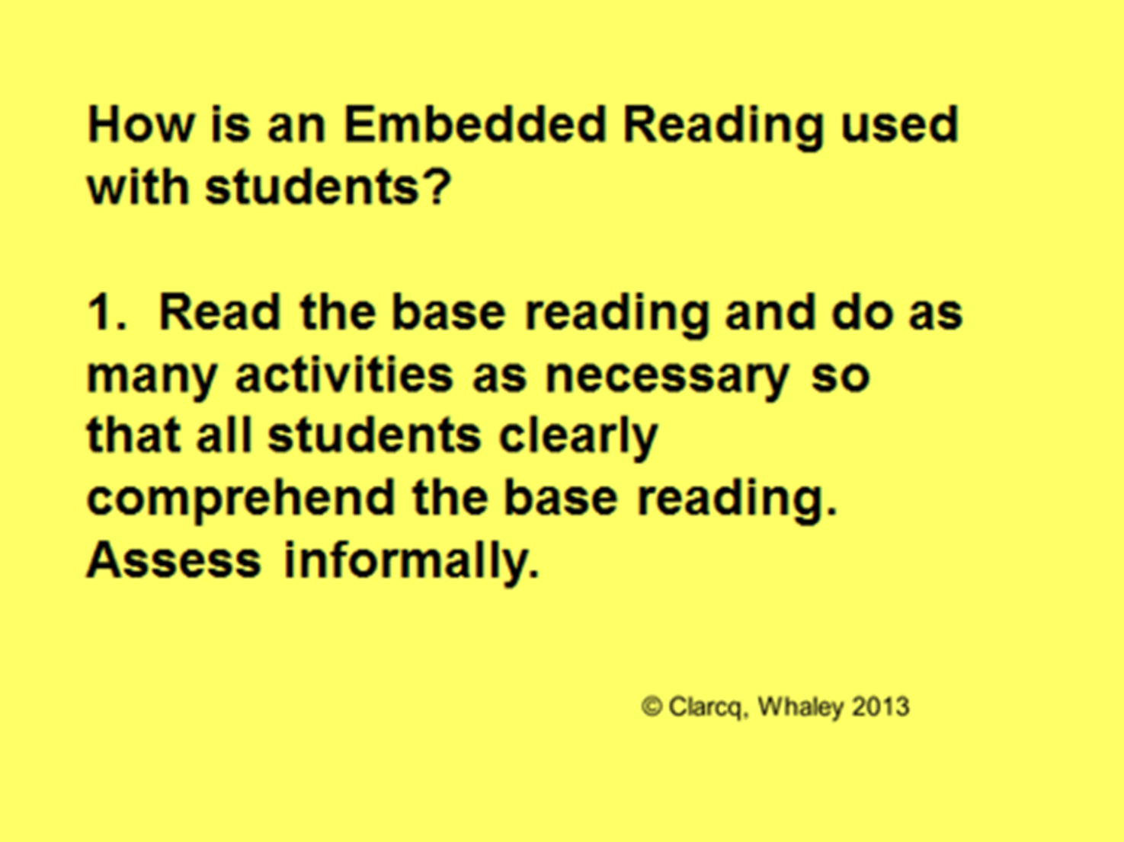

Slide 31
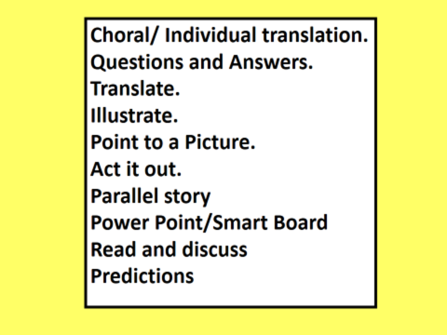

Slide 32
Question #2:
How do I use/present the readings?

Slide 33
A variety of presentation modes with
one reading!!
Pre-teach with a song: projected
Ask and act a story: read from paper
Create a second version with class: screen
© Clarcq, Whaley 2014

Slide 34
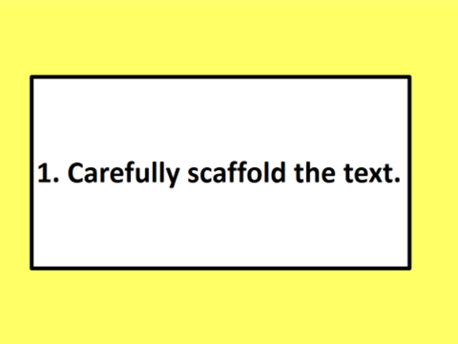
© Clarcq, Whaley 2014

Slide 35
Dave wanted to teach and went to TeachersRUs
University to study. It’s a unique university. Now Dave
is a teacher. He decided to try to find a unique job. Dave
thought that he wanted to teach in an important university
in London, England. But, he found a job someplace else.
© Clarcq, Whaley 2014

Slide 36

© Clarcq, Whaley 2014

Slide 37
Then use the next reading!!
Question #3+: When do I create the readings….all at once?
Can I create some levels with the students?
Could I create the next reading after I use the first
one so that I better know how to level up the text?
ANSWER: YES… IF IT BENEFITS YOUR STUDENTS!!
© Clarcq, Whaley 2014

Slide 38
HELPFUL PHRASES FOR “LEVELING UP”
When? today, on Friday, last year, next summer
How? very, quickly, easily, on a train, nervously
Which (one)? blue, favorite, this/that, the best
How often? always, never, six times, every day
Common phrases: all of a sudden, next, well…
Dialogue: said “…” thought “….”
Questions: What happened next?
Additional verb: discovered/saw/realized that
© Clarcq, Whaley 2014

Slide 39
Hints:
Change the first line of the reading.
Create a hook at the end.
But (the character) did/found/saw something else.
went somewhere else.
saw/danced with someone else.
But (the character) was determined/convinced/sure that _______.
But nothing in life is easy so….
Believe it or not…..
The door opened and……
© Clarcq, Whaley 2014

Slide 40
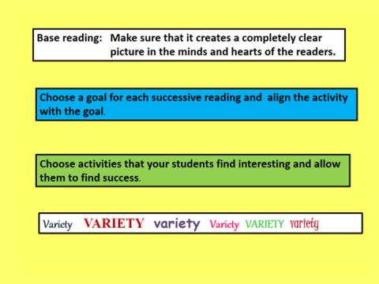
© Clarcq, Whaley 2014

Slide 41
Activities:
Translate
Read and discuss
Read and draw
Read and act
Read and discuss
Read and predict
Read and….you choose what works with your students!!
© Clarcq, Whaley 2014

Slide 42
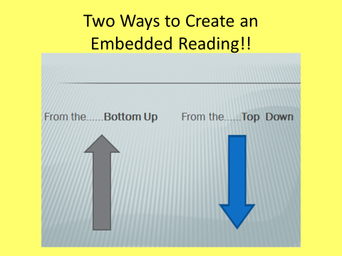

Slide 43
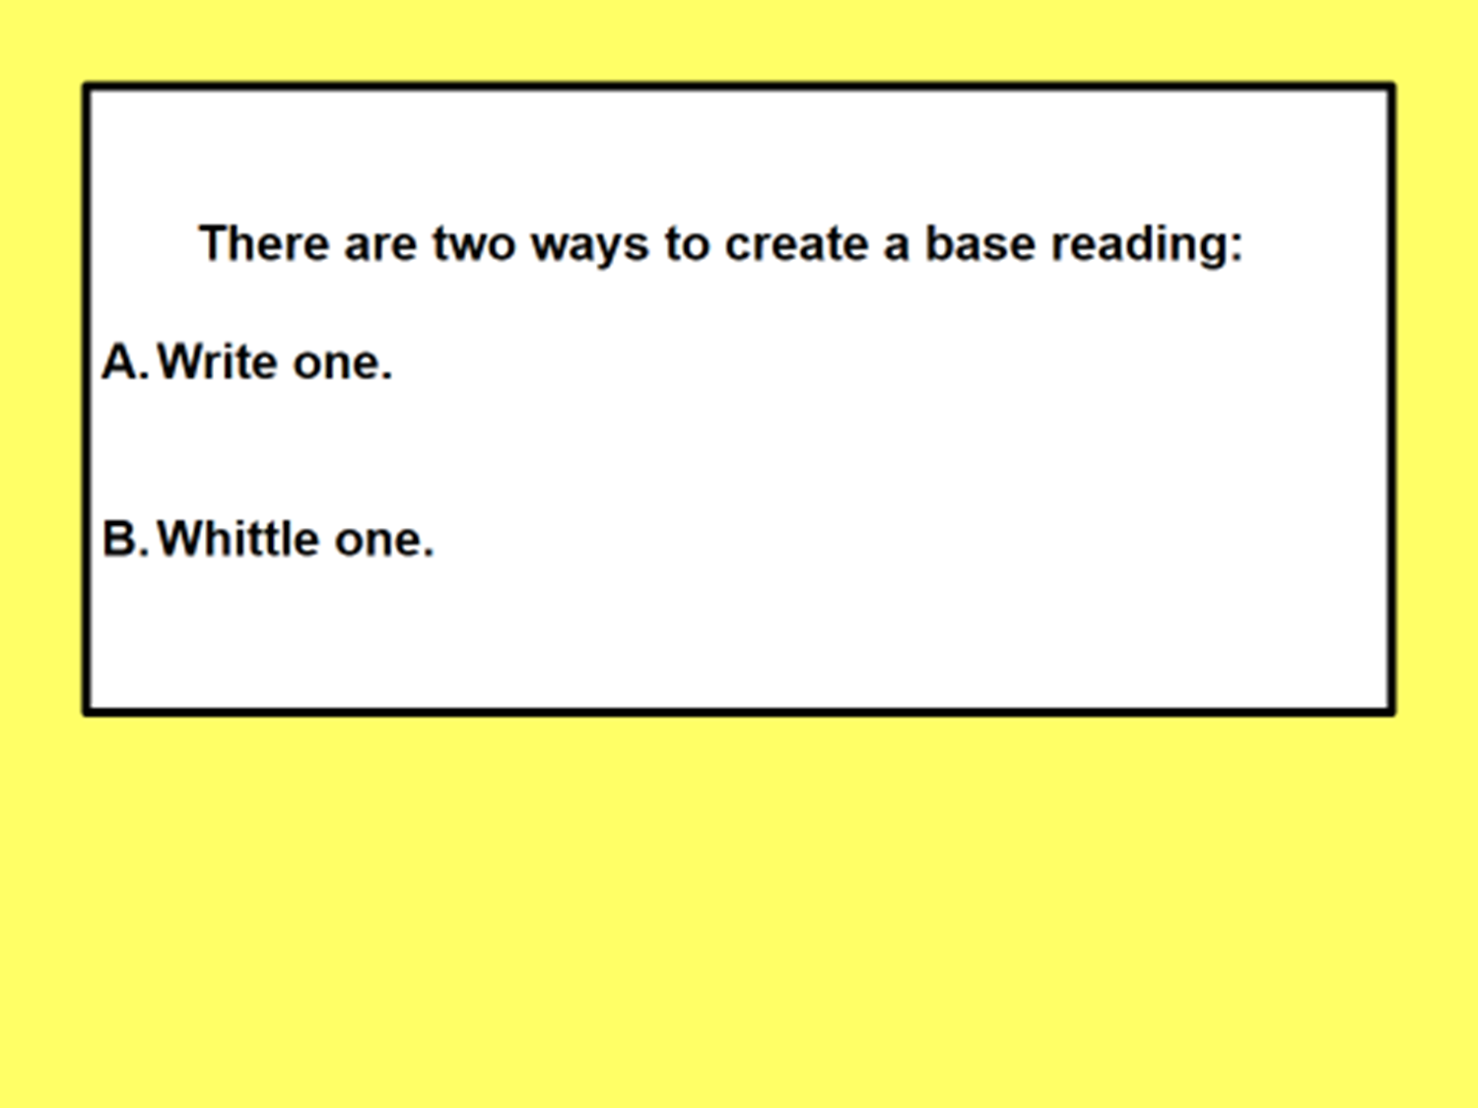
© Clarcq, Whaley 2014

Slide 44
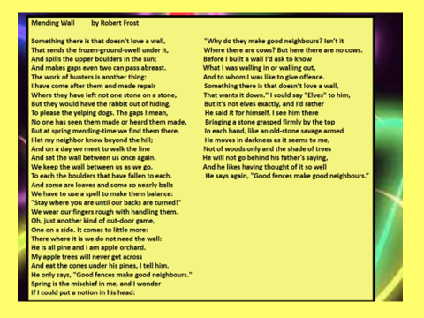

Slide 45
IF POSSIBLE….
Identify what you would like the base reading to be.
You may adjust it…but it is so helpful to have an
idea of where you want to end up.
© Clarcq, Whaley 2014

Slide 46
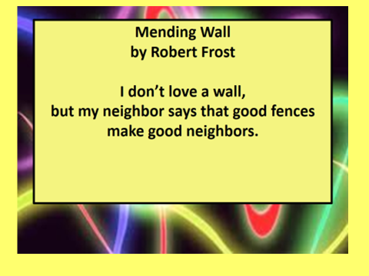

Slide 47
Then go back to the original
Copy and Paste
And remove ¼ of the new version!!
Copy, Paste, Repeat
Until you get to your base reading!!
© Clarcq, Whaley 2014

Slide 49
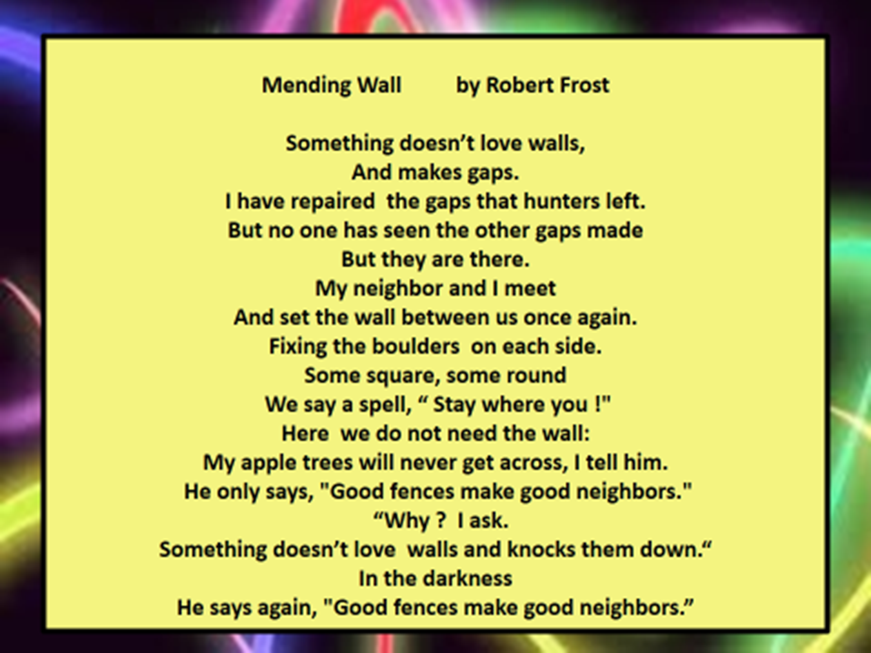

Slide 50


Slide 52
Do you….?
Can you…?
Could you…?
Should you…?

Slide 53
Yes!! If it benefits your students!!

