Slide 1

Embedded Reading
Laurie Clarcq and Michele Whaley
www.EmbeddedReading.com
lclarcq@yahoo.com

Slide 2

The purpose of language
used in communication
is to put a picture
in the heart, and/or mind
of another person.

Slide 3
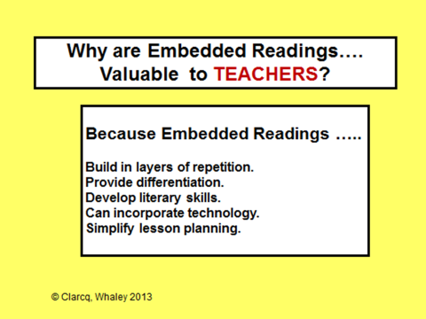
Because Embedded Readings…
Create layers of repetition.
Provide differentiation.
Develop literacy skills.
Can incorporate technology.
Simplify lesson planning.

Slide 4
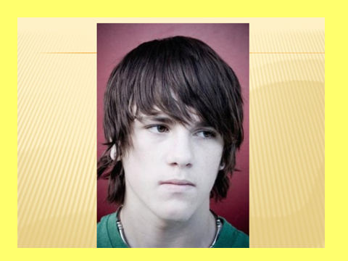

Slide 5
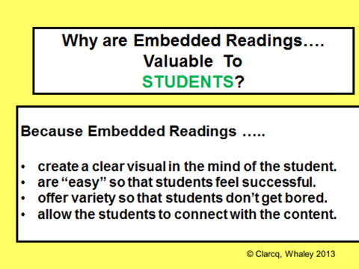

Slide 6
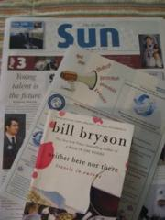

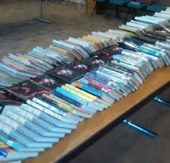
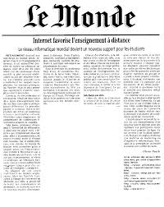
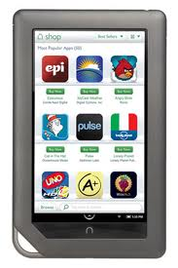
Any text can be used to create an Embedded Reading: Articles, Books, Stories, Poetry, Editorials, Poems, Conversations, Songs etc….

Slide 7
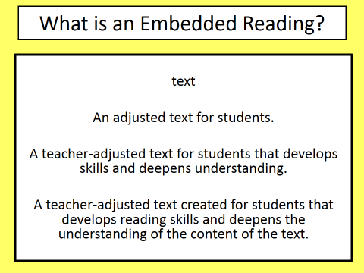

Slide 8
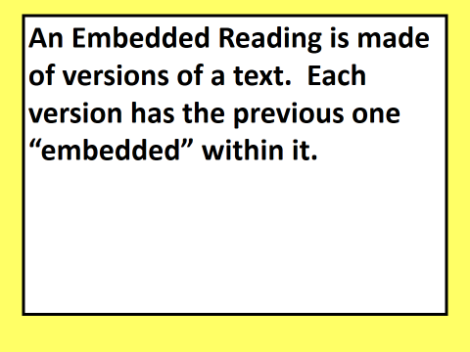

Slide 9
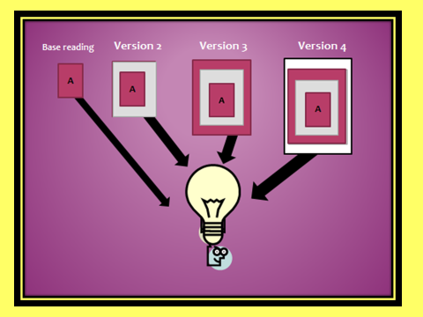

Slide 10
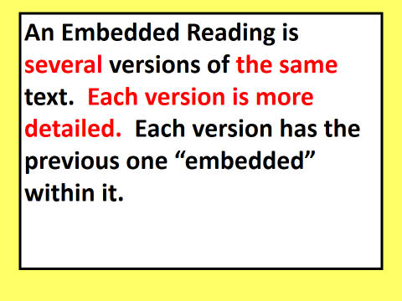

Slide 11
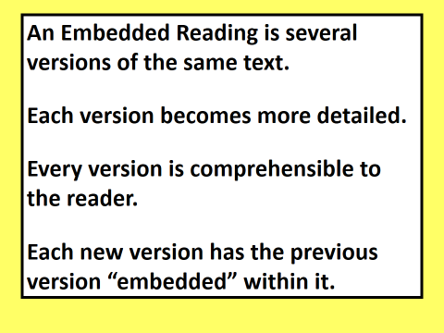

Slide 12
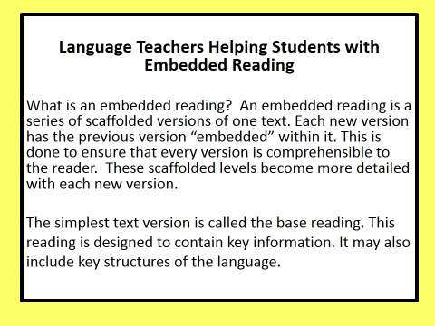

Slide 13
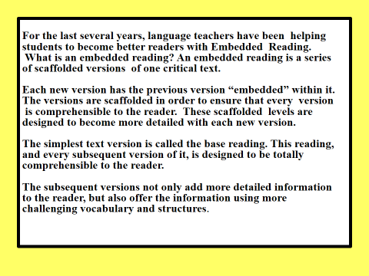

Slide 14
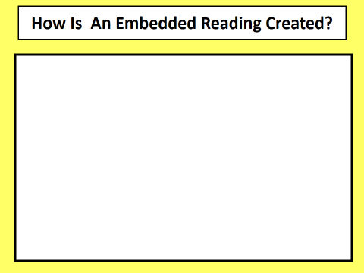
1. By creating a base reading and adding
details and information to create
additional versions.
2. Pulling details and information out of a
longer reading to create shorter, simpler
versions.

Slide 15
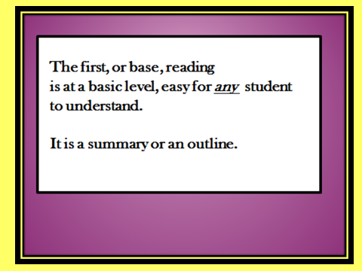

Slide 16
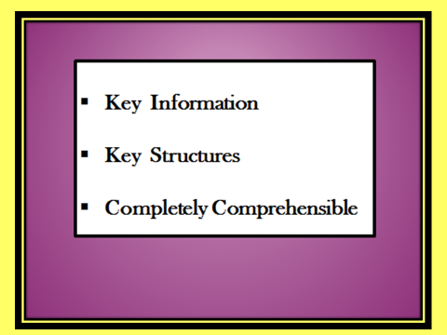

Slide 17
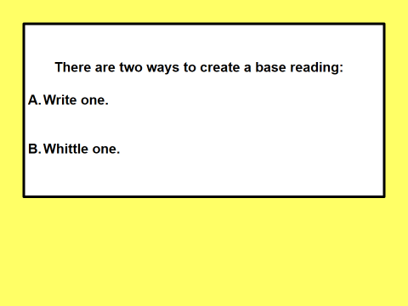

Slide 18
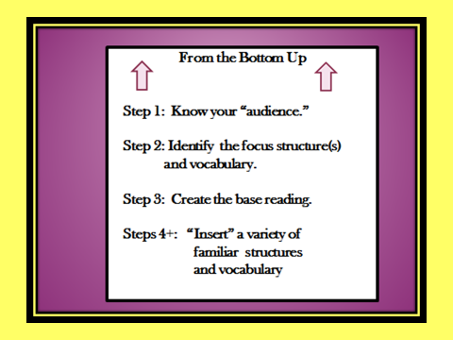

Slide 19
Audience: Teachers Learning About Embedded Reading

Slide 20
Audience: Teachers Learning About Embedded Reading
Structures: wanted to teach
decided to try to

Slide 21
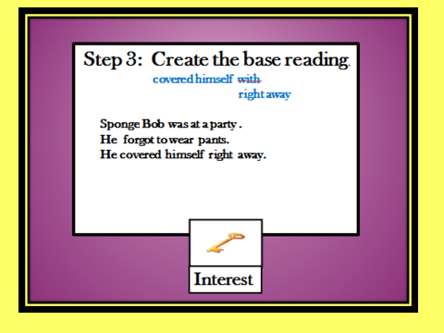

Slide 22
Audience: Teachers Learning About Embedded Reading
Dave is a teacher. He decided to try to
find a job. Dave wanted to teach in an
important university. He found a job.

Slide 23
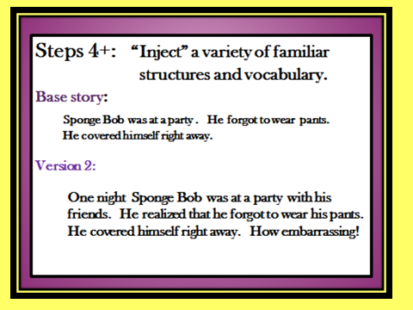
Dave is a teacher. He decided to try to find a job.
Dave wanted to teach in an important university.
He found a job.
Dave wanted to teach and went to TeachersRUs
University to study. It’s a unique university. Now Dave
is a teacher. He decided to try to find a unique job. Dave
thought that he wanted to teach in an important university
in London, England. But, he found a job someplace else.

Slide 24

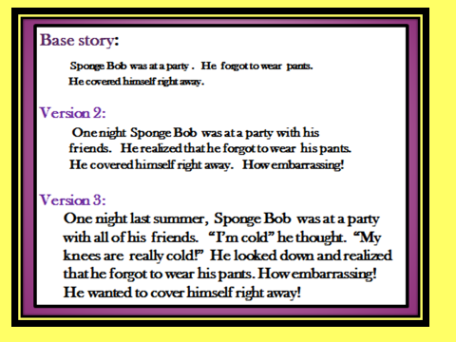
Add words / phrases / structures from the following slide to the second level to create the third level!!
Dave wanted to teach and went to TeachersRUs University to study. It’s a unique university. Now Dave is a teacher. He decided to try to find a unique job. Dave thought that he wanted to teach in an important university in London, England. But, he found a job someplace else.

Slide 25
Step 4: Ideas
When? today, on Friday, last year, next summer
How? very, quickly, easily, on a train, nervously
Which (one)? blue, favorite, this/that, the best
How often? always, never, six times, every day
Common phrases: all of a sudden, next, well…
Dialogue: said “…” thought “….”
Questions: What happened next?
Additional verb: discovered/saw/realized that

Slide 26
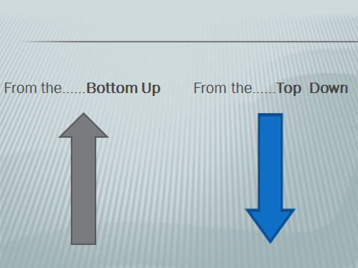
Two Ways to Create an
Embedded Reading!!

Slide 27
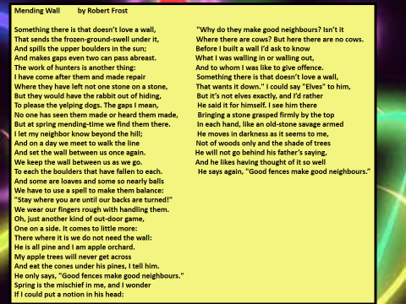

Slide 28
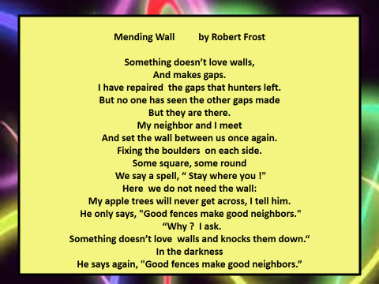

Slide 29
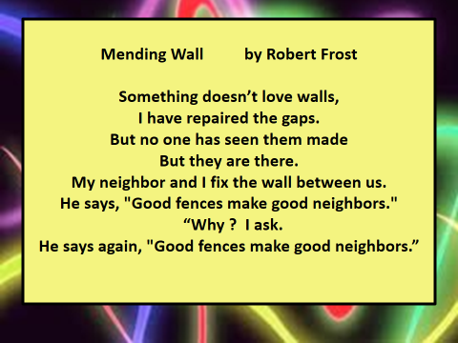

Slide 30
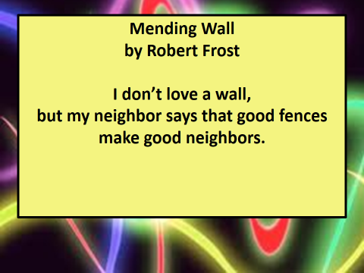

Slide 31
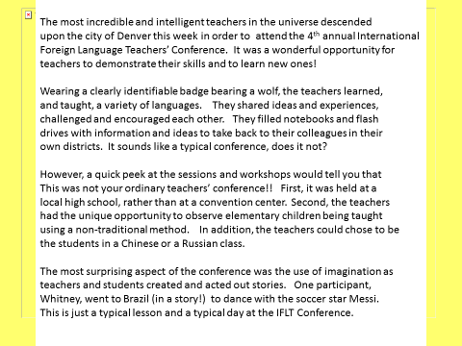

Slide 32
Step 1
Identify the most important part of the text, the
Part that will serve as the base story/reading.

Slide 33
Step 2
Go back to the original, copy and paste it.
Pull out approximately ¼ of it. Take out some
difficult words/phrases and some less-challenging ones.

Slide 34
The most incredible and intelligent teachers in the universe descended
upon the city of Denver this week in order to attend the 4th annual International
Foreign Language Teachers’ Conference. It was a wonderful opportunity for
teachers to demonstrate their skills and to learn new ones!
Wearing a clearly identifiable badge bearing a wolf, the teachers learned,
and taught, a variety of languages. They shared ideas and experiences,
challenged and encouraged each other. They filled notebooks and flash
drives with information and ideas to take back to their colleagues in their
own districts. It sounds like a typical conference, does it not?
However, a quick peek at the sessions and workshops would tell you that
This was not your ordinary teachers’ conference!! First, it was held at a
local high school, rather than at a convention center. Second, the teachers
had the unique opportunity to observe elementary children being taught
using a non-traditional method. In addition, the teachers could chose to be
the students in a Chinese or a Russian class.
The most surprising aspect of the conference was the use of imagination as
teachers and students created and acted out stories. One participant,
Whitney, went to Brazil (in a story!) to dance with the soccer star Messi.
This is just a typical lesson and a typical day at the IFLT Conference.

Slide 35
Step 3
Copy and paste the new version of the text and
repeat the process!

Slide 36
Step 4
Repeat!!

Slide 37
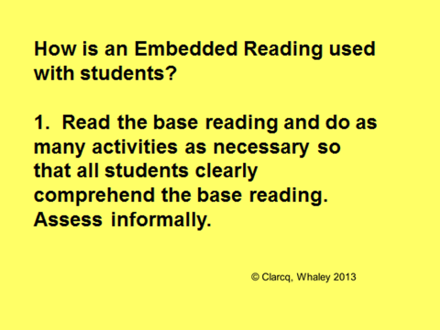

Slide 39
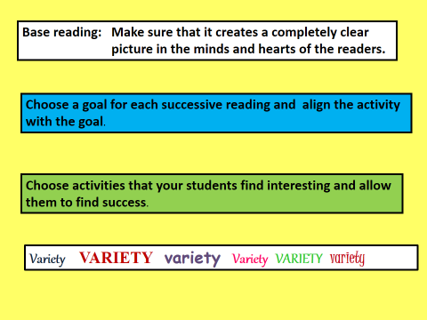

Slide 41
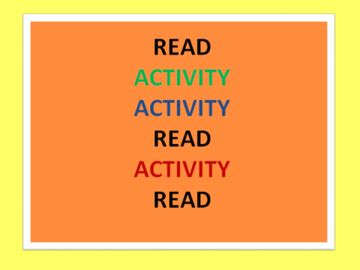

Slide 44
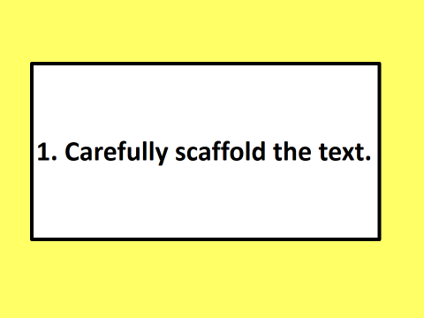

Slide 45
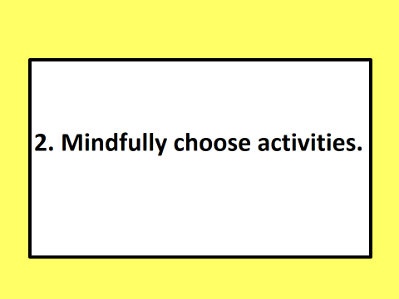

Slide 46
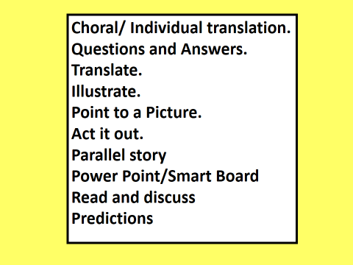

Slide 47
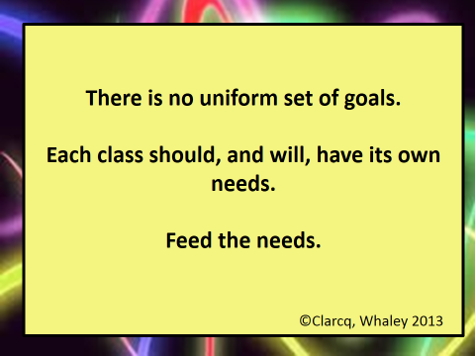

Slide 48
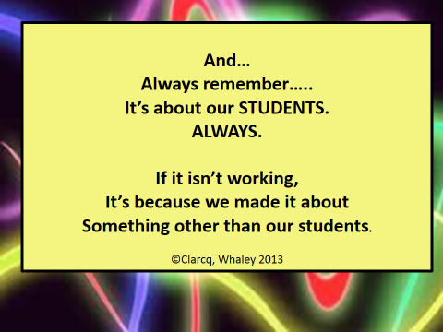

Slide 49


