Slide 1
VFLA 2017
Laurie Clarcq
www.heartsforteaching.com
www.embeddedreading.com
lclarcq@yahoo.com

Slide 2
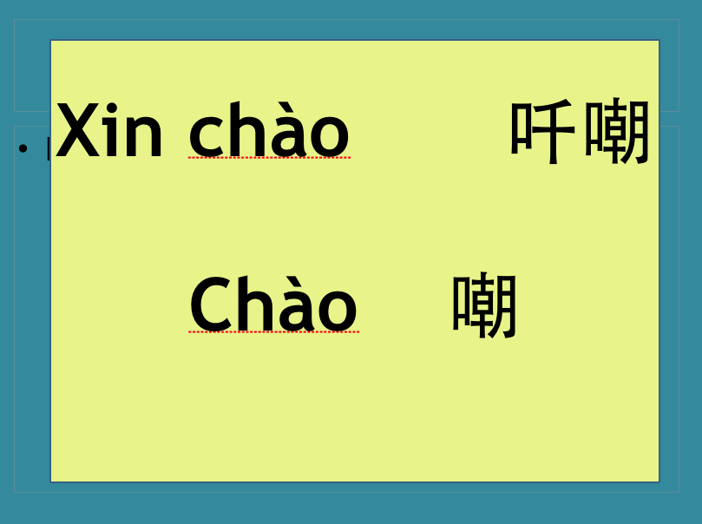

Slide 3
The purpose of language
As used in communication
Is to put a picture
From one heart, and/or mind,
Into another.
L. Clarcq
Notes:
Picks from kids????

Slide 4

Notes:
Focus the picture...or see a part/whole of the picture

Slide 5
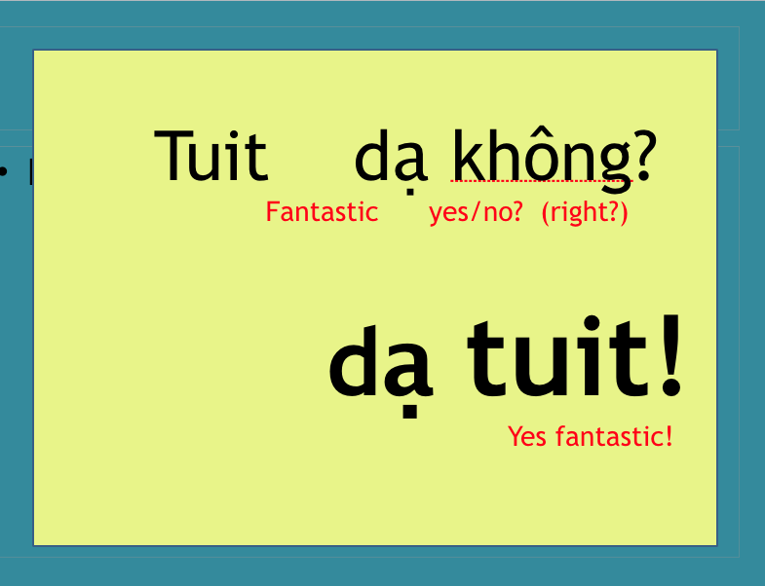

Slide 6
Define TPRS®
Teaching Proficiency through Reading and Story”telling”.

Slide 7
TPRS®
Approach?
Method?
Technique?
Tool?
Trick question?

Slide 8
TPRS®

Slide 9
TPRS®
“Definition”

Slide 10
Notes:
Focus the picture...or see a part/whole of the picture

Slide 11
“Definition”: A way to approach interaction in the language classroom.
Goal: Increase students’ ability to COMMUNICATE
Using: Interactive Input-based Activities
Based on: Dr. Krashen’s Hypotheses

Slide 12
www.sdkrashen.com
the Acquisition-Learning hypothesis
the Monitor hypothesis
the Natural Order hypothesis
the Input hypothesis
the Affective Filter hypothesis
the Reading Hypothesis

Slide 13
Language Acquisition
provides a better base for communication than
Language Learning.
Subconscious Brain at Work
Less affected by the Affective Filter
© L.Clarcq 2017

Slide 14
Comprehended Input
creates and grows language in the brain..
Layers of Comprehended Input provide
a language base for the brain.
© L.Clarcq 2017

Slide 15
TPRS®
Three __________
© L.Clarcq 2017

Slide 16
Ways to Provide Comprehensible Input
Three Steps of TPRS®

Slide 17
Ways to Provide Comprehensible Input
Three of TPRS®
© L.Clarcq 2017

Slide 18
Ways to Provide Comprehensible Input
Three Elements of TPRS®
© L.Clarcq 2017

Slide 19
Three Elements of TPRS®
Three Elements of TPRS®
Identify meaning.
Interact via a Storyline.
Read.
© L.Clarcq 2017

Slide 20
Ways to Provide Comprehensible Input
Use the Elements in an interactive activity:
Discussions about an interesting topic
Story-asking
Storytelling/Storylistening
Picture Talk/Movie Talk
Discussing any kind of reading
Etc.!! © L.Clarcq 2017

Slide 21
TPRS®
Student Success
© L.Clarcq 2017

Slide 22
Student Success=Increased Proficiency
Who are the students?
What is their present proficiency level?
What kind of input are they successful with?
Where are their strengths?
How are they going to interact with the input?
How and How often do I need to check for comprehension?
© L.Clarcq 2017

Slide 23
Questions to ask about the instruction:
1. Is the goal to increase students’ ability to COMMUNICATE?
2. Does it incorporate interactive Input-based activities?
3. Is it based on Krashen’s Hypotheses?
4. Does the teacher check for comprehension?
5. Does it include the three Elements of TPRS®?
Is it created for students’ success?
© L.Clarcq 2017

Slide 24
TPRS®
Storyline
© L.Clarcq 2017

Slide 25
7.
Is the student focus
on the storyline?
© L.Clarcq 2017

Slide 26
What a Demo is
and is not….

Slide 27
A Demo is NOT an example of a lesson.
It is more like a scrapbook of things that can happen as part of instruction over the course of days, or even weeks.
It is condensed so that participants can become familiar with, in a short period of time, what a student in a TPRS® classroom experiences over a longer period of time.

Slide 28
A Demo is NOT a training.
I do not participants expect to be able to plan, construct, or deliver a TPRS® lesson after participating in a demo.

Slide 29
Demo+Training Student brain+Teacher brain
(Clarcq’s) Stages of Comprehension
Interact in Vietnamese
(Focus: Create a Base Using Input)

Slide 32
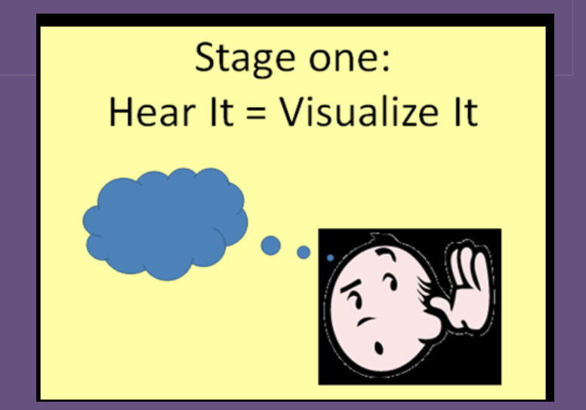

Slide 33
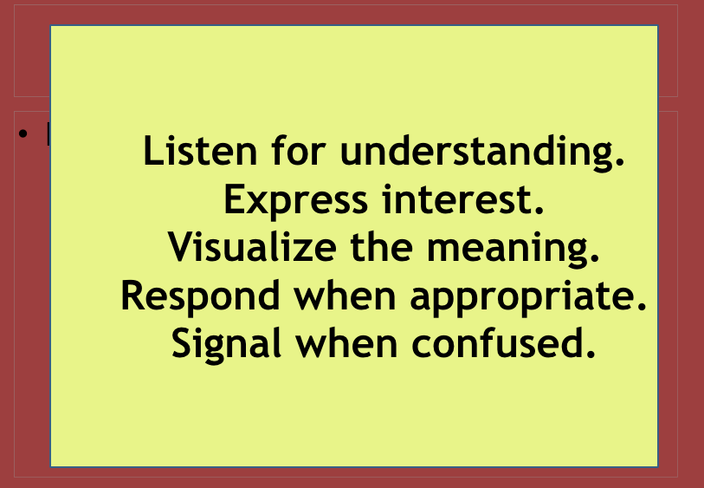

Slide 34
Visualize this:

Slide 35


Slide 36


Slide 37
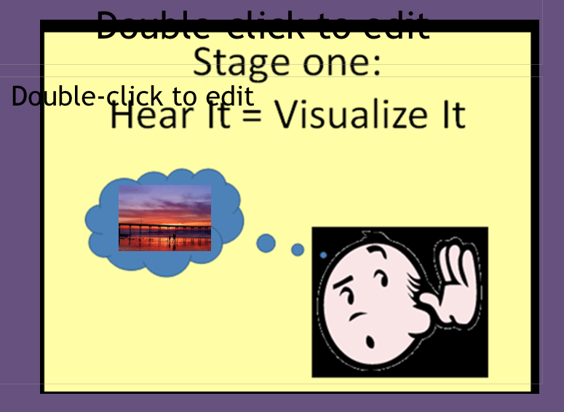

Slide 38


Slide 39


Slide 40


Slide 41
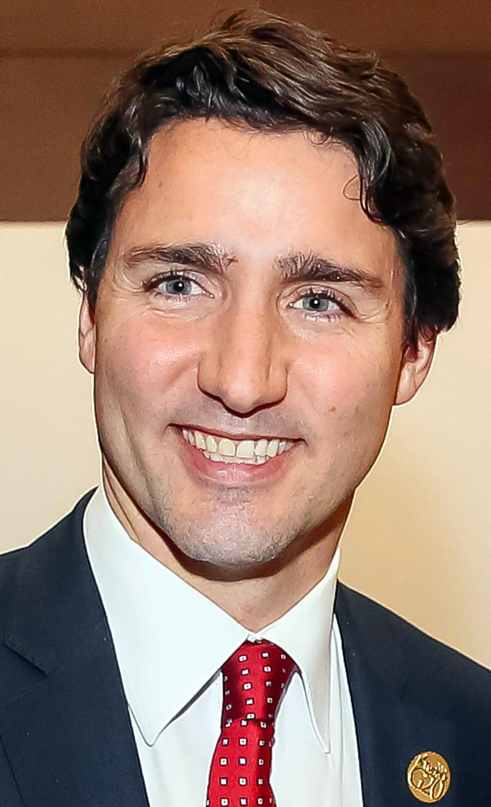

Slide 42


Slide 43
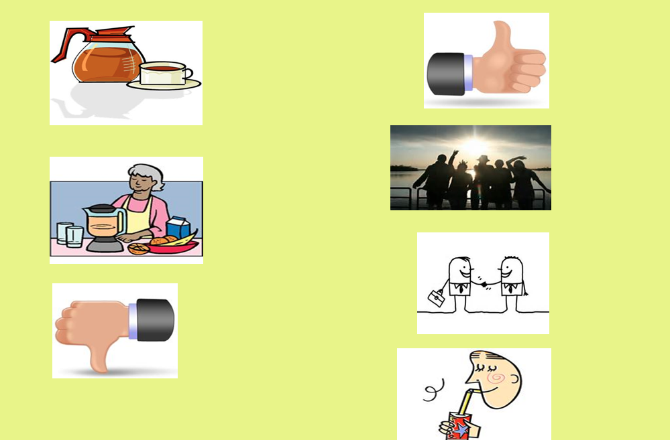

Slide 44
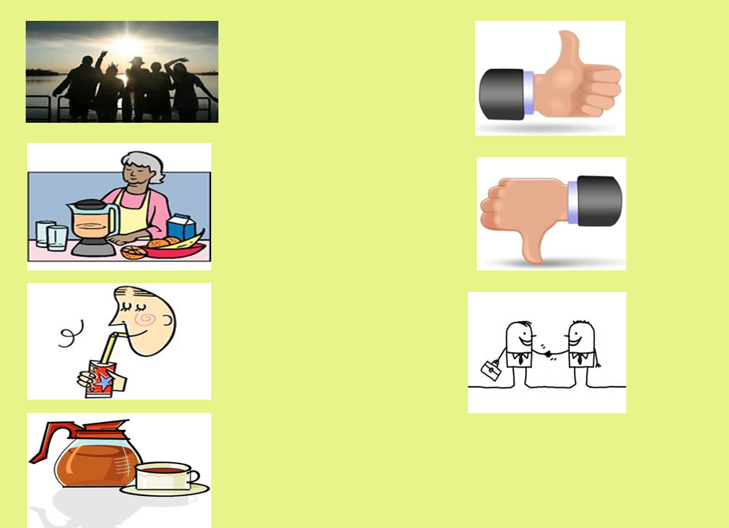

Slide 45
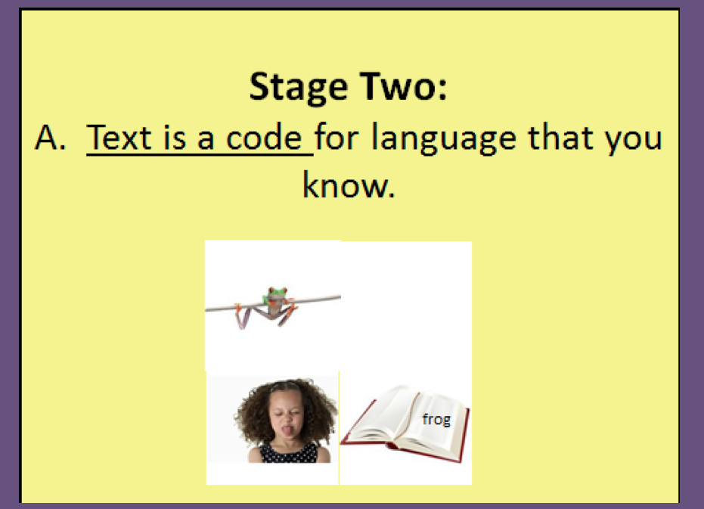

Slide 46
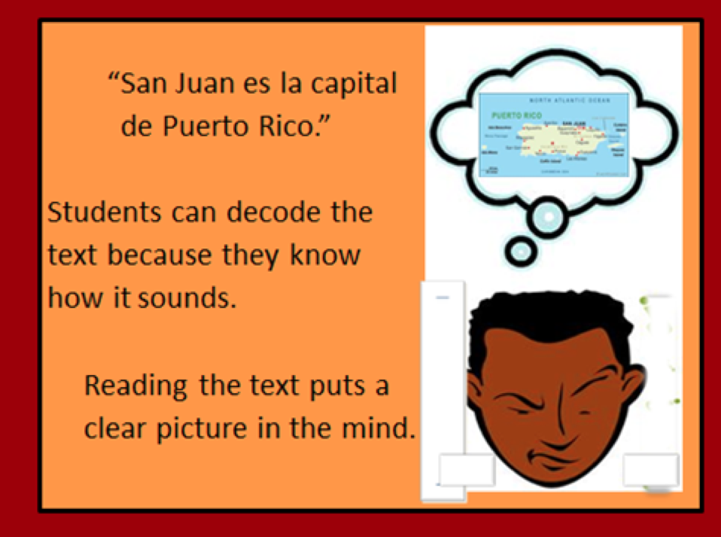

Slide 47


Slide 48


Slide 49


Slide 50
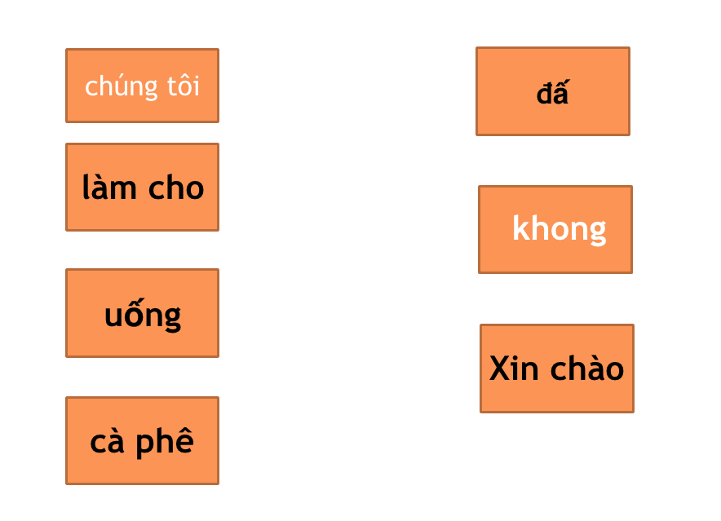

Slide 52


Slide 53
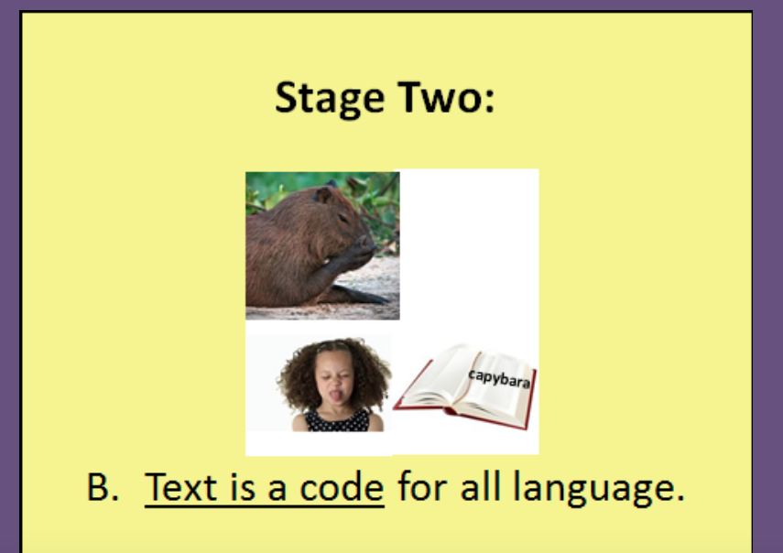

Slide 54
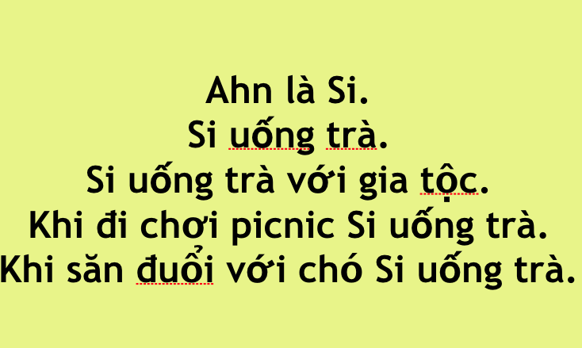

Slide 56
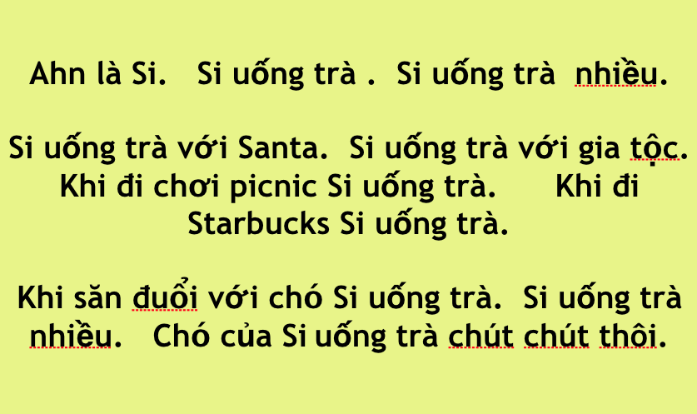

Slide 57
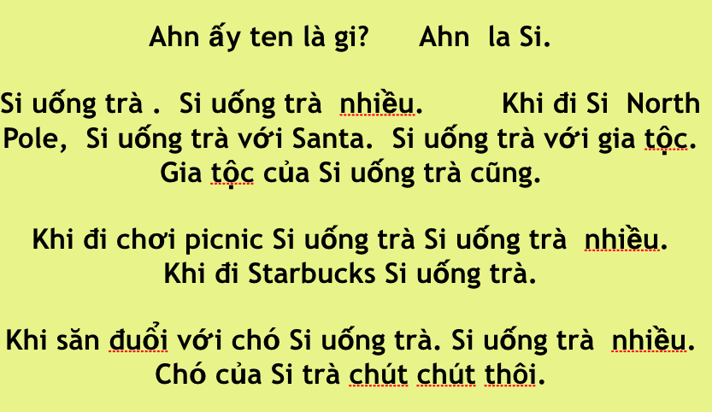

Slide 58
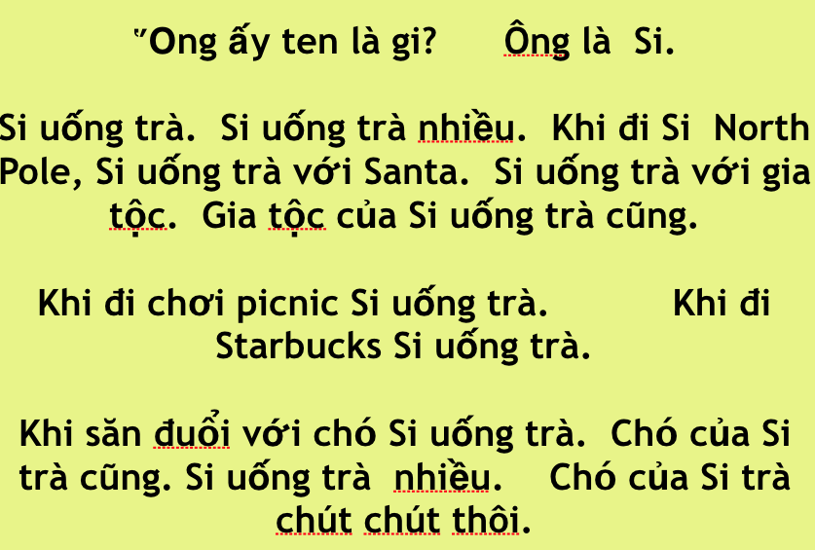

Slide 59
What kinds of “stories” have we seen so far?
Stories of people meeting people.
Stories of people and what they like to drink (including Justin T.!!)
Stories of people and where they get their coffee.
Stories about Si.
Coming up:
Stories about videos
Stories connected to stories about videos.
Notes:
Personal conversations stories read
Mini real stories stories written
Mini co- created stories stories from a picture

Slide 60
TPRS®
© L.Clarcq 2017

Slide 61
1. Is the goal to increase students’ ability to COMMUNICATE?
2. Does it incorporate interactive Input-based activities?
Is it based on Krashen’s Hypotheses?
4. Is the teacher checking for comprehension?
5. Does it include the three Elements of TPRS®?
6. Is it created for students’ success?
Are the students focused on the storyline?
© L.Clarcq 2017

Slide 62
If you have questions like these:
What about classes above Novice-Low?
What about using a textbook?
What about finding materials?
What other kinds of “stories” are there?
What does a class look like?

Slide 63
Or these:
How do I bridge students to/from a program that uses TPRS®?
How do I talk to administrators about it?
How do I prepare students for it?
How do I prepare myself for it?
How do I know if I am doing it right?
How do I get started?

Slide 64
You can find a schedule for numerous training opportunities here:
Http://blog.heartsforteaching.com/upcoming-tprstci-training-opportunities/
© L.Clarcq 2017

