Slide 1
Embedded Reading
Part II
IFLT17
Denver Colorado
July 2017

Slide 2
This PowerPoint is available for you to use in order to review the concepts and ideas that we shared with you in our workshop. It is also available in order to share the concept of Embedded Reading with other interested educators.
We request that you not sell this PowerPoint nor distribute it other than for the purpose for which it was intended.
Thank you, Laurie and Michele

Slide 3

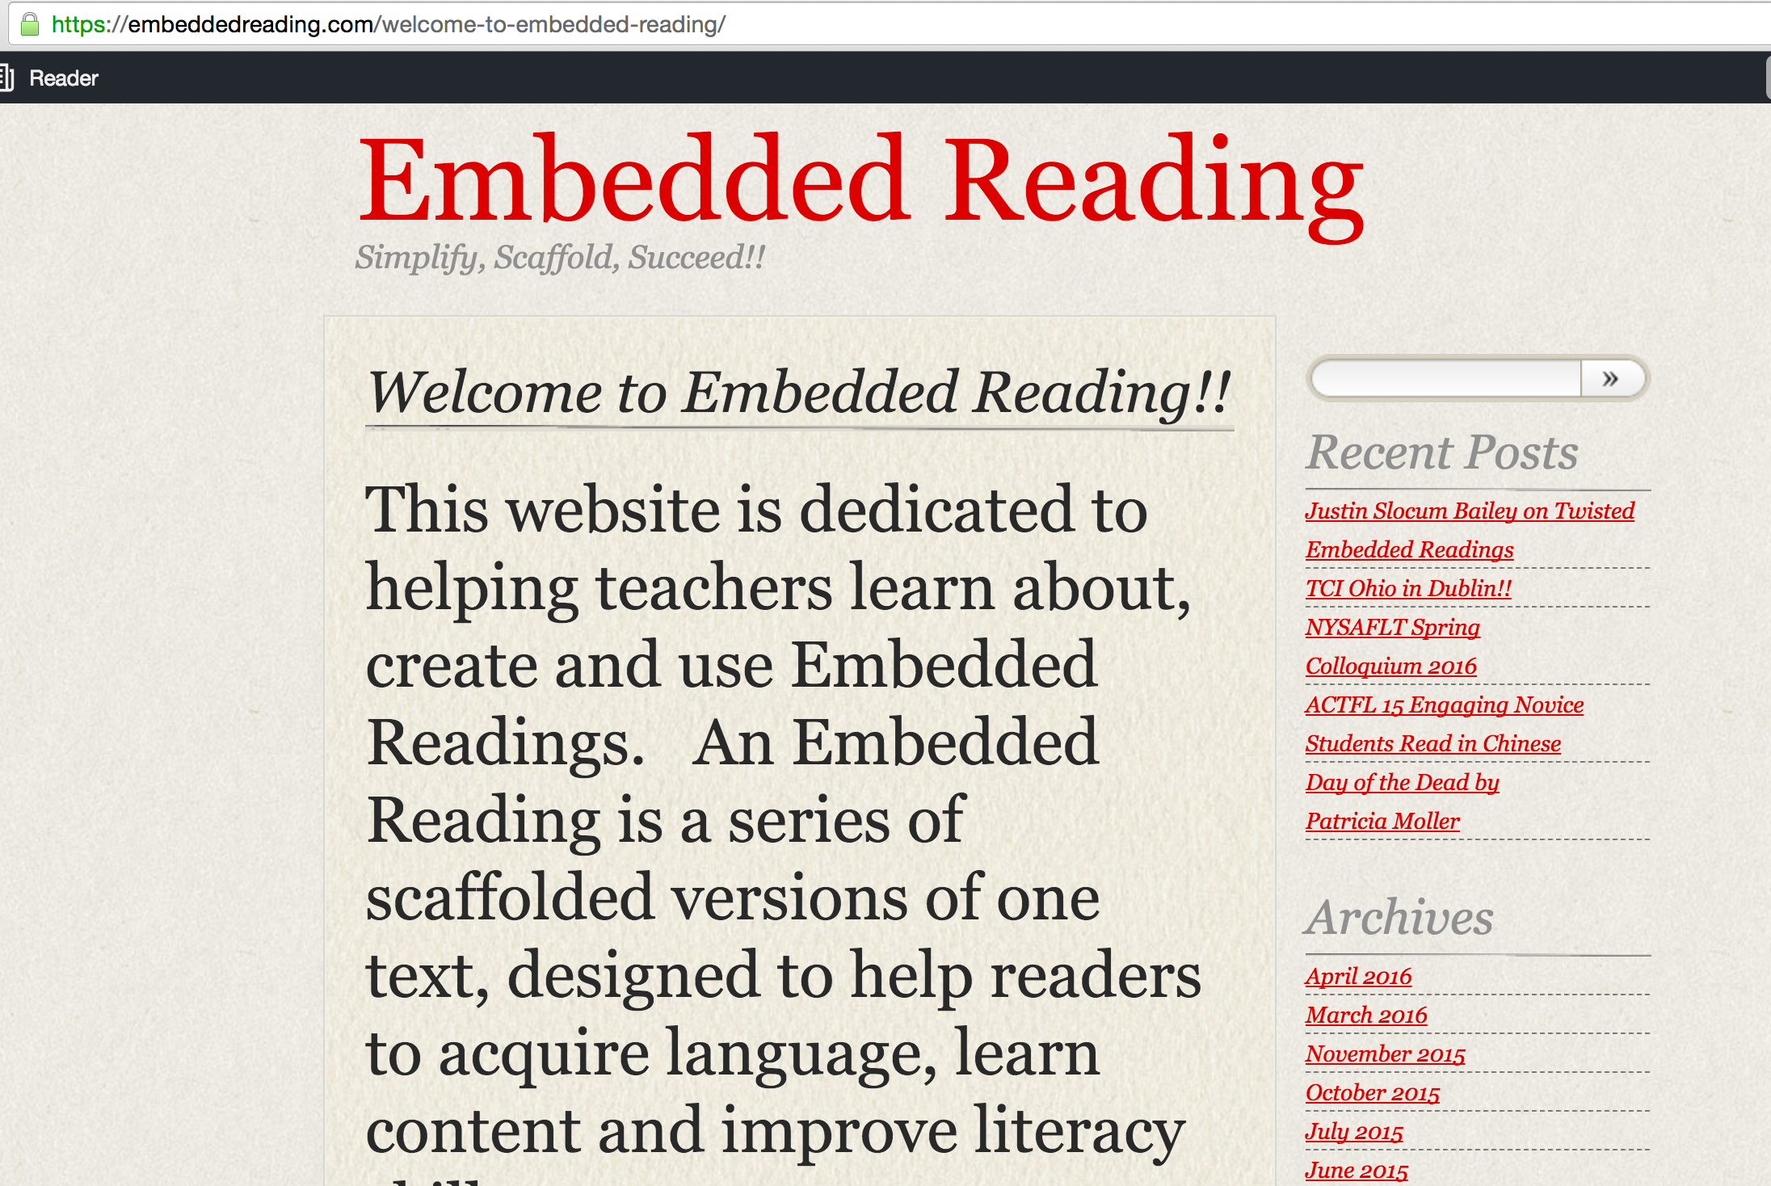

Slide 4
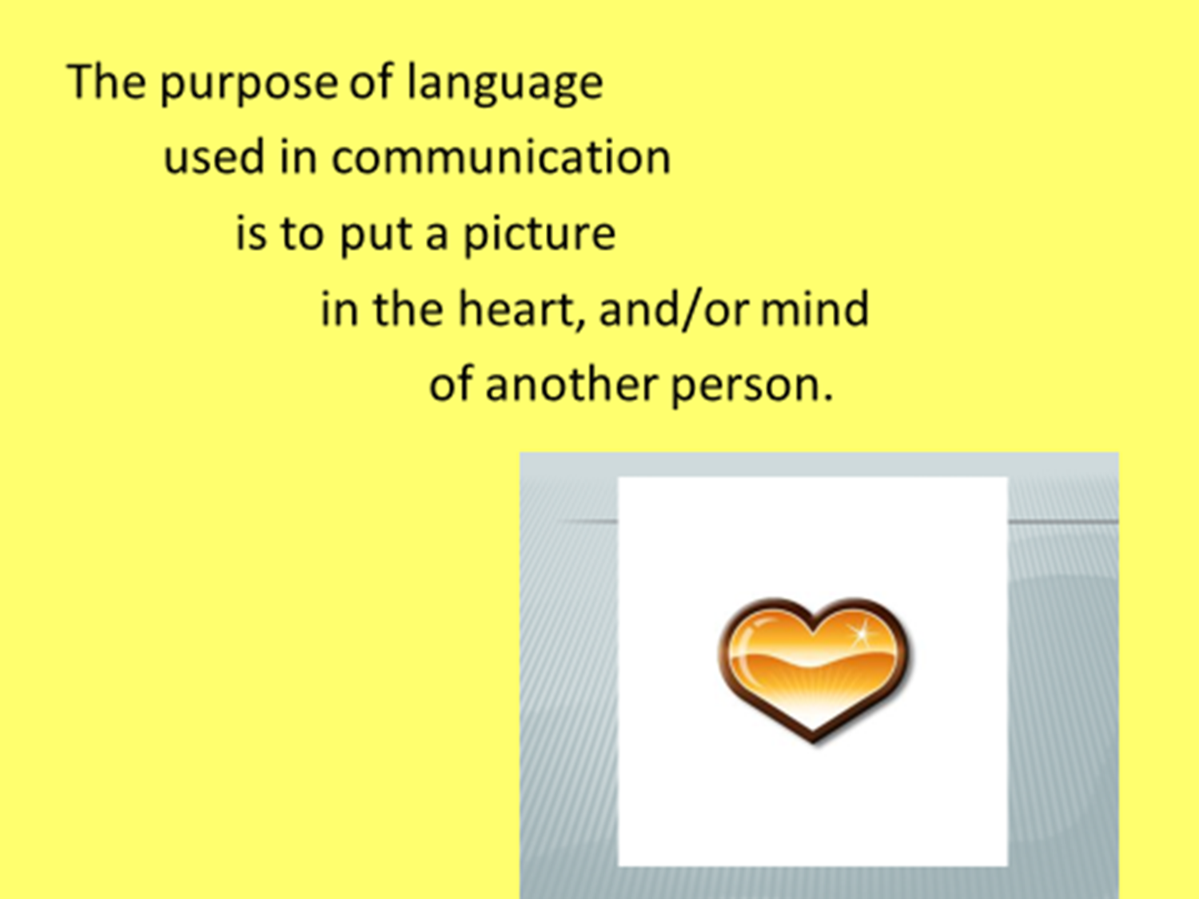

Slide 5
Reading in many language classes
Reading
in a CI language class
© 2017 Clarcq, Whaley

Slide 6
WHY do students read in a second language class?
? ? ? ? ?
© 2017 Clarcq, Whaley

Slide 7
WHY do students read in a second language class?
To memorize.
To prepare for a skit.
To prepare to understand spoken language.
To simulate an immersion situation.
To learn about culture.
© 2017 Clarcq, Whaley

Slide 8
WHY do students read in a second language class?
To memorize.
To prepare for a skit.
To prepare to understand spoken language.
To simulate an immersion situation.
To learn about culture and……..
So that they can be evaluated using a multiple choice test.
© 2017 Clarcq, Whaley

Slide 9
WHAT do students read
in a second language class?
? ? ? ?
© 2017 Clarcq, Whaley

Slide 10
WHAT do students read
in a second language class?
Dialogues/Conversations
Authentic Texts/Authentic Resources
© 2017 Clarcq, Whaley

Slide 11
What percentage of the text do students COMPLETELY understand when they read the texts?
? ? ? ?
© 2017 Clarcq, Whaley

Slide 12
What percentage of the text do students COMPLETELY understand when they read the texts?
Teachers in our workshops generally report comprehension between 10% and 30%
in textbook-based tests.
© 2017 Clarcq, Whaley

Slide 13
What are students doing when they read in a second language class?
? ? ? ?
© 2017 Clarcq, Whaley

Slide 14

What are students doing when they read in a second language class?
© 2017 Clarcq, Whaley

Slide 15
Reading in many language classes:
Involves dialogues and authentic resources.
Is “easy” to evaluate.
Is really hunting for recognizable text.
What is generally accepted as true:
Reading text that is too difficult will eventually increase reading ability.
© 2017 Clarcq, Whaley

Slide 16
Reading in a CI classroom
Aligns with Dr. Krashen’s research on reading
Compelling
Comprehensible
© 2017 Clarcq, Whaley

Slide 17
WHY do students read in a CI language class?
? ? ?
© 2017 Clarcq, Whaley

Slide 18
WHY do students read in a CI language class?
To understand a compelling story.
To get interesting information.
© 2017 Clarcq, Whaley

Slide 19
WHAT do students read in a CI language class?
? ? ? ?
© 2017 Clarcq, Whaley

Slide 20
WHAT do students read in a CI language class?
Comprehensible and Compelling texts.
© 2017 Clarcq, Whaley

Slide 21
What percentage of the text do students COMPLETELY understand when they read the texts?
© 2017 Clarcq, Whaley

Slide 22
What percentage of the text do students need to COMPLETELY understand when they read the texts
in order to acquire language?
Shared/Supported reading with a teacher: 90-95%
Independent reading: 96-100%
© 2017 Clarcq, Whaley

Slide 23
What are students doing when they read in a CI class?
? ? ? ?
© 2017 Clarcq, Whaley

Slide 24
What are students doing when they read in a CI class?
Focusing on the message or the story.
© 2017 Clarcq, Whaley

Slide 25
© 2017 Clarcq, Whaley

Slide 26
Language acquisition proceeds best when the acquirer is “open” to the input, not “on the defensive”; not anxious about performance.
-Stephen Krashen

Slide 27
“Hirsch and Nation (1992) claim that in order to reach text comprehension, readers and listeners need to be familiar with 85% of the words in a text.”
– Thornber

Slide 28
For an incredible example of how the percentage of compehensibility reallly impacts comprehension, go to this slide show:
www.slideshare.net/MarcosBenevides/how-easy-is-easy

Slide 29
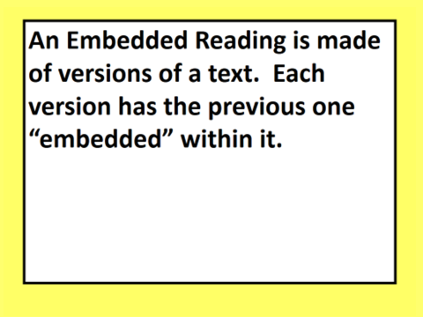
© 2017 Clarcq, Whaley

Slide 30
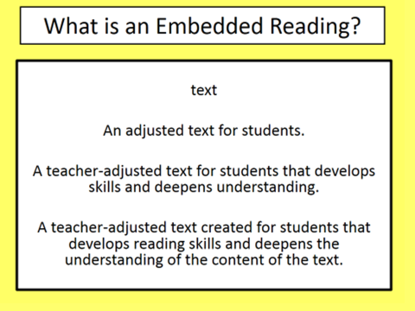
© 2017 Clarcq, Whaley

Slide 31
        In CI …..
        We read words we know.
        (sound and meaning)
        …in order to build fluency.
© 2017 Clarcq, Whaley

Slide 32
        In CI …..
        We visualize what we read…..
        …in order to build fluency.
© 2017 Clarcq, Whaley

Slide 33
        In CI …..
        We read together
        We read and discuss
        We read and wonder
        …in order to build fluency.
© 2017 Clarcq, Whaley

Slide 34
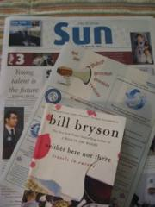

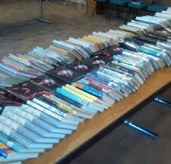
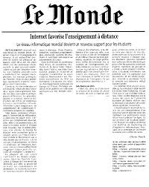
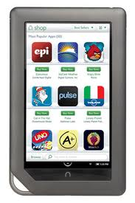
Any text can be used to create an Embedded Reading: Articles, Books, Stories, Poetry, Editorials, Poems, Conversations, Songs etc….
Notes:
Michele

Slide 35
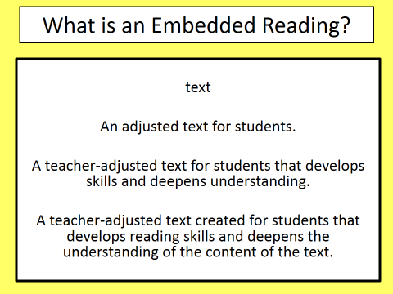
Notes:
Michele

Slide 36
PS. Pay attention to the size and type of the font you use when preparing readings for students. They may be pretty, but they may also be pretty hard to read.

Slide 37
PS. Pay attention to the size and type of the font you use when preparing readings for students. They may be pretty, but they may also be pretty hard to read.

Slide 38
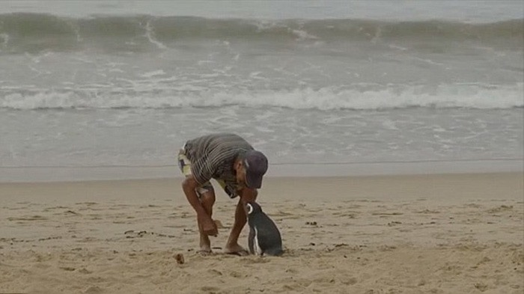

Slide 39
Это пингвин. Это небольшой пингвин. Это – пингвин Диндим.

Slide 40
Role of Translation in CI
Create/clarify a picture.
Check for understanding.
© 2017 Clarcq, Whaley

Slide 41
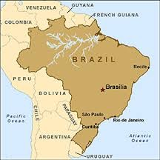
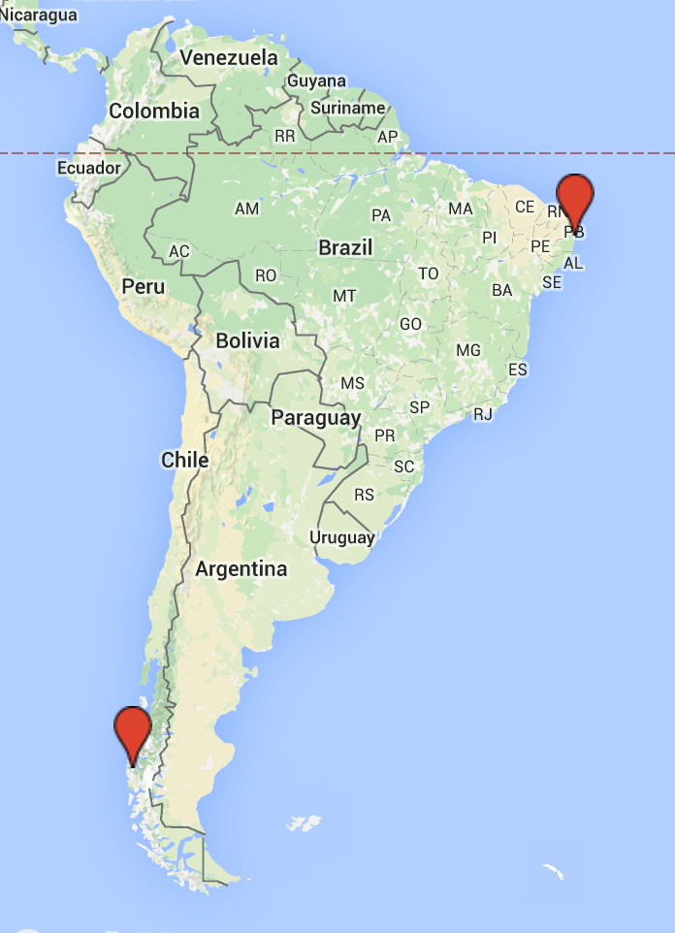
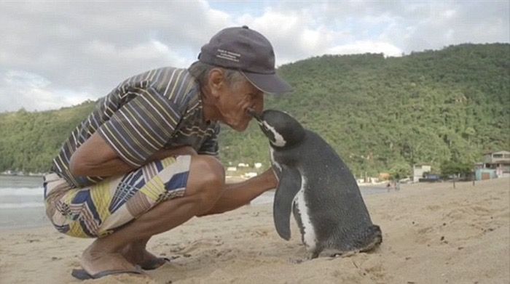
История пингвина
Using a news story:
  jivyot v lives in otmyil washed plivyot swims

Slide 42
Version 1

Slide 43
Это пингвин. Это небольшой пингвин. Это – пингвин Диндим. Это Жоао. Жоао – не пингвин.
Диндим думает, что Жоао – пингвин.
Пингвин любит Жоао.
Пингвин живёт в Аргентине.
Диндим думает, что Жоао – пингвин.

Slide 44
Version 2

Slide 45
Это пингвин. Это небольшой пингвин. Это – пингвин Диндим. Это Жоао. Жоао – не пингвин.
Диндим думает, что Жоао – пингвин. Диндим думает, что Жоао – папа.
Пингвин любит Жоао.
–Пингвин любит меня! – говорит Жоао.
Пингвин живёт в Аргентине.
Диндим думает, что Жоао – пингвин.

Slide 46
Version 3

Slide 47
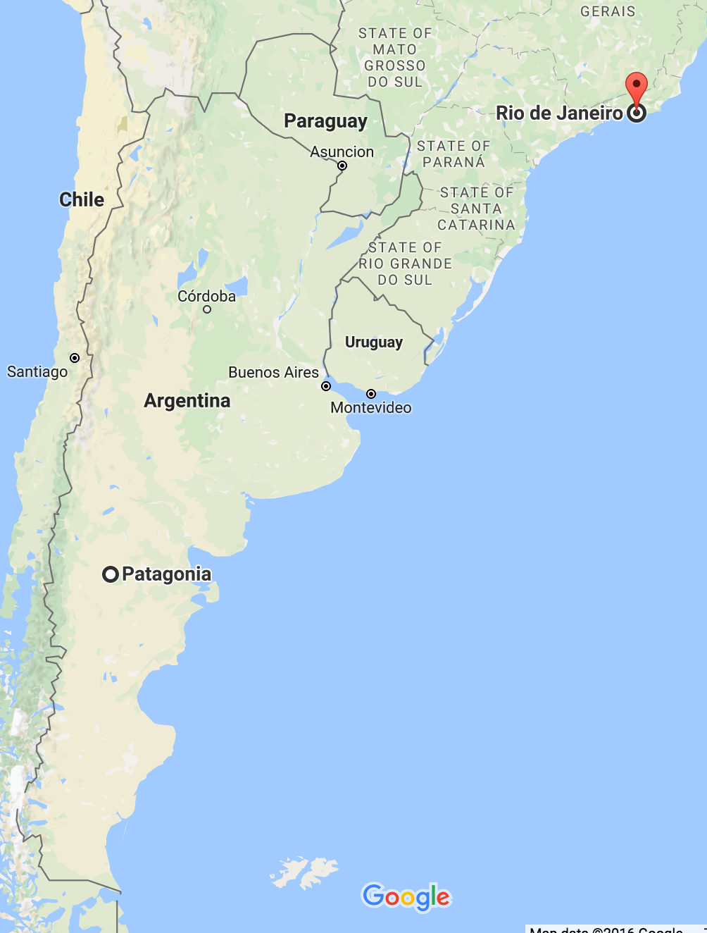
Пингвин живёт в Аргентине. Пингвин живёт не в Бразилии. Пингвин плывёт в Бразилию, в Рио-де-женеро. Это 8,000 километров! Пингвин плывёт в Бразилию.

Slide 48
Пингвин любит Жоао.
–Пингвин любит меня! – говорит Жоао.
Пингвин любит Жоао. И Жоао любит пингвина.

Slide 49
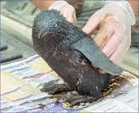
В 2011, Жоао отмыл Диндима.
Диндим думает, что Жоао – пингвин. Диндим думает, что Жоао – папа. Жоао не пингвин! И Жоао не папа пингвина.

Slide 50
Это пингвин. Это небольшой пингвин. Это – пингвин Диндим. В 2011, Жоао отмыл Диндима.
Диндим думает, что Жоао – пингвин. Диндим думает, что Жоао – папа. Жоао не пингвин! И Жоао не папа пингвина.
Пингвин любит Жоао.
–Пингвин любит меня! – говорит Жоао.
Пингвин любит Жоао. И Жоао любит пингвина.
В 2011, Жоао отмыл Диндима.
Пингвин живёт в Аргентине. Пингвин живёт не в Бразилии. Пингвин плывёт в Бразилию, в Рио-де-женеро. Это 8,000 километров! Пингвин плывёт в Бразилию.
Диндим думает, что Жоао – пингвин. Диндим думает, что Жоао – папа. Жоао не пингвин! И Жоао не папа пингвина.

Slide 51
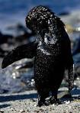
История пингвина
Using a news story:
  jivyot v lives in veedit sees
        otmyil washed plivyot swims

Slide 52
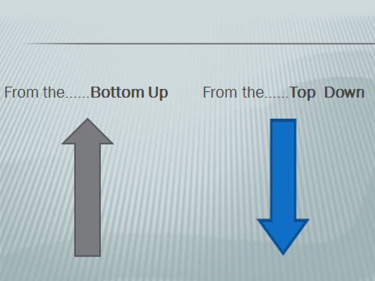
Two Ways to Create an Embedded Reading!!
Notes:
Michele review slide

Slide 53
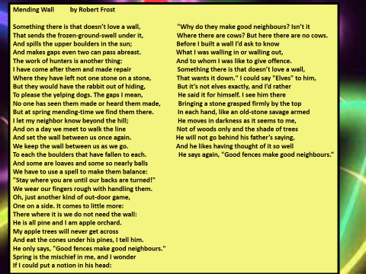
Notes:
Laurie….chose Mending Wall Step 1 chose core/kernel

Slide 54
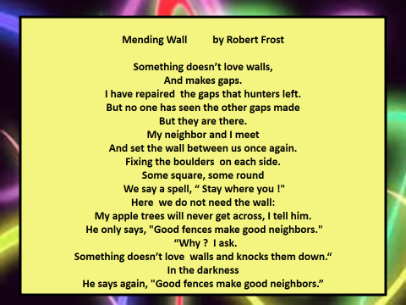

Slide 55
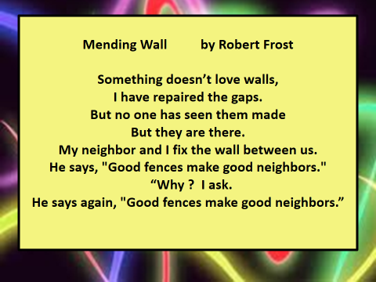

Slide 56


Slide 59
Notes:
Laurie….chose Mending Wall Step 1 chose core/kernel

Slide 60
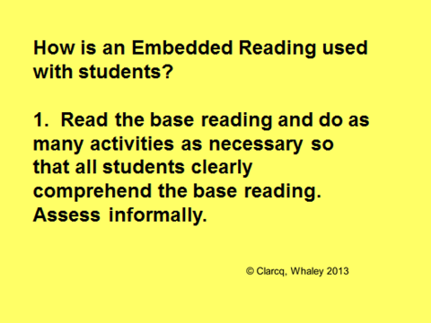

Slide 61
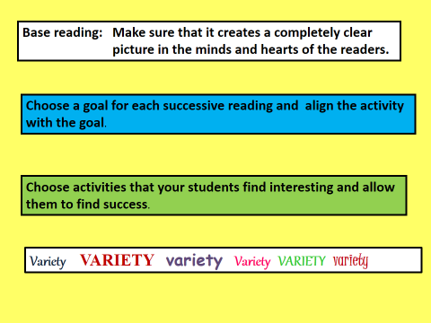

Slide 62
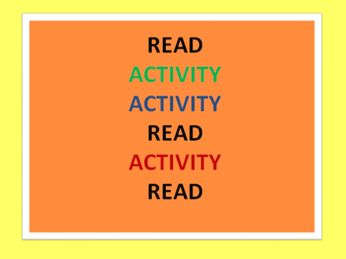

Slide 63
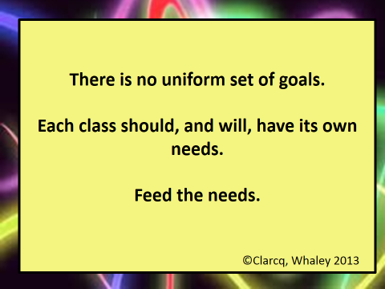

Slide 64
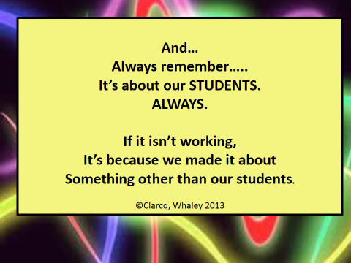

Slide 65
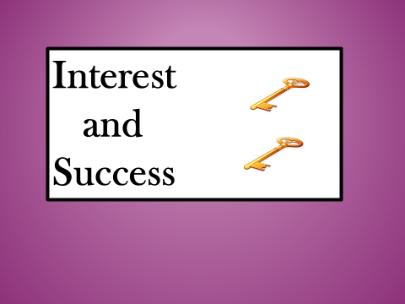

Slide 66
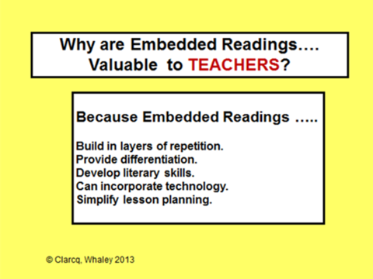

Slide 67
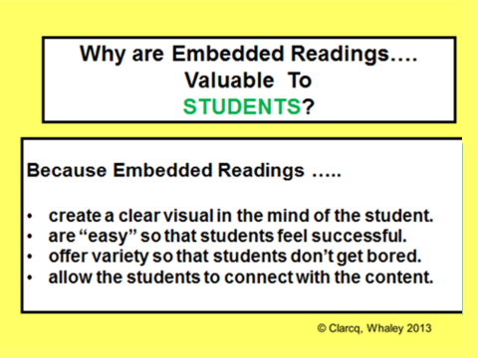

Slide 68
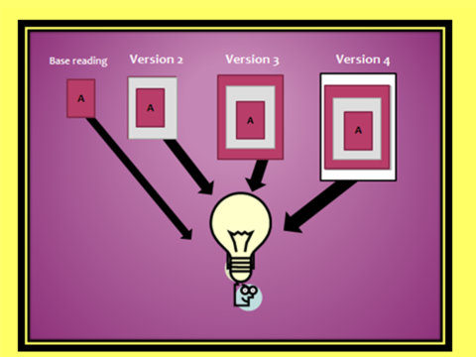
© 2017 Clarcq, Whaley

Slide 69
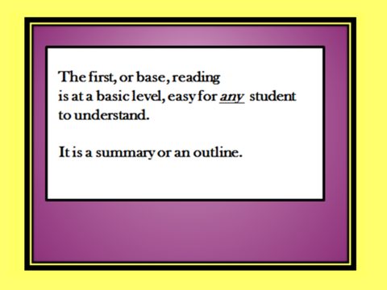
© 2017 Clarcq, Whaley

Slide 70
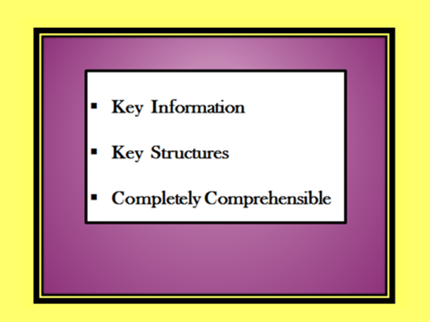
© 2017 Clarcq, Whaley

Slide 71
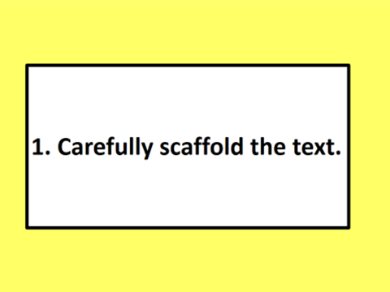
© 2017 Clarcq, Whaley

Slide 72
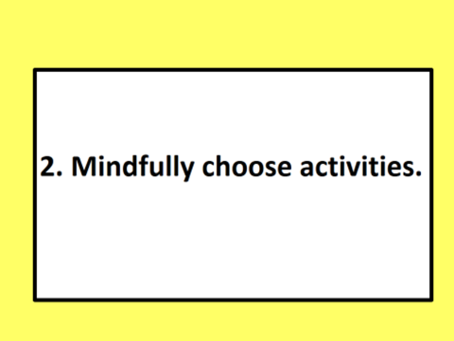
© 2017 Clarcq, Whaley

Slide 73
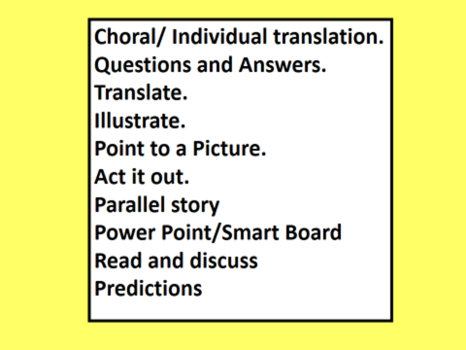

Slide 74
Thank you for coming! Write to us!
www.EmbeddedReading.com
laurieclarcq@gmail.com
Michelejwhaley@gmail.com

