Slide 1

Embedded Reading
Laurie Clarcq and Michele Whaley
www.EmbeddedReading.com
michelejwhaley@gmail.com
laurieclarcq@gmail.com
Notes:
Michele Welcome

Slide 2
Embedded Reading
Goals for today:
Understand what Embedded Reading is/why
Experience and write a Bottom-up ER
Notes:
Michele Welcome

Slide 3
This PowerPoint is available for you to use in order to review the concepts and ideas that we shared with you in our workshop. It is also available in order to share the concept of Embedded Reading with other interested educators.
We request that you not sell this PowerPoint nor distribute it other than for the purpose for which it was intended.
Thank you, Laurie and Michele

Slide 4

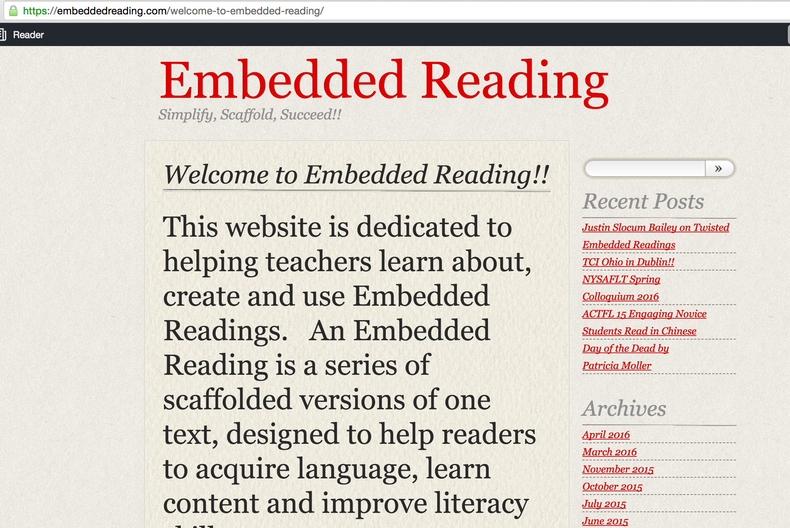

Slide 5


The purpose of language
used in communication
is to put a picture
in the heart, and/or mind
of another person.
Laurie Clarcq
©2017 Clarcq, Whaley
Notes:
Laurie

Slide 6

Creating a picture in the heart/mind
©2017 Clarcq, Whaley

Slide 7

        eta this is
    i and
  yedut v they go to
  rad(a) happy

Slide 8

Stage one:
Hear It = Visualize It
©2017 Clarcq, Whaley

Slide 9
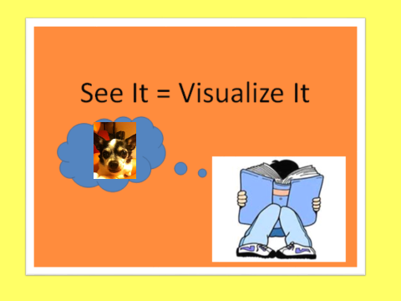
perro

Slide 10
Stage two:
Text is a code for language
that you know.
“Sight words” “Decoding”
Your brain should always be going back to….
©2017 Clarcq, Whaley

Slide 11
perro
dog

Slide 12
Students who are not
accomplished readers…
…need to read text with language that creates a picture when they hear it.
©2017 Clarcq, Whaley

Slide 13
Once a student reads familiar words and phrases easily,
attacking new words is the next skill.
©2017 Clarcq, Whaley

Slide 14
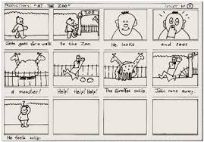
Stage Three: Pictures in a Series
the Movie in the Head.
©2017 Clarcq, Whaley

Slide 15
Stage One:
Hear It = Visualize It
Stage Two:
Text is a code for language that you know.
Text can be a code for all language.
Stage Three:
Pictures in a Series
“The Movie In The Head”
©2017 Clarcq, Whaley

Slide 16
        In a CI classroom…..
        We visualize what we read…..
        …in order to build fluency.
©2017 Clarcq, Whaley

Slide 17
        In a CI classroom …..
        We read together
        We read and discuss
        We read and wonder
        …in order to build fluency.
©2017 Clarcq, Whaley

Slide 18
Это доктор Стивен Крашен.
Это Мистер Ули.
Доктор Крашен и Мистер Ули едут в Дэнвер.
Доктор Крашен рад.

Slide 19
Why are Embedded Readings Valuable to Teachers?
Because Embedded Readings…
build in layers of repetition,
provide differentiation,
develop literary skills,
can incorporate technology,
and simplify lesson planning.
©2017 Clarcq, Whaley
Notes:
Laurie
Michele: maybe need to show the original if it’s too easy.

Slide 20
Why are Embedded Readings Valuable for Students?
Because Embedded Readings…
create a clear visual in the student’s mind,
are “easy” and students feel successful,
offer variety so students aren’t bored, and
allow students to connect with content.
©2017 Clarcq, Whaley
Notes:
Laurie
Michele: maybe need to show the original if it’s too easy.

Slide 21



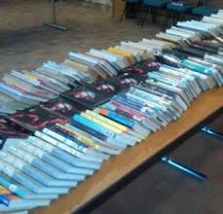


To create an Embedded Reading, use articles, books, stories, poetry, editorials, poems, conversations, songs…
Notes:
Michele

Slide 22
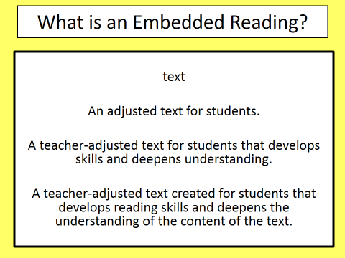
©2017 Clarcq, Whaley
Notes:
Michele: add information or details in each level

Slide 23
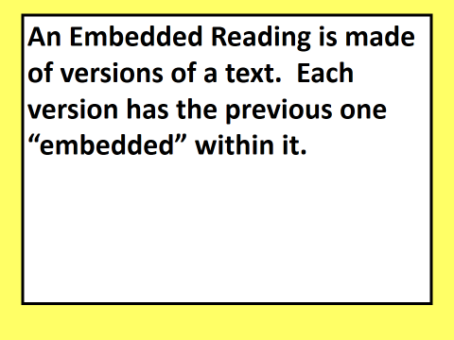
©2017 Clarcq, Whaley
Notes:
Michele: this is a the start to a longer reading. New info?

Slide 24
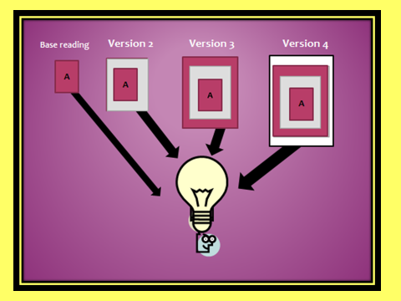
©2017 Clarcq, Whaley
Notes:
Laurie % of new material

Slide 25
©2017 Clarcq, Whaley
Notes:
Michele…..this is a base story

Slide 26
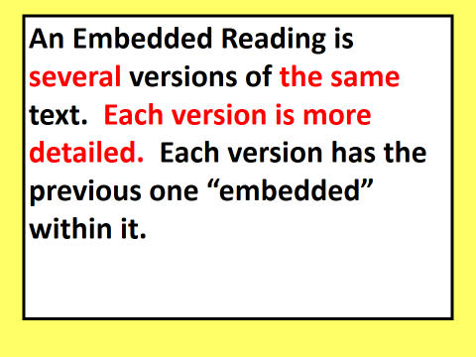
©2017 Clarcq, Whaley
Notes:
Michele….Level 2 …possibilities of highlighted/bold/colored/ etc new info

Slide 27
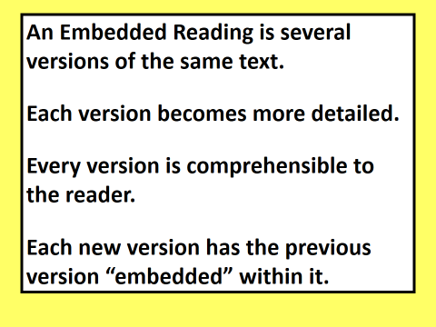
©2017 Clarcq, Whaley
Notes:
Laurie…..use of white spaces for mental pauses

Slide 28

©2017 Clarcq, Whaley
Notes:
Michele: Notice title….question….spacing….hook
To hook people into what’s coming up next, add a sentence at the end.

Slide 29
Russian demo

Slide 30
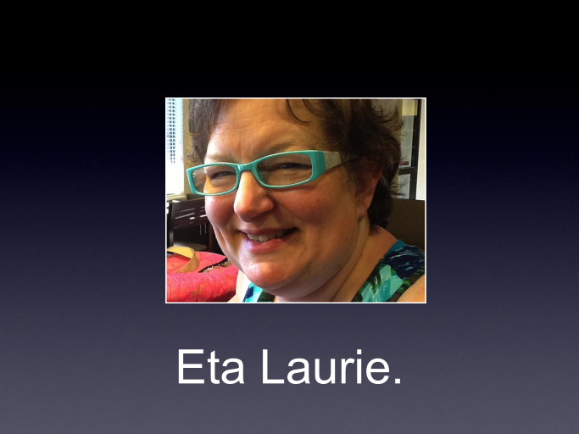
Это Лори.

Slide 31
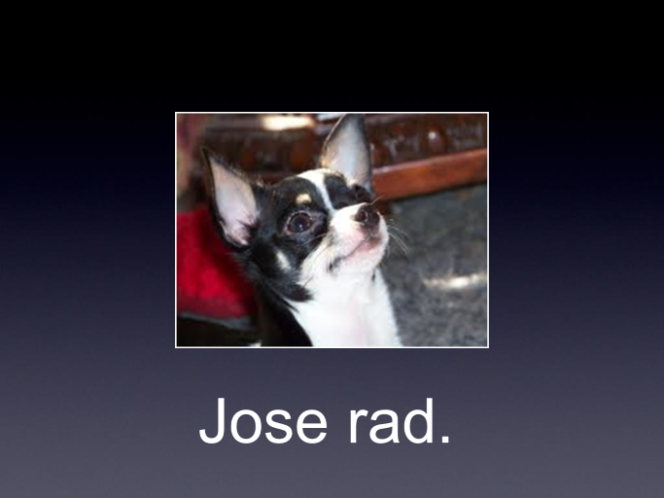
Это Хозэ.

Slide 32
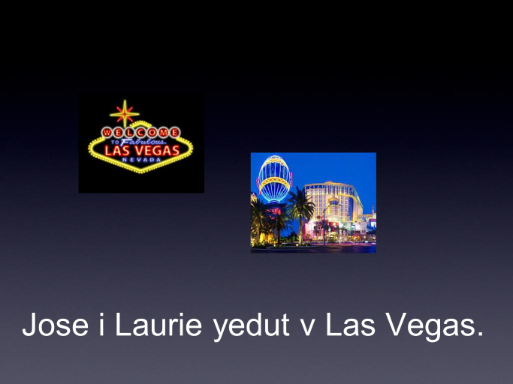
Хозэ и Лори едут в Лас Вегас.

Slide 33
Хозэ рад.

Slide 34
Base reading
Это Лори. Это Хозэ. Хозэ и Лори едут в Лас Вегас. Хозэ рад!

Slide 35
Это Лори.
Это Хозэ.
Хозэ и Лори едут в Лас Вегас. Хозэ рад!

Slide 36
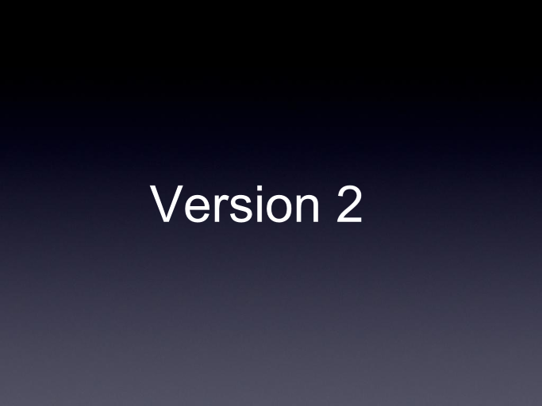

Slide 37
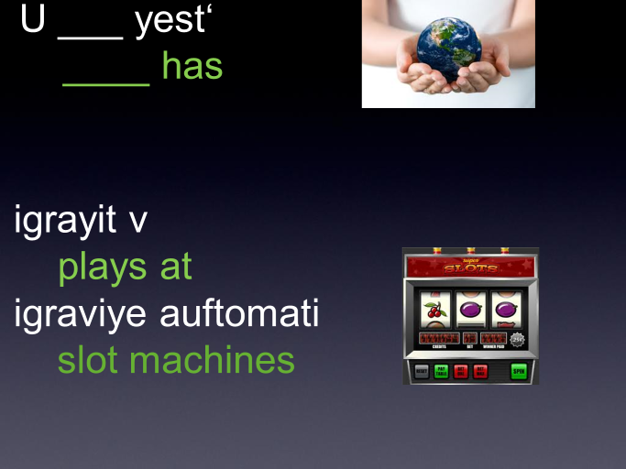

Slide 38
Это Лори.

Slide 39
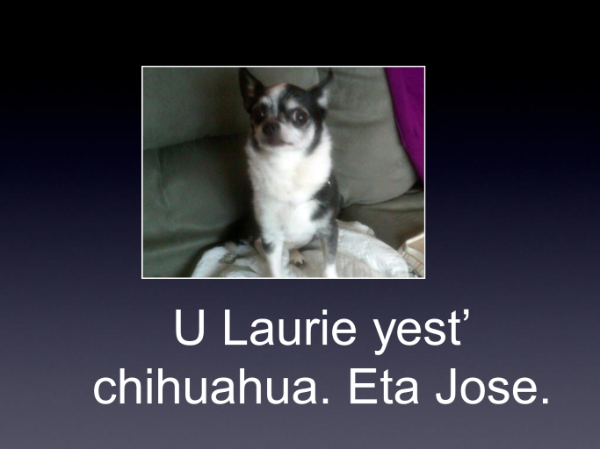
У Лори есть чихуахуа.
Это Хозэ.

Slide 40
Хозэ и Лори едут в Лас Вегас.

Slide 41
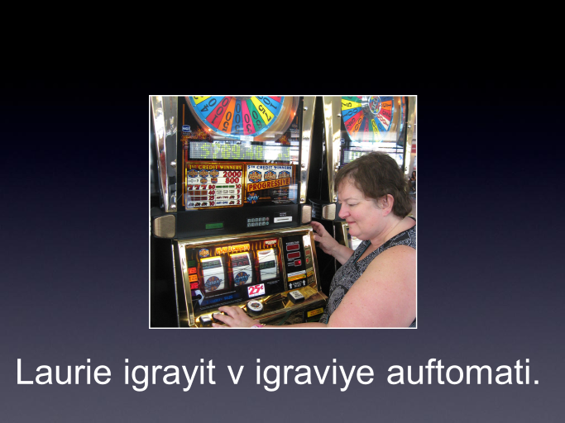
Лори играет в игровые автоматы.

Slide 42
Role of Translation
Create/clarify a picture.
Check for understanding.
©2017 Clarcq, Whaley

Slide 43
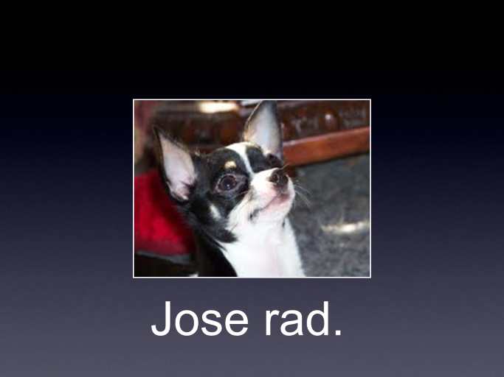
Хозэ рад.

Slide 44
Version 2: Это Лори. У Лори есть чихуахуа. Это Хозэ. Хозэ и Лори едут в Лас Вегас. Лори играет в игровые автоматы. Хозэ рад!

Slide 45

How do we create an
Embedded Reading?
By writing a base reading and adding details and information to create additional versions.
  OR…
By pulling details and information out of a longer reading to create shorter, simpler versions.
©2017 Clarcq, Whaley
Notes:
Laurie

Slide 46
Two ways to create a base reading:
Write one. (Bottom up)
2. Whittle one. (Top down)
©2017 Clarcq, Whaley

Slide 47
The base reading is easy for any student to understand. It is a summary, or an outline.
©2017 Clarcq, Whaley
Notes:
Michele…..when using with students we always start with the small or base story (sometimes show long one first…)

Slide 48
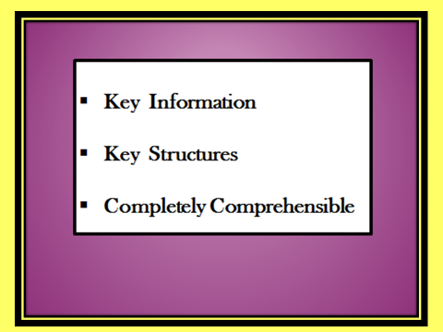
©2017 Clarcq, Whaley
Notes:
Michele

Slide 49

From the bottom up
Step 1: Know your audience.
Step 2: Identify focus structures and vocabulary
Step 3: Create the base reading.
Step 4: Insert a variety of familiar structures and vocabulary
©2017 Clarcq, Whaley
Notes:
Laurie
Save surprises for the end (or at least spread them through).

Slide 50

Step 1
Audience: teachers
Notes:
Laurie
Save surprises for the end (or at least spread them through).

Slide 51

Step 2
Identify focus structures
Notes:
Laurie
Save surprises for the end (or at least spread them through).

Slide 52
Structures: wanted to
decided to
Notes:
Michele

Slide 53

Step 3
Create the base reading.
Notes:
Laurie
Save surprises for the end (or at least spread them through).

Slide 54
Audience: Teachers Learning About Embedded Reading
Base Story
Dave wanted to teach. He decided to find a job.
Dave wanted to teach in an important university.
He found a job.
Notes:
Michele: What are the base structures? What is additional information? Character/situation Ending?
Ways to work with a base reading.
3-5 sentences per level of study.

Slide 55

Step 4
Add a variety of familiar structures and vocabulary.
Notes:
Laurie
Save surprises for the end (or at least spread them through).

Slide 56
Step 4 Ideas
When? today, on Friday, last year, next summer
How? very, quickly, easily, on a train, nervously
Which (one)? blue, favorite, this/that, the best
How often? always, never, six times, every day
Common phrases: all of a sudden, next, well…
Dialogue: said … thought ….
Questions: What happened next?
Additional verb: discovered/saw/realized that
Notes:
Michele…possible ideas…(adding details)….ask participants to pick any three from slide

Slide 57
Base story
Dave is a teacher. He decided to find a job. Dave wanted to teach in an important university. He found a job.
Version 2
Dave wanted to teach. He went to TeachersRUs University to study. Now Dave is a teacher. He decided to try to find a unique job. Dave thought that he wanted to teach in an important university in London, England, but he found a job someplace else.
©2017 Clarcq, Whaley
Notes:
Michele: Next level….insert BUT if there’s a surprise, always keep to the end.

Slide 58
Dave wanted to teach. He went to TeachersRUs University to study. It’s a unique university. Now Dave is a teacher. He decided to try to find a unique job. Dave thought that he wanted to teach in an important university in London, but he found a job someplace else.
When? today, on Friday, last year, next summer
How? very, quickly, easily, on a train, nervously
Which (one)? blue, favorite, this/that, the best
How often? always, never, six times, every day
Common phrases: all of a sudden, next, well…
Dialogue: said … thought ….
Questions: What happened next?
Additional verb: discovered/saw/realized that
Notes:
Laurie…….ask participants to add

Slide 59
But this was only half true.
She turned and smiled to herself.
He had no idea how wrong he was.
The truth had never been good enough for Carla.
He didn’t let her see the tears forming in his eyes.
That moment sealed her fate.
Juliet would never be the same again.
Then, for the first time in her life, she lied to him.
In a plush office across town, a look of triumph crossed the face of Don Cornelio.
This was the beginning of the end.
But it wasn’t.
But it was.
Justin Slocum-Bailey: How to Twist ERs
Notes:
Laurie…….ask participants to add

Slide 60
Dave wanted to teach. He went to TeachersRUs University to study. It’s a unique university. Now Dave is a teacher. He decided to try to find a unique job. Dave thought that he wanted to teach in an important university in London, England. He found a job someplace else, and that was where the trouble started.
Notes:
Laurie…….ask participants to add

Slide 61
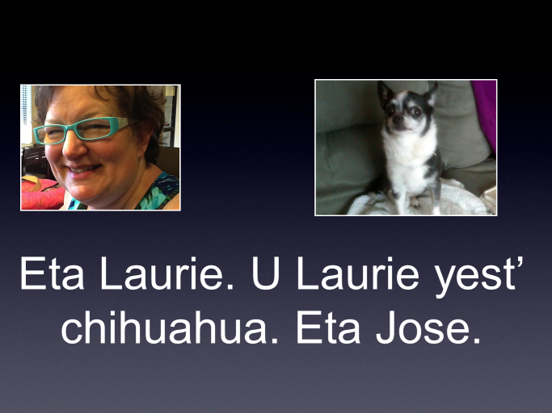
У Лори есть чихуахуа.
Это Хозэ.

Slide 62
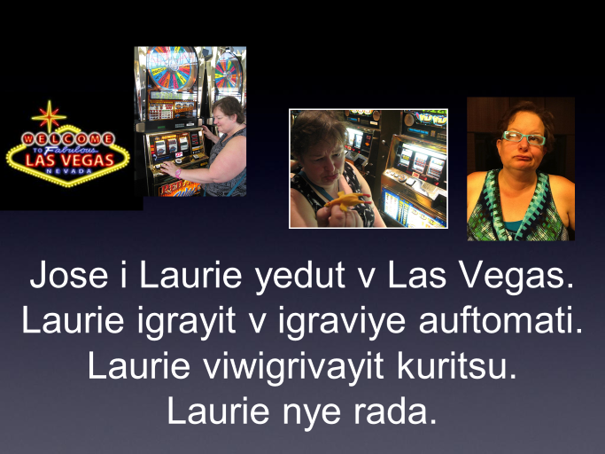
Это Лори. У Лори есть чихуахуа. Это Хозе. Хозэ и Лори едут в Лас Вегас. Лори играет в игровые автоматы. Лори выигрывает курицу.
Лори не рада.

Slide 63
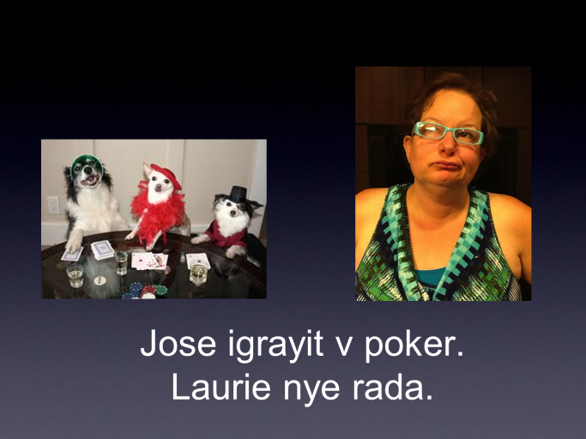
Хозэ играет в покер.
Лори не рада.

Slide 64
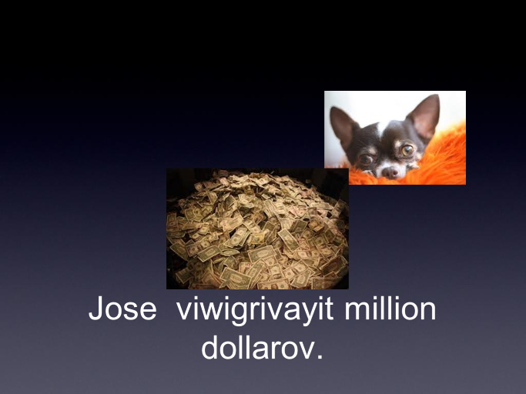
Хозэ выигрывает миллион долларов.

Slide 65
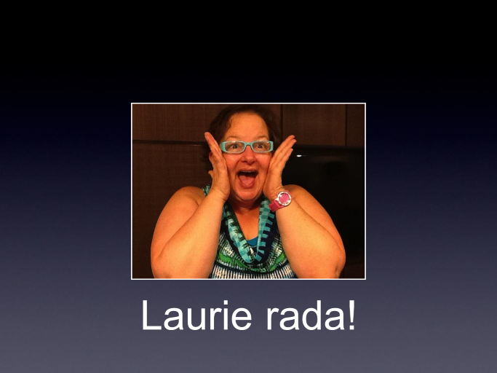
Лори рада!

Slide 66
Это Лори. У Лори есть чихуахуа. Это Хозе. Хозэ и Лори едут в Лас Вегас. Лори играет в игровые автоматы. Лори выигрывает курицу. Лори не рада. Хозэ играет в покер. Лори не рада. Хозэ рад. Хозэ выигрывает миллион долларов. Лори рада! Хозэ не рад. У Ходе есть курица. Хозэ рад.

Slide 67
1. Create a base reading.
Notes:
Michele Kids will shut down; make a level in between if they do. Don’t have to finish. Don’t finish if one level is a challenge.

Slide 68
2. Scaffold the text.
Notes:
Michele Kids will shut down; make a level in between if they do. Don’t have to finish. Don’t finish if one level is a challenge.

Slide 69
3. Mindfully choose activities.
Notes:
Laurie

Slide 70
Read
Activity
Activity
Read
Activity
Read
Notes:
Michele: pre-teach (?), draw pictures, choral reading, underline new stuff, act out, read and discuss…
If it’s good for your kids, it is good to do.

Slide 71
Base reading: creates a clear picture in the minds and hearts of the readers.
Each successive reading: choose a goal and match the activity to that goal.
Choose activities your students find interesting and that allow them to be successful.
Variety, variety, variety!
Notes:
Laurie

Slide 72
Activities
Choral/Individual translation
Questions and answers
Translate
Illustrate
Point to a picture
Act it out
Parallel story
Powerpoint/smart board
Read and discuss
Predictions
Notes:
Laurie: Add movies, ads, etc.

Slide 73
More tips
Use more space or larger font for base.
Differentiate. Not everyone has to read every version.
Ask kids to help.
Use what kids write to create.
Build parallel stories.
Color the new stuff.
Don’t color the new stuff.
Use across years.

Slide 74
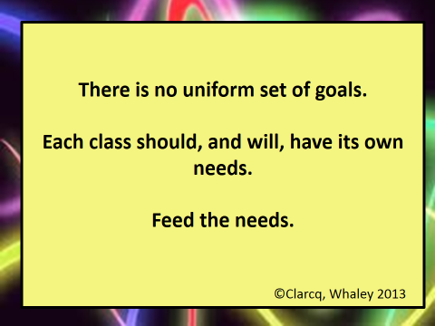
Notes:
M: Tell kids there are different goals.

Slide 75
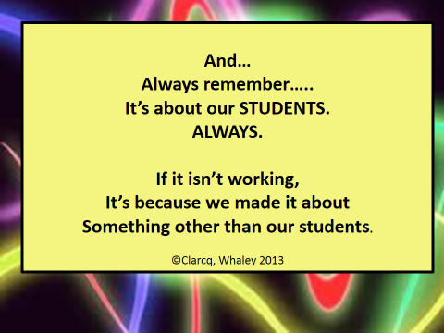
Notes:
Laurie

Slide 76
Thank you for coming!
Please fill out an evaluation!!
Michele Whaley
www.EmbeddedReading.com
michelejwhaley@gmail.com
Notes:
Michele Welcome

